Slide 1
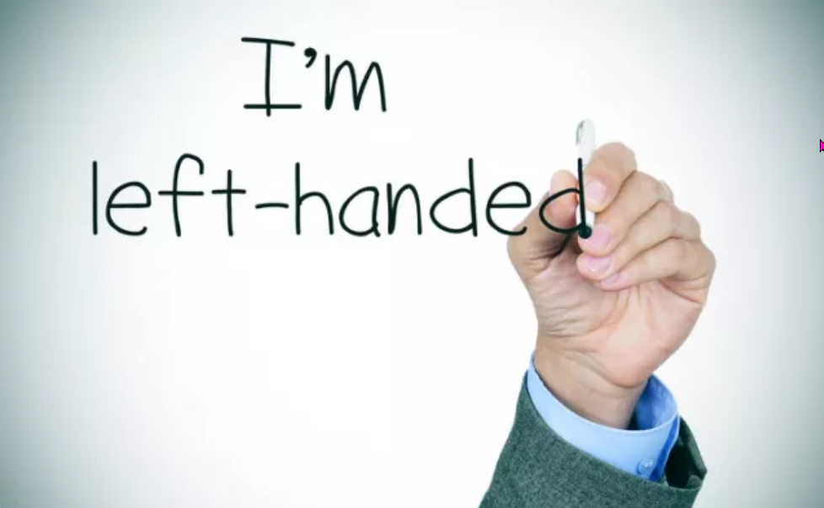
https://www.teachingenglish.org.uk/

Slide 2
Reading for gist
Read the article and match the paragraphs (A- I) with the summary sentences (1-10) below. One summary sentence is not needed.
1 Problems caused by equipment designed for right-handers
2 A genetic basis to left-handedness
3 Physical punishment.
4 Some well-known left-handers.
5 Linguistic discrimination
6 Advantages of being left-handed.
7 Events held on Left Hander’s Day.
8 Health issues
9 The purpose of Left Hander’s Day.
10 Some possible reasons for left-handers doing well in life.
https://www.teachingenglish.org.uk/

Slide 3
Reading for gist - Answers
Read the article and match the paragraphs (A- I) with the summary sentences (1-10) below. One summary sentence is not needed.
1 Problems caused by equipment designed for right-handers E
2 A genetic basis to left-handedness I
3 Physical punishment. H
4 Some well-known left-handers. C
5 Linguistic discrimination G
6 Advantages of being left-handed. B
7 Events held on Left Hander’s Day. Not used
8 Health issues F
9 The purpose of Left Hander’s Day. A
10 Some possible reasons for left-handers doing well in life. D
https://www.teachingenglish.org.uk/

Slide 4
True or false
1. Left-Handed Day was first celebrated in 1990.
2. Left-handed women earn more than right-handed women.
3. Left-handed drivers learn to drive more quickly than right-handed drivers.
4. Left-handers are more creative because they use the left side of the brain.
5. Only Latin gave the word ‘left’ a negative connotation.
6. King George VI was left-handed.
7. More people are naturally left-handed nowadays than in the past.
https://www.teachingenglish.org.uk/

Slide 5
True or false - Answers
1. Left-Handed Day was first celebrated in 1990. F
2. Left-handed women earn more than right-handed women. F
3. Left-handed drivers learn to drive more quickly than right-handed drivers. T
4. Left-handers are more creative because they use the left side of the brain. F
5. Only Latin gave the word ‘left’ a negative connotation. F
6. King George VI was left-handed. T
7. More people are naturally left-handed nowadays than in the past. F
https://www.teachingenglish.org.uk/

Slide 6
Discussion
Do you think it is generally a positive thing to be left-handed? (why/why not?)
Do you think people are still generally prejudiced against left-handers? Why/why not?
What other kinds of prejudice against different groups can you think of? Which do you think is the most/least serious? Why?
https://www.teachingenglish.org.uk/

Slide 7
Example language
13th August is Left Handers’ Day, a day when Left Handers everywhere can celebrate being left-handed
The Left Handers’ Club, who started the day, are keen to remind people that there certainly are some positive points.
1 Which example is a defining relative clause (a clause which says who or what we are talking about), and which a non-defining relative clause (a clause which gives extra information)?
2 What difference in punctuation is there between defining and non-defining relative clauses?
3 In which kind of relative clause can we use ‘that’ instead of ‘who(m)’ or ‘which’?
https://www.teachingenglish.org.uk/

Slide 8
Relative and participle clauses 1
1b Which word could be omitted in the following sentence? Why?
Why haven’t you replied to any of the emails which I sent?
2a Look at the examples of reduced relative clauses from the article and add the ‘missing’ words to make them full relative clauses.
….to remind people of some of the difficulties faced by left handers.
…. in a world designed for right-handed people
https://www.teachingenglish.org.uk/

Slide 9
Relative and participle clauses 2
2b Rewrite the following sentences using reduced relative clauses.
1. Cars that are left here after 11pm will be locked into the carpark.
2. The man who was driving the car was arrested.
3. The chair, which was made in France in the 14th Century, was undamaged.
4. Did you see the girl who was wearing the orange dress?
5. I can only eat food which is made without wheat.
6. The students who were taught by him all passed their exams.
https://www.teachingenglish.org.uk/

Slide 10
Relative and participle clauses 2 - Answers
Cars left here after 11pm will be locked into the car park
The man driving the car was arrested.
The chair, made in France in the 14th Century, was undamaged.
Did you see the girl wearing the orange dress?
I can only eat food made without wheat.
The students taught by him all passed their exams.
https://www.teachingenglish.org.uk/

Slide 11
Relative and participle clauses 3
Look at the examples from the article where a present participle (in bold) has been used instead of a relative clause and rewrite them using a relative clause. (Note that a present participle can replace present simple as well as present continuous)
…it may simply be the difficulties and dangers of living in a right-handed world, leading to more accidents.
The word sinister, meaning harmful or evil, comes from the Latin for left.
The left hand is often considered unclean, making life very difficult for those who would naturally use it to eat.
https://www.teachingenglish.org.uk/

Slide 12
Relative and participle clauses 3 - answers
…it may simply be the difficulties and dangers of living in a right-handed world, which is leading/which leads to more accidents.
The word sinister, which means harmful or evil, comes from the Latin for left.
The left hand is often considered unclean, which makes life very difficult for those who would naturally use it to eat.
https://www.teachingenglish.org.uk/

