Slide 1
Future learning
TeachingEnglish lessons
September 2020

Slide 2
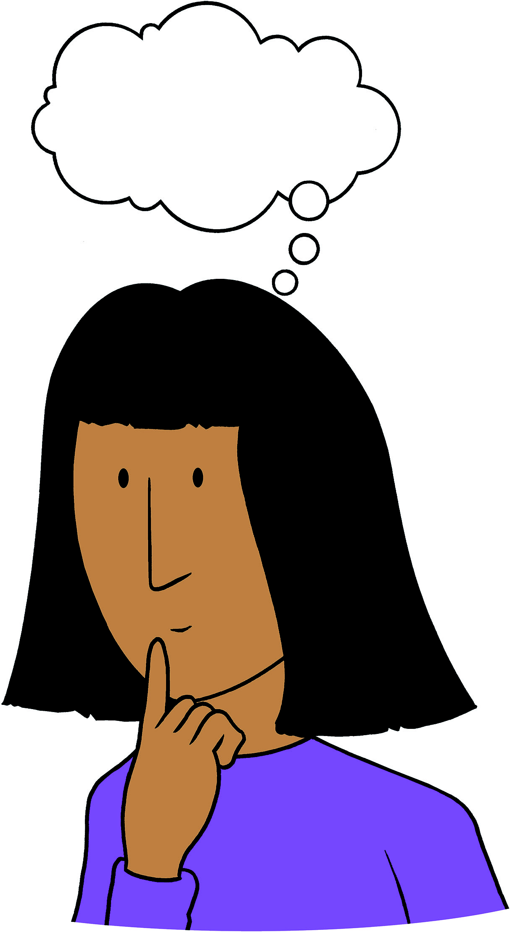
Future learning
Listen to the teacher!
Do you agree? Is it the same for you?
Do you disagree? Is it different for you?

Slide 3
Future learning
What can you see in the pictures?
Where are the children?
What are they doing?
Picture 1 A
Picture 2 A
Illustrations by Karen Elliott

Slide 4
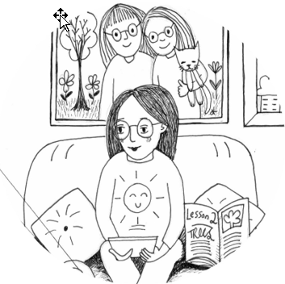
Future learning
This is the centre of a larger picture. What do you think you will see in the larger picture?
Illustration by Karen Elliott

Slide 5
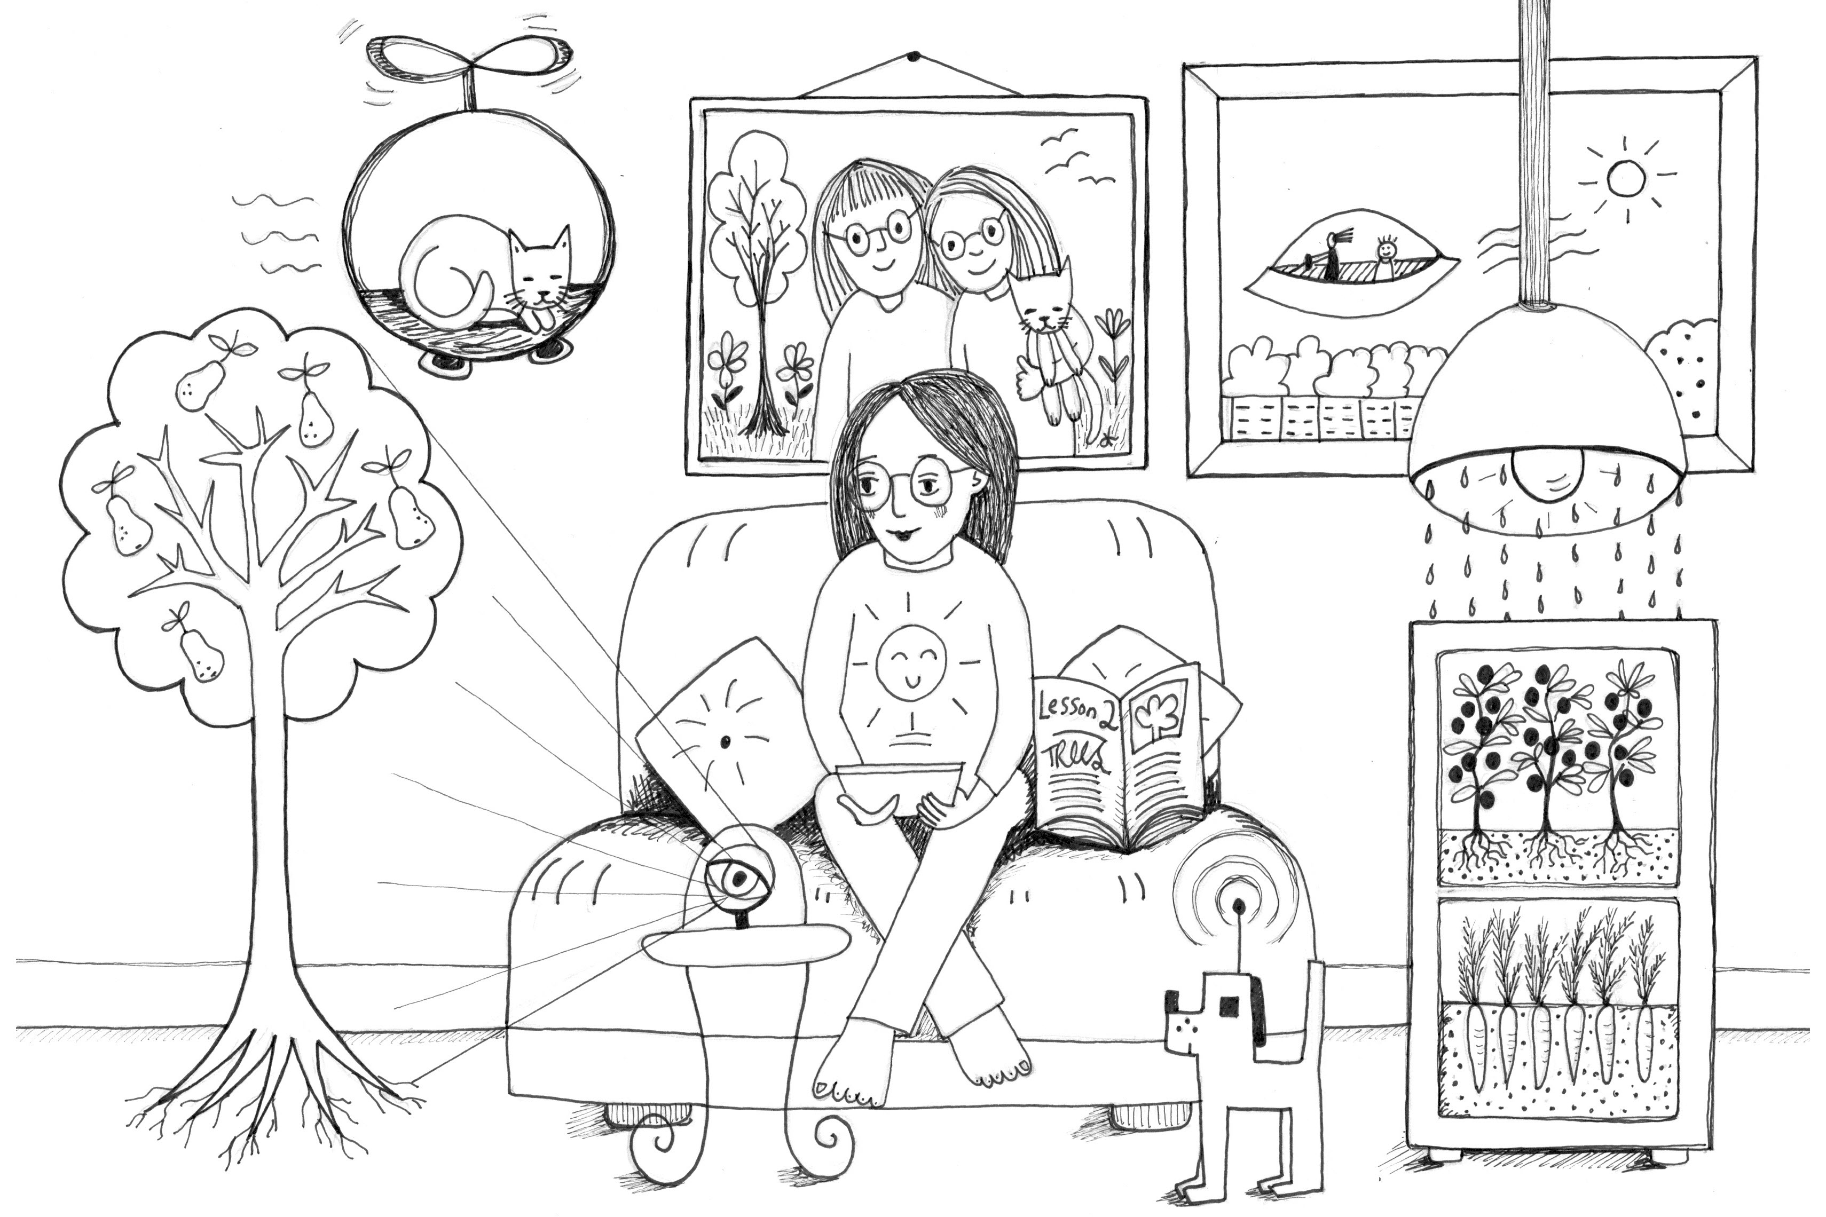
Future learning
Picture 1B
Illustration by Karen Elliott

Slide 6
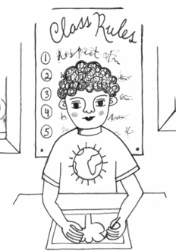
Future learning
This is also the centre of a larger picture. What do you think you will see in the larger picture?
Illustration by Karen Elliott

Slide 7
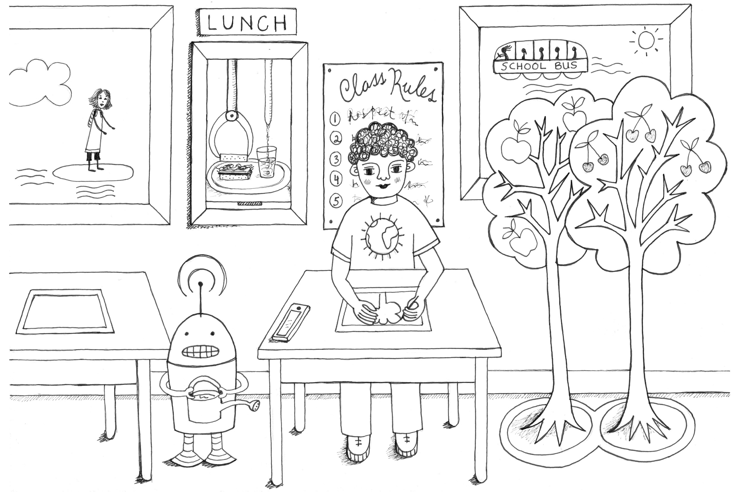
Future learning
Picture 2A
Illustration by Karen Elliott

Slide 8
Future learning
Look at the pictures. What’s different?
Illustrations by Karen Elliott

Slide 9
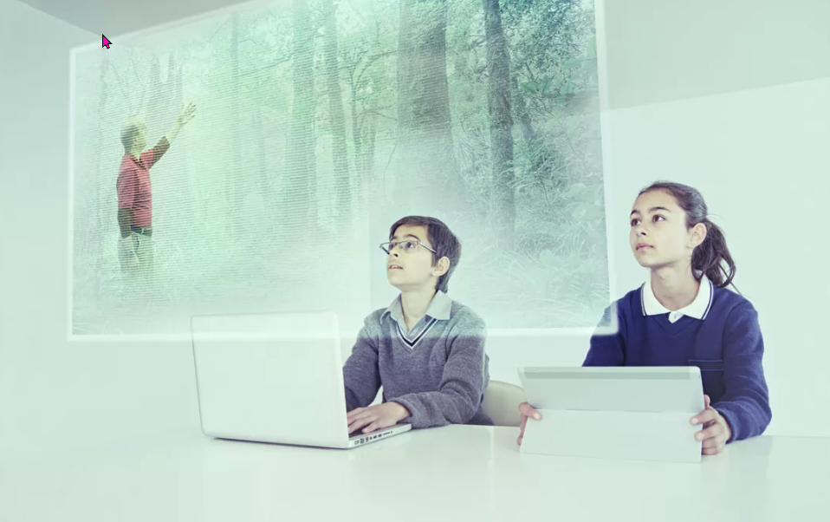
In the future…
we will go to school three days a week
we’ll have robot teachers.
we’ll do more homework.
We’ll use computers every day.

Slide 10
My future…
study
job
marry
children
live

Slide 11
My perfect school in the future
How will you study?
Who will teach you?
What subjects will you study?
What will the timetable be like?
What time will you start/ finish studying?

Slide 12
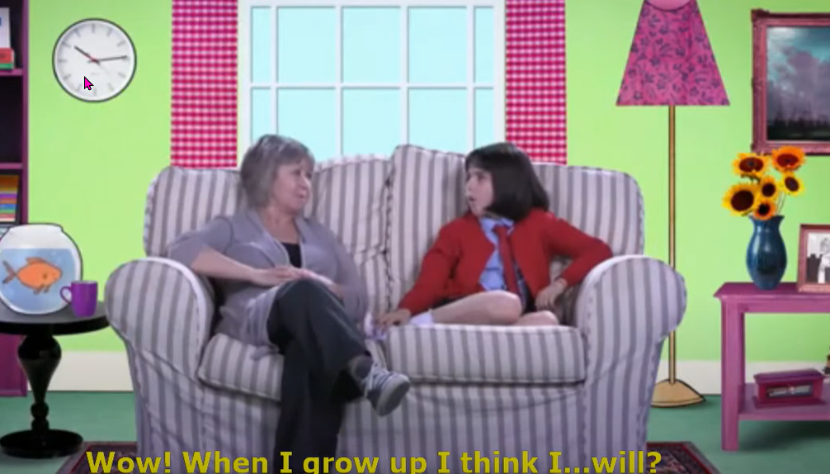
Kitty’s dream job
What job will she do?
Where will she live?
Who will she live with?
What kind of house will she have?
What will she eat?

Slide 13
Future learning
TeachingEnglish lessons
Thanks for coming!

