Slide 1
Food I like/don’t like
TeachingEnglish lessons
May 2020

Slide 2
What is it?
What food have I got?
Which one do I like?
Which one don’t I like?
Do you like them?

Slide 3
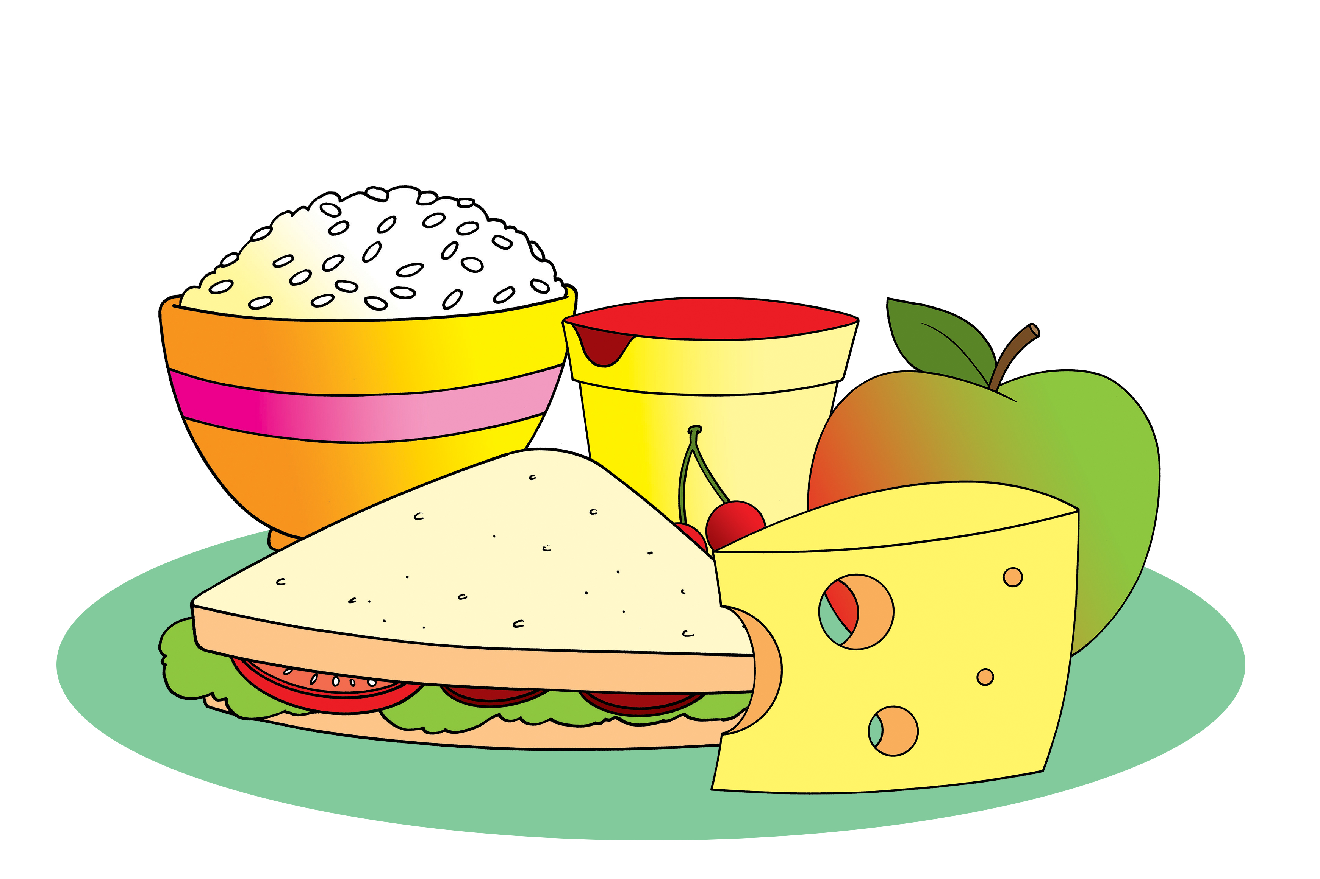
Food I like/don’t like
Your turn!
Say what food you’ve got, but don’t say which one you like and which one you don’t like!
Ask your classmates:
Do you like …?
www.teachingenglish.org.uk

Slide 4
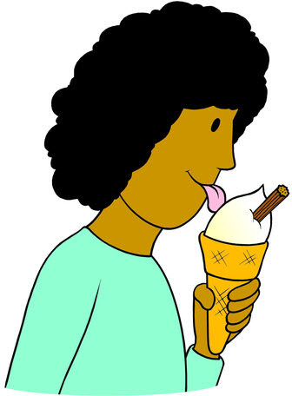
Food I like/don’t like
Is it … big? small? long? round? green?
Is it … a vegetable? a fruit? meat?
Is it … sweet? spicy? crunchy? soft?
www.teachingenglish.org.uk

Slide 5
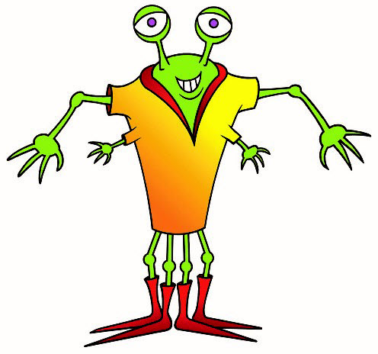
The Hungry Monster Restaurant
Starters
…
Main meals
…
Desserts
…
Drinks
…
www.teachingenglish.org.uk

Slide 6
Food I like/don’t like
TeachingEnglish lessons
Thanks for coming!

