Slide 1
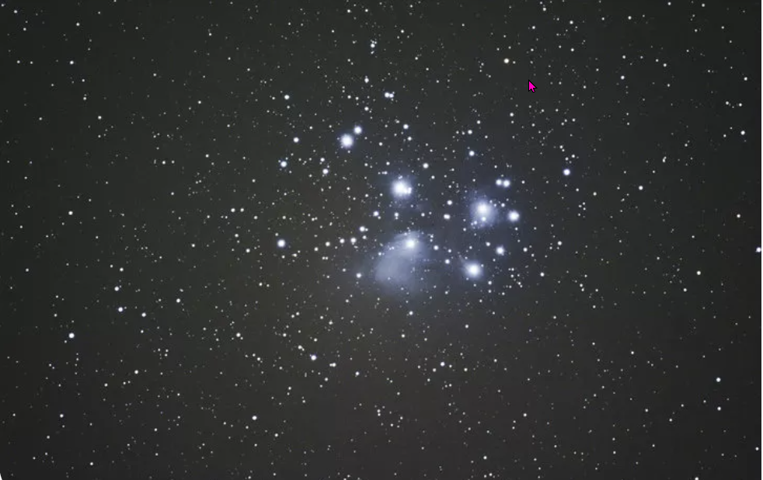
Space
https://www.teachingenglish.org.uk/

Slide 2
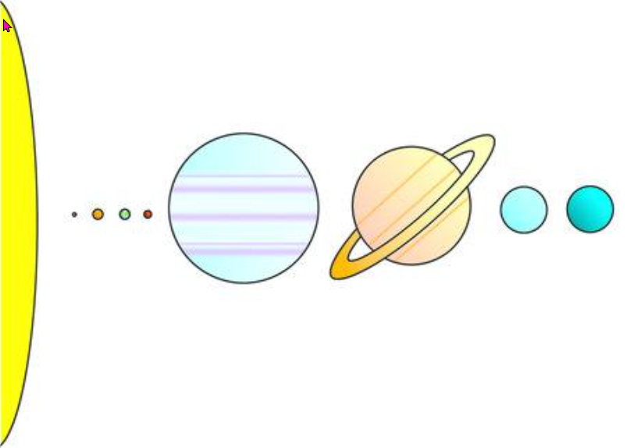
The planets
https://www.teachingenglish.org.uk/

Slide 3
The planet names
The sun
Jupiter
Saturn
Neptune
Venus
Mercury
Mars
Uranus
Earth
https://www.teachingenglish.org.uk/

Slide 4
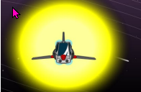
Flying from the sun to the stars
We’re flying from the sun to the stars
Through this solar system of ours.
Mercury, Venus, Earth and Mars
Flying from the sun to the stars.
Mercury’s hot and Venus is bright
Earth is where we live and Mars is red at night
Flying from the sun to the stars.
Jupiter, Saturn, Uranus and Neptune
Last of all is little biddy Pluto.
Flying from the sun to the stars
Through this solar system of ours
Flying from the sun to the stars.
Mercury, Venus, Earth and Mars
Flying from the sun to the stars.
Mercury’s hot and Venus is bright
Earth is where we live and Mars is red at night
Flying from the sun to the stars
Jupiter, Saturn, Uranus and Neptune
Last of all is little biddy Pluto.
https://www.teachingenglish.org.uk/

Slide 5
Fill it in
Watch the story. Write the missing words in the sentences.
a. Look at this forest . The trees are red, and the leaves are red.
b. Look at the yellow _______________and the yellow clouds.
c. Look at the pink _____________. There are pink shells and pink plants in the sea.
d. This planet is very __________________.There is a big blue sun and a desert with blue sand.
https://www.teachingenglish.org.uk/

