Slide 2
Types of holidays
What types of holidays can we go on?
https://www.teachingenglish.org.uk/

Slide 3
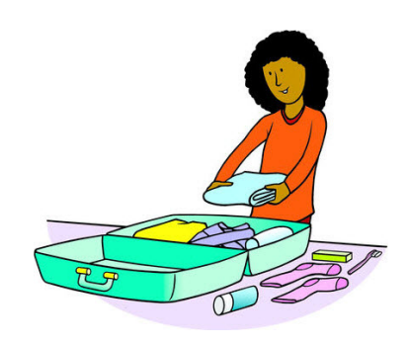
Holiday questions
Can you …?
go swimming / make a fire / see dolphins / …
Do you stay in …?
a hotel / a tent / your house / …
Do you need …?
sun cream / warm clothes / a helmet / …
Is it …?
cold / hot / fun / scary / …
https://www.teachingenglish.org.uk/

Slide 4
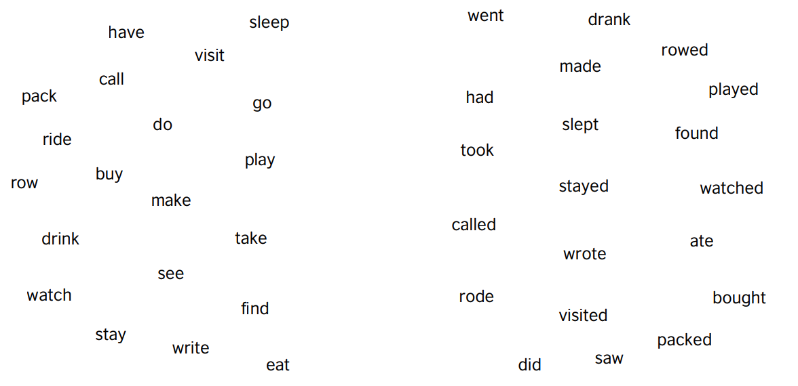
Vocabulary
https://www.teachingenglish.org.uk/

Slide 5
Can you put the words into 2 groups?
https://www.teachingenglish.org.uk/

Slide 6
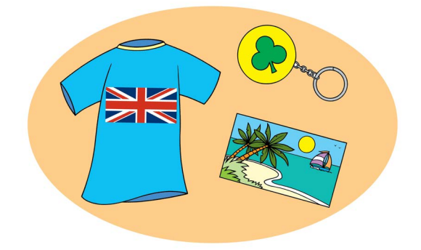
Remembering holidays
What can help us remember a holiday?
Find a s_ _ _ _ _ _ _ and findout what it’s called in English!
https://www.teachingenglish.org.uk/

Slide 7
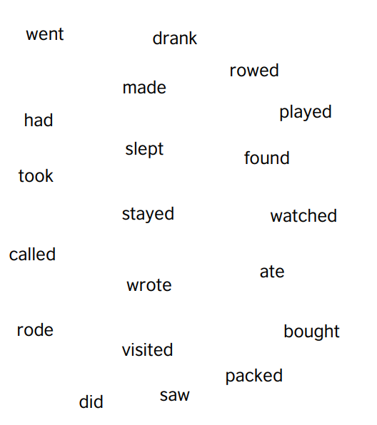
Bingo
Draw a bingo grid!
Choose nine words to write in your grid.
https://www.teachingenglish.org.uk/

Slide 8
Your souvenir
What souvenir did you find?
It’s a …
I bought / found it in …
I like / chose it because …
https://www.teachingenglish.org.uk/

Slide 9
Your holiday
Write about the holiday!
I went to …
I saw …
I ate …
I …
https://www.teachingenglish.org.uk/

Slide 10
Homework
Think about our ideas for our ‘class
holiday’ last year and choose some of
them.
At the end of the holiday, you sent a
postcard to a friend.
Write the postcard! Say what you did
on each day of the holiday.
https://www.teachingenglish.org.uk/

