Slide 1
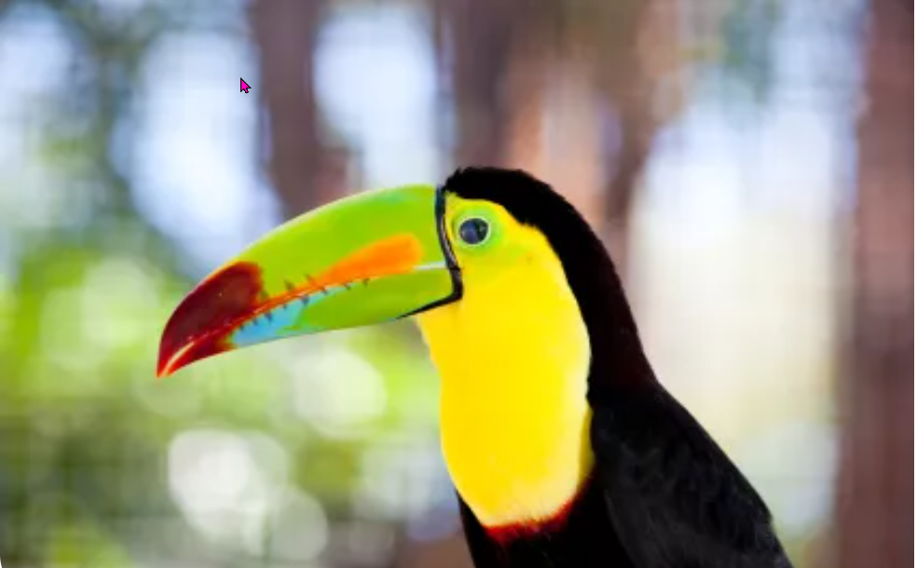
Carnivores vs. herbivores
https://www.teachingenglish.org.uk/

Slide 2
Task 1: Classify the animals
Lion Gazelle Antelope Zebra Buffalo Wolf
Cheetah Koala North-American Pronghorn Baboon
Carnivores | Herbivores | Omnivore (both)
https://www.teachingenglish.org.uk/

Slide 3
Classify the animals - answers
Carnivores | Herbivores | Omnivore (both)
Lion Wolf Cheetah | Gazelle Antelope Buffalo Koala North-American Pronghorn | Baboon
https://www.teachingenglish.org.uk/

Slide 4
Task 2A: Useful terms
These are some terms which you might need to know. Match the terms with their definitions.
1. Carnivore | A) a large group of animals that live and eat together
2. Herbivore | B) an animal that kills and eats other animals
3. Herd | C) an animal that eats meat
4. Predator | D) two hard pointed growths on the heads of some animals. E.g. cows or goats
5. Prey | E) an animal that eats only plants
6. Hoof (plural hooves) | F)an animal that is killed for food by another animal
7. Horns | G) the hard part on the bottom of some animals’ foot, for example horses
https://www.teachingenglish.org.uk/

Slide 5
Task 2B: Practise using the terms
A __________ is any animal that hunts and eats other animals, which are called the __________. Generally, __________ are predators and __________ are prey. To be successful hunters, predators need to be able to see, smell or hear their prey. To avoid being eaten, the prey have to run fast or defend themselves by using their _________ or kicking with their ___________. Predators are very important in the balance of nature, usually hunting only the sick or weak members of a _________. This leaves the strong and healthy animals to reproduce.
https://www.teachingenglish.org.uk/

Slide 6
Practise using the terms - answers
A predator is any animal that hunts and eats other animals, which are called the prey. Generally, carnivores are predators and herbivores are prey. To be successful hunters, predators need to be able to see, smell or hear their prey. To avoid being eaten, the prey have to run fast or defend themselves by using their horns or kicking with their hooves. Predators are very important in the balance of nature, usually hunting only the sick or weak members of a herd. This leaves the strong and healthy animals to reproduce.
https://www.teachingenglish.org.uk/

Slide 7
3: Never-ending battle on the plains
1. Animals gathering in herds have a lower chance of escaping predators
2. The cheetah is the fastest running animal in the world
3. Zebras can put their heads down to feed and adjust their eyes to watch for carnivores at the same time
4. Carnivores run on tiptoes (=with just their toes touching the ground and the rest of the foot in the air)
5. Gazelles have eyes on the sides of their heads and cannot see forward
6. Antelopes’ ears can turn in different directions to watch out for predators while they are feeding
7. Many herbivores use hooves and horns to defend against predators
8. Koalas sometimes sleep for up to 18 hours a day
https://www.teachingenglish.org.uk/

Slide 8
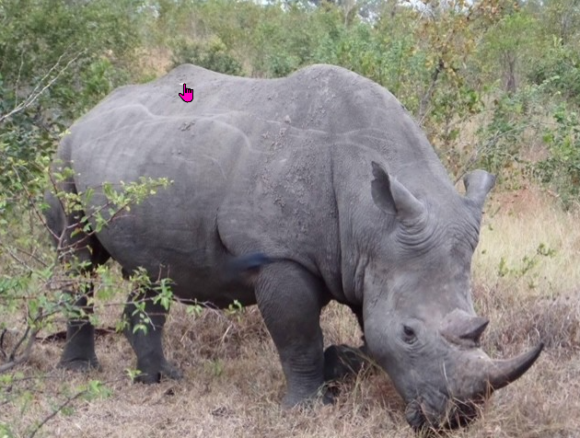
4: Discussion
• Which fact mentioned in the video surprised you most?
• In the pre-task you had to classify animals into two groups: carnivores and herbivores. Can you think of other ways of classifying animals?
• Do you think humans are carnivores or herbivores by nature?
https://www.teachingenglish.org.uk/

Slide 9
5:Verbs starting with out-
In the video you heard “Herbivores manage to out-manoeuvre their enemies more often than you can suppose” meaning they were more skilful than their enemies.
Complete the sentences below with other verbs with the prefix out paying attention to the tense.
outweigh outsmart outnumber outperform
• In the story, the wolf is stronger, but the fox manages to _____________ him.
• All things considered, the advantages clearly _____________ the possible disadvantages.
• In our class, the girls _____________ the boys.
• Last year Toyota ______________ other Japanese cars.
https://www.teachingenglish.org.uk/

