Slide 1
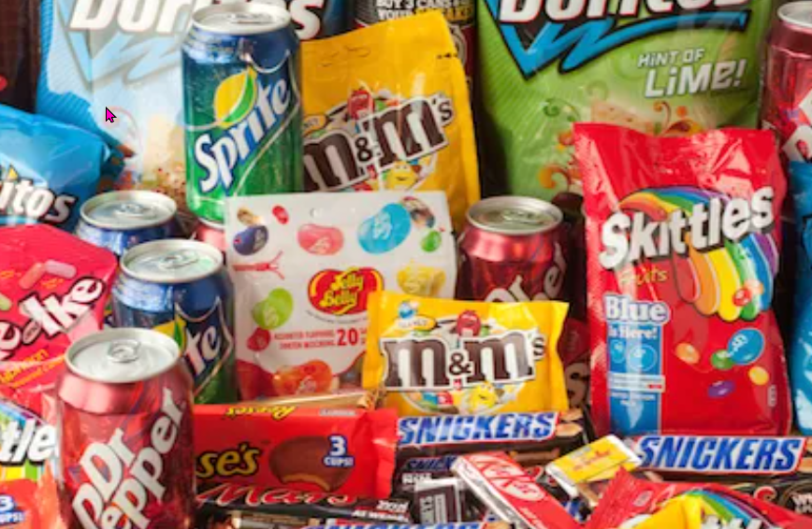
Branding and brand names
https://www.teachingenglish.org.uk/

Slide 2
Which brand names do you know?
Nike
Brands
Coca-Cola
https://www.teachingenglish.org.uk/

Slide 3
About brand names
The name is the most important element of a successful brand. Packaging changes, advertising changes, products even change but brand names never change. Where do great brand names come from? All different sources, they may come from family names or perhaps the inventor’s favourite colour or animal or sometimes the names are just completely made up. For example, McDonald’s is a family name, Adidas was created from the inventor’s name Adi Dassler, Volvo means “to roll” in Latin and KODAK was completely made up by the inventor George Eastman because he thought it was unusual and different.
https://www.teachingenglish.org.uk/

Slide 4
Why are brand names important?
1. Why are brand names important?
2. Name three different sources of brand names.
3. Do you think brands are important? Why?
4. Do you have a favourite brand? What is it and why do you like it?
https://www.teachingenglish.org.uk/

Slide 5
Brand name origins
1. Toyota 2. Chanel no.5. 3. Rolls Royce 4. Reebok 5. Nike 6. Nivea
a) From the Latin word meaning, ‘snow-white’.
b) This was the fifth perfume made by the same company.
c) Named after the Greek goddess of victory.
d) Originally a Japanese family name Toyoda. The inventors changed one letter to make it easier to pronounce overseas.
e) Named after an African gazelle.
f) The family names of two men, one a motor enthusiast and the other an engineering genius.
https://www.teachingenglish.org.uk/

Slide 6
Mini-presentation
In pairs invent a new product and give it a name.
Think about the following points:
• What is special or unusual about your product?
• Why would people want to use or buy it?
• How does the name relate to the product?
Here are some useful phrases that may help you with your presentation:
• We would like to introduce our new product…
• We chose the name… because…
• You can use it to…
https://www.teachingenglish.org.uk/

Slide 7
Mini-presentation
If you can’t think of any ideas for a new product, use one of these ideas:
1. A thick slimy green jelly soda drink
2. A flying schoolbag that you can control by remote control
3. An alarm clock that switches off when you shout at it
4. A television computer
5. A digital watch with a built-in mobile phone and minicomputer
6. A new digital homework personal organiser
7. A new high speed flying carpet
https://www.teachingenglish.org.uk/

