Slide 1
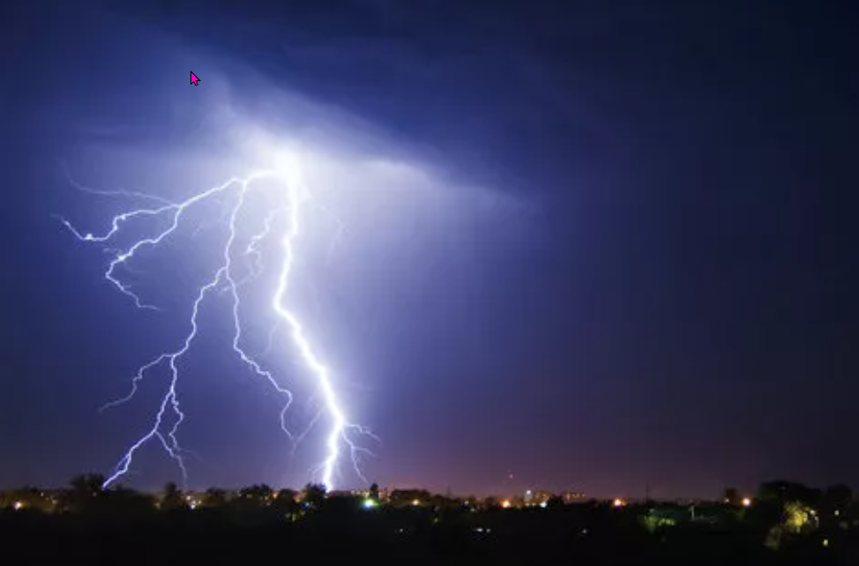
The weather
https://www.teachingenglish.org.uk/

Slide 2
Discussion
Look at the following groups or pairs of words and discuss what the difference
is between them:
• snow, sleet and hail
• a storm and a blizzard
• a breeze, a gale and a hurricane
• flooding and droughts
• mist and fog
• a shower and sunny spells
• rain and humidity
• a hurricane and a tornado
https://www.teachingenglish.org.uk/

Slide 3
Pronunciation
Match the beginnings of six weather phenomena with the ends of the words. The words are all written in phonemic script, so this is how the words sound – not how we spell them.
a) ˈblɪz | 1. ts
b) ˈhʌrɪk | 2. dz
c) ˈsaɪkl | 3. ədz
d) draʊ | 4. ɪtɪ
e) hju:ˈmɪd | 5. ənz
f) flʌ | 6. ənzʊ
Write the written word (i.e. how we spell it) and the corresponding phonemic script next to each other and practise saying them with the correct pronunciation and word stress.
https://www.teachingenglish.org.uk/

Slide 4
Pronunciation - answers
a) ˈblɪz | 3. ədz | blizzards
b) ˈhʌrɪk | 5. ənz | hurricanes
c) ˈsaɪkl | 6. ənzʊ | cyclones
d) draʊ | 1. ts | droughts
e) hju:ˈmɪd | 4. ɪtɪ | humidity
f) flʌ | 2. dz | floods
https://www.teachingenglish.org.uk/

Slide 5
Collocations
A | B
torrential | gales
flash | humidity
severe | spells
dense | weather conditions
sunny | rain
freak | storms
violent | floods
high | fog
https://www.teachingenglish.org.uk/

Slide 6
Collocations – suggested answers
torrential rain
flash floods
severe gales
dense fog
sunny spells/weather conditions
freak gales/weather conditions/storms/floods
violent gales/weather conditions/storms
high humidity
https://www.teachingenglish.org.uk/

Slide 7
Collocations
Discuss the following questions with a partner.
Have you ever been caught in torrential rain? Describe the experience.
What weather conditions can lead to flash floods? Are they a problem where you live?
How does your region prepare for severe weather events?
Have you ever been in a car in dense fog? Was it scary?
Does sunny weather always improve your mood? Why or why not?
What is the difference between a “freak gale" and a regular wind?
Have you ever witnessed a violent storm firsthand? Describe the experience.
How do people in regions with high humidity adapt to the climate?
https://www.teachingenglish.org.uk/

Slide 8
Pre-reading
Answer the following questions:
In what ways can we predict the weather?
There are many sayings in English about the weather. For example: Red sky at night, shepherd’s delight; red sky in the morning, shepherd’s warning. What do you think this saying means? Are there any similar sayings in your own language? Can you translate them into English and say what they mean?
Do you think the weather can influence our moods? If so, in what way?
Do you think the weather can influence the personalities of people living in different countries or regions? If so, in what way?
https://www.teachingenglish.org.uk/

Slide 9
While-reading
Read the article and answer the following questions.
According to scientific studies, what effects can the weather have on people?
What connection between health and the weather is mentioned?
What kinds of weather leave a trail of destruction and displacement?
How reliable is technology in predicting the weather?
What are storm chasers?
https://www.teachingenglish.org.uk/

Slide 10
While-reading - answers
According to scientific studies, changeable weather can make it harder to concentrate, cloudy skies slow reflexes, and hot, dry winds can turn us into irritable snaps.
Studying weather patterns might help predict outbreaks like the Ebola epidemic. Favorable wind conditions are crucial for limiting the spread of airborne diseases.
Sandstorms, tornadoes, blizzards, and flash floods leave a trail of destruction and displacement?
technology can predict the weather accuracy limited to about a week ahead.
Storm chasers are weather enthusiasts who risk their lives chasing tornadoes and thunderstorms
https://www.teachingenglish.org.uk/

Slide 11
Post-reading discussion
• Had you heard of any of the ideas in the article before?
• Are there any parts of the article that you agree or disagree with? Why?
• Have you ever experienced any extreme weather conditions? Where were you and what was it like?
https://www.teachingenglish.org.uk/

