Slide 1
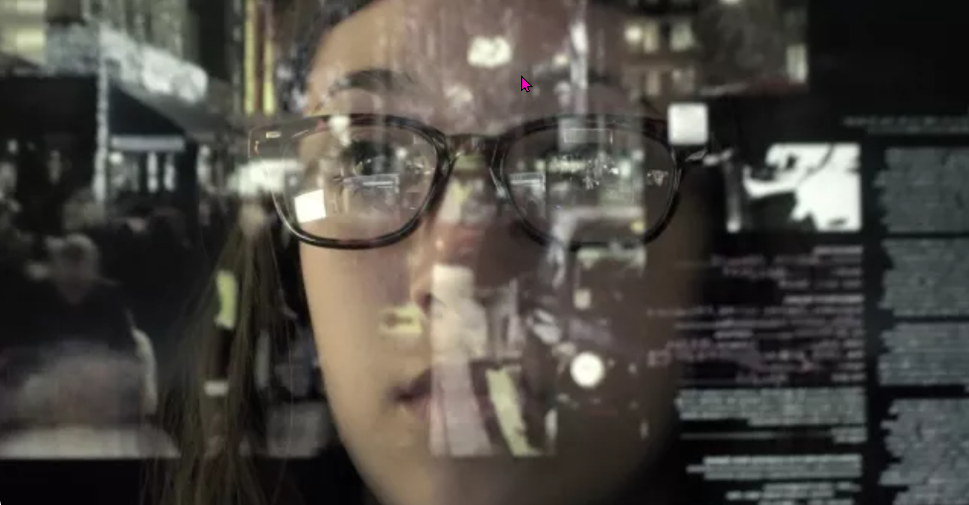
Fake news
https://www.teachingenglish.org.uk/

Slide 2
Task 1. Discussion
Where do you get your news? Which sources do you use?
What do you think about this sentence? ‘It must be true because I read it on the internet.’
What do you understand by ‘fake news’? Brainstorm some keywords you associate with it.
https://www.teachingenglish.org.uk/

Slide 3
Definition of fake news
Cambridge dictionary definition of ‘fake news’:
False stories that appear to be news, spread on the internet or using other media, usually created to influence political views or as a joke
https://www.teachingenglish.org.uk/

Slide 4
Task 2: Two websites
 | Habitat | Characteristics | History
Tree Octopus
Octopus Tree
https://www.teachingenglish.org.uk/

Slide 5
Task 2: Two websites
 | Habitat | Characteristics | History
Tree Octopus | In the temperate rainforests of the west coast of North America. | The octopus has eight arms. On average (measured from arm-tip to mantle-tip) it is 30–33cm long. It is amphibious, intelligent and its eyesight is comparable to that of humans. | The octopus has become endangered because the fashion industry began to kill it in large numbers and sell it to the rich in the form of hat ornaments.
Octopus Tree | Pacific Northwest coast of the USA | The tree itself extends from a central base that is 15 metres around, and instead of shooting straight up with a central trunk, the body of the tree splits into a number of smaller trunks. | It is believed to be around 250 to 300 years old. No one knows how this tree came to have so many trunks.
https://www.teachingenglish.org.uk/

Slide 6
The 5 Questions
WHERE does the information come from? Look at the URL. Does it look familiar or credible?
WHEN was the post put online? What’s the date on the post? Is the date real? Is the post recent?
WHO created the information? Who wrote the article? Who took the photo?
WHAT does the post or website look like? Look at the layout. Is the website well presented and carefully organised?
HOW do you know for certain that it’s true? Check the content again. Does any information seem unlikely? Too good (or too amazing) to be true?
https://www.teachingenglish.org.uk/

Slide 7
Fake news tips
Websites with these URLs are usually legitimate: .com, .org, .net, .edu, .gov
Fake websites often have URLs that end with: lo, .com.co. Alternatively, fake URLs are incomplete.
Fake websites have similar names to authentic sites, e.g. Sky Newz (instead of Sky News).
Fake news is often posted on dates which don’t exist (e.g. 30 February) or on 1 April (April Fool’s Day).
Always check the date. Sometimes the news was posted years ago but is still being circulated as ‘news’.
Real photos should always give the name of the person who took them. Could the photos have been Photoshopped? Check suspicious photos by doing a reverse Google image search. Other websites may have used the same photo for different news.
Real news stories should appear in several news outlets, not just the one you’re looking at. Cross-check the information with a credible website to see if you can find the same story!
https://www.teachingenglish.org.uk/

Slide 8
Fake news meme
A weird cat with two legs was captured by Google Street View.
Japan has the best fireworks in the world – the fireworks are moons and stars.
The world’s tallest teenager is 6ft 11in (210.82cm) and towers over her teacher.
A 79-year-old woman called Abigail wants to give you $5.7 million to distribute to charity
Kentucky Fried Chicken is giving three free chicken buckets to everyone as a way of celebrating the company's 67th anniversary
The actor Peter Dinklage (who plays the character Tyrion Lannister in Game of Thrones) is dead.
https://www.teachingenglish.org.uk/

