Slide 1
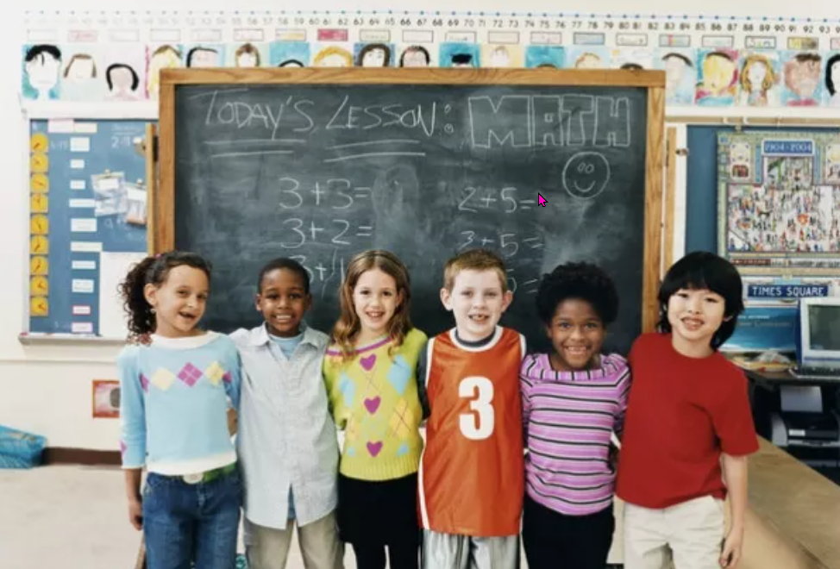
Children's rights
https://www.teachingenglish.org.uk/

Slide 2
Is this ok?
I work in a factory
I haven’t eaten for days.
Children have the right to eat.
Children have the right not to work
https://www.teachingenglish.org.uk/

Slide 3
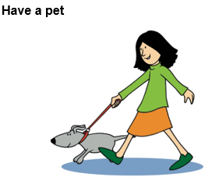
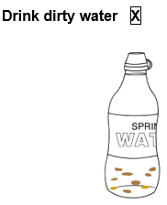
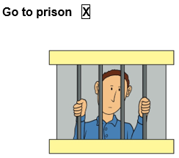
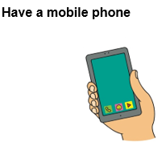
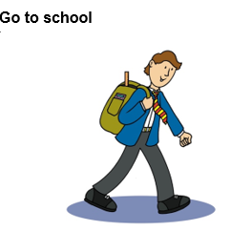
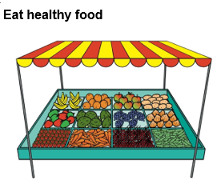
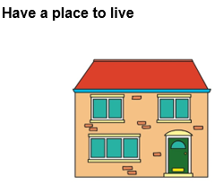
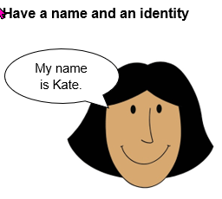
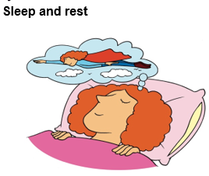
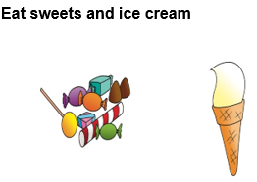
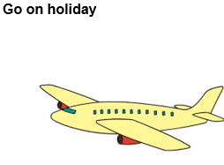
Rights or wants?
https://www.teachingenglish.org.uk/

Slide 4
Children have the right to/ not to…
https://www.teachingenglish.org.uk/

Slide 5
UN Convention on the Rights of the Child
The right to be safe
The right to be happy and healthy
The right to learn and grow
the right to be YOU.
https://www.teachingenglish.org.uk/

Slide 6
Children's rights pocketbook
1) The right to be SAFE
Article 19: You have the right to be protected from being hurt.
Article 27: You have the right to a safe place to live.
Article 33: You have a right to be protected from dangerous drugs.
2) The right to be HAPPY and HEALTHY
Article 31: You have the right to play and rest.
Article 24: You have the right to the best health care possible, safe water to drink, healthy food and a clean environment, to help you stay well.
3) The right to DEVELOP and LEARN
Article 28: You have the right to a good-quality education.
Article 13: You have the right to find out information.
Article 14: Your parents should help you decide what is right and wrong.
4) The right to be YOU
Article 7: You have the right to a name.
Article 8: You have the right to an identity.
https://www.teachingenglish.org.uk/

Slide 7
Children's rights pocketbook
Copy the form. Fill it in. Then make the booklet.
Title of our booklet
The child rights we want to include
Ideas of words or sentences for our booklet
Ideas of pictures we want to illustrate
Other information for our booklet
https://www.teachingenglish.org.uk/

