Slide 1
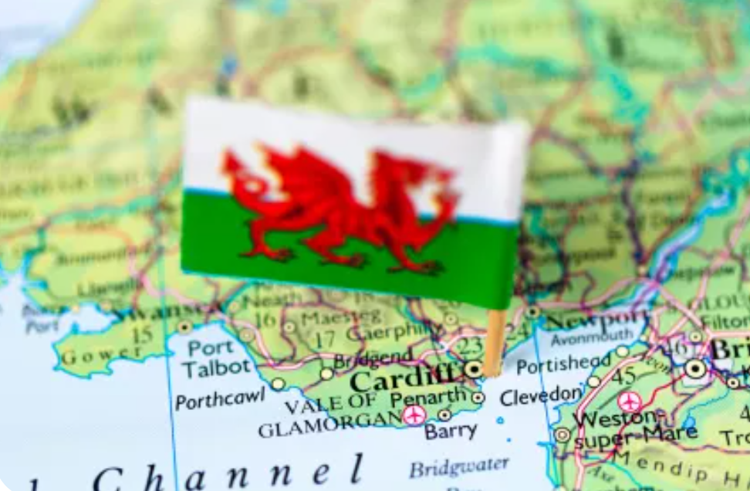
Kaleidoscope - Cardiff
https://www.teachingenglish.org.uk/

Slide 2
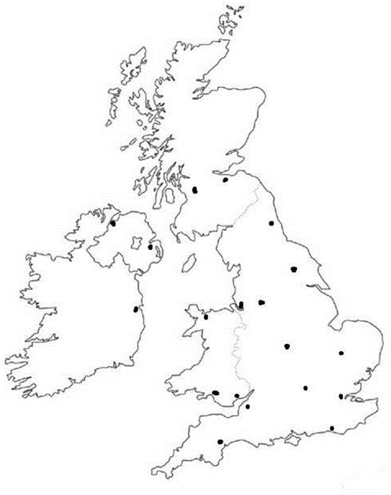
Where is Cardiff?
https://www.teachingenglish.org.uk/

Slide 3
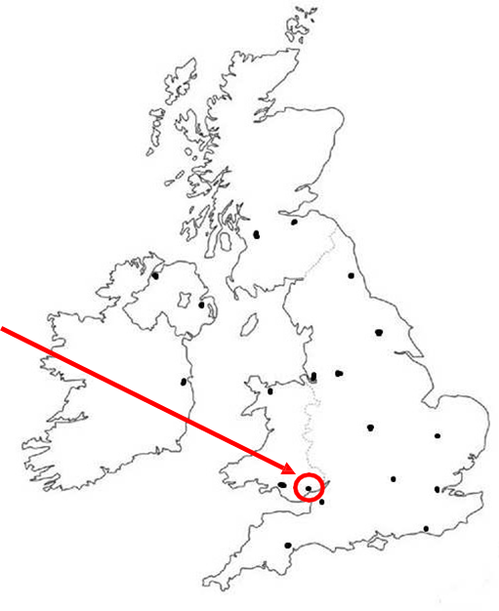
Cardiff in Wales
https://www.teachingenglish.org.uk/

Slide 4
Making comparisons
Old | New
https://www.teachingenglish.org.uk/

Slide 5
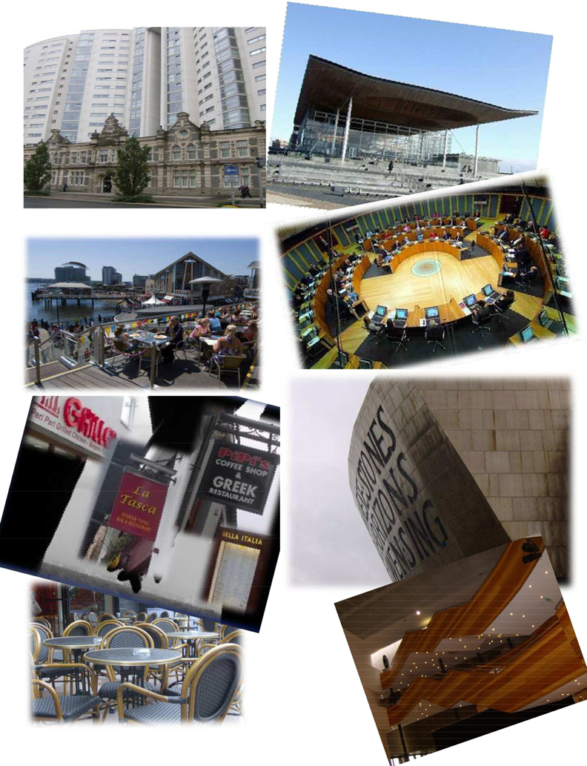
What’s the difference?
Old Cardiff
New Cardiff
https://www.teachingenglish.org.uk/

Slide 6
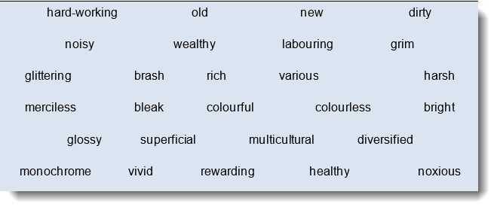
Positive or negative?
https://www.teachingenglish.org.uk/

Slide 7
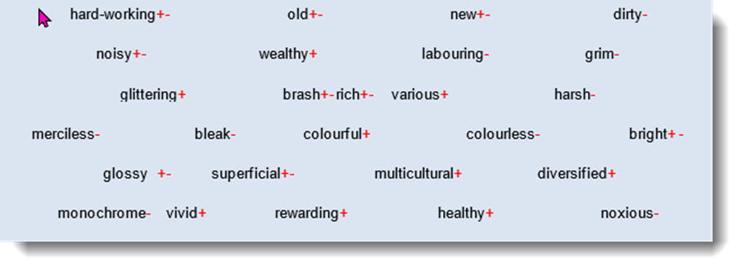
Positive or negative - answers
https://www.teachingenglish.org.uk/

Slide 8
Welsh language
Half of the poem was in the Welsh language. Not more than half a million people speak Welsh as a first language, so it probably sounds unusual to you. However, modern Welsh has lexical links with other modern languages, and also contains some loan words from other languages. You’re going to look at extracts taken from the poem and match some of the words with the pictures. (You'll have to read the words aloud to hear what they might sound like - the spelling might not help you!)
https://www.teachingenglish.org.uk/

Slide 9
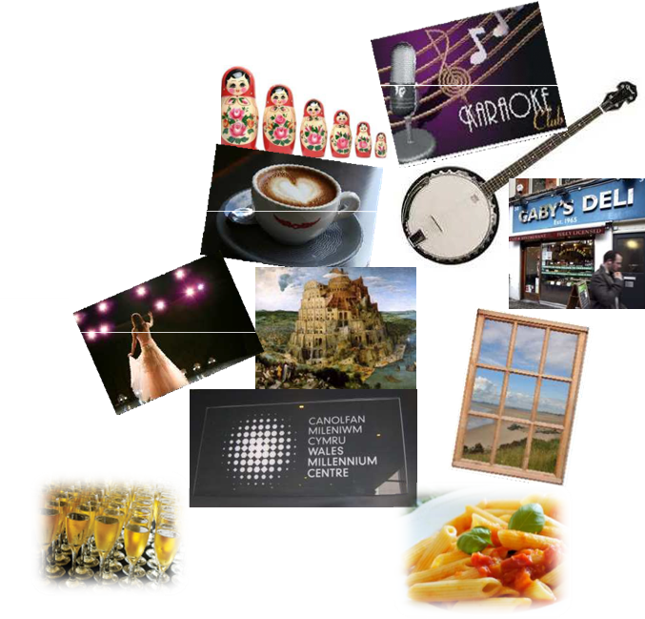
Welsh language
Hon yw dinas cariad a cariôce, Dinas babushka a banjos,
Gan yfed coffi klatsch a macchiato,
Yma, mae delis, cân ‘Delilah’ yn cael ei hymian Lingua franca y dydd yw heddi,
Babel o ieithoedd yn Bute St,
Yn y Senedd swish yn y bae; Ffenestri’n hawlio’r dŵr a’r a r
ger y Mileniwm, lle bydd opera yna, olifau’n llifo gyda siampaen, gwledd al fresco a phasta al dente,
https://www.teachingenglish.org.uk/

Slide 10
Welsh language - hints
1. Cariôce Karaoke
2. Babuska babushka
banjos banjos
3 coffi coffee (also coffee klatsch (social gathering) and macchiato (type of coffee))
4 delis delis (delicatessen)
5 Lingua franca Lingua franca (no picture)
6 Babel Tower of Babel - many languages
7 Senedd Senate (no picture)
8 Ffenestri Window (similar to Latin fenestra - also French fenêtre, Italian finestra)
9 Mileniwm Millennium (name of the main arts centre in Cardiff)
10 siampaen Champagne
11 phasta al dente pasta al dente (pasta cooked lightly)
https://www.teachingenglish.org.uk/

Slide 11
Welsh language - answers
https://www.teachingenglish.org.uk/

