Slide 1
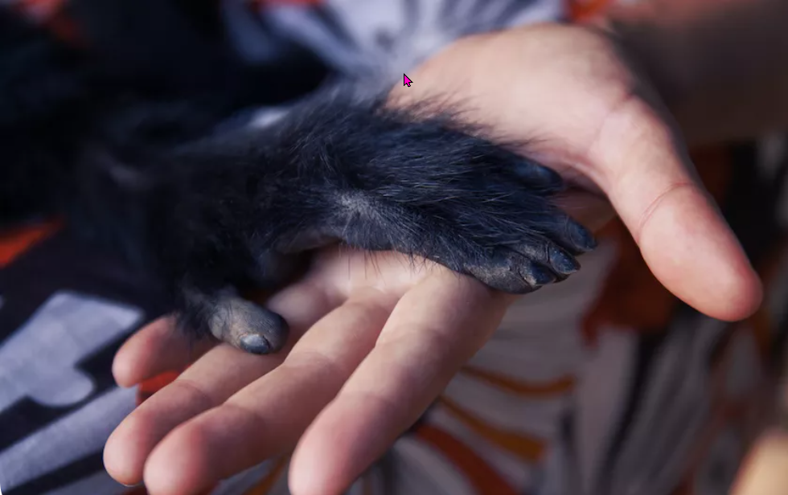
Hooray! It's World Monkey Day!
https://www.teachingenglish.org.uk/

Slide 2
About monkeys…
Monkeys
have | like
can | are
https://www.teachingenglish.org.uk/

Slide 3
Our monkeys
https://www.teachingenglish.org.uk/

Slide 4
Our monkeys
Monkeys like fruit.
Monkeys can climb trees.
https://www.teachingenglish.org.uk/

