Slide 1
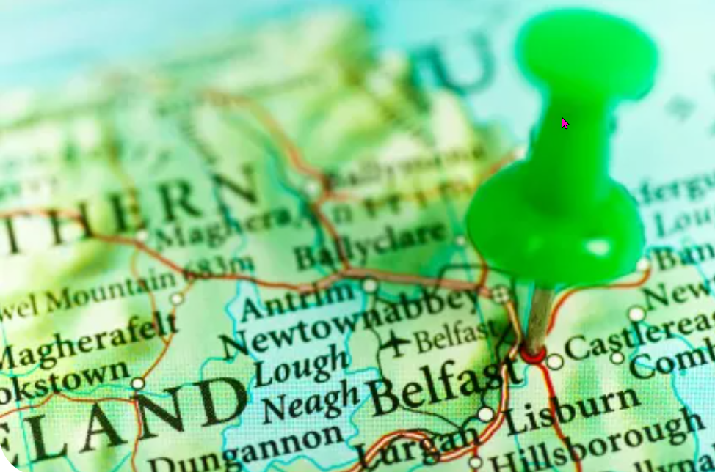
Kaleidescope - Belfast
https://www.teachingenglish.org.uk/

Slide 2
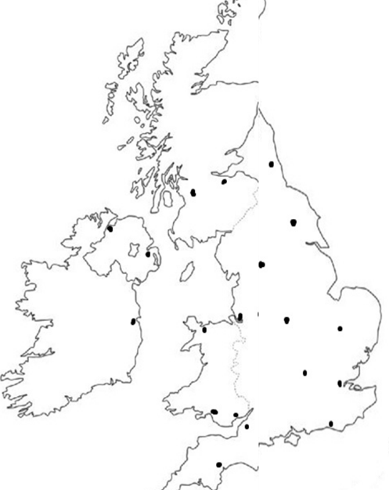
Task 1: Where is Belfast?
https://www.teachingenglish.org.uk/

Slide 3
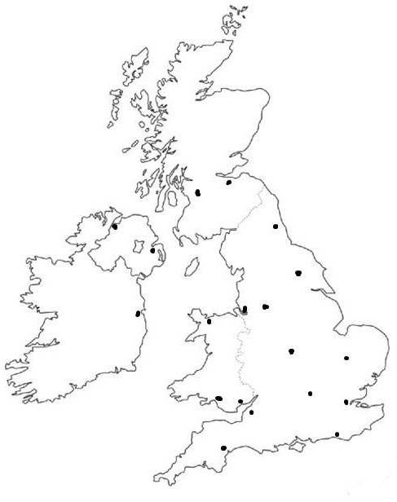
Location of Belfast
https://www.teachingenglish.org.uk/

Slide 4
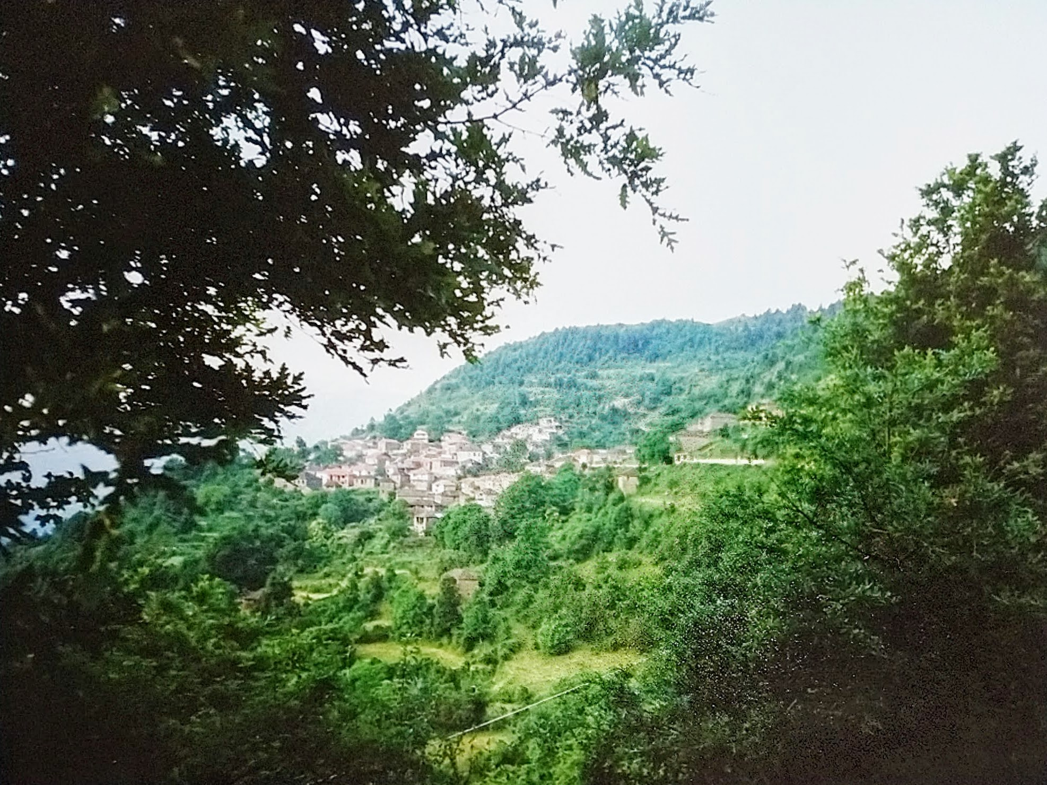
Discussion
Do you ever wish you lived in a different place?
If you live in a city, do you ever wish you lived in the country? Why?
If you live in the country, do you ever wish you lived in the city? Why?
https://www.teachingenglish.org.uk/

Slide 5
Task 2: Stephen’s story
1. Why did Stephen want his mother to put flowers in window boxes of their house?
2. Why didn't Stephen's mother put flowers in window boxes?
3. What kind of house does Stephen live in?
4. Why did Stephen go on long walks across Belfast?
5. How did Stephen feel when he reached the 'wide open space and green loveliness' of Ormeau Park?
6. Why does the Ormeau Bridge carry 'the tensions of two communities who would not meet halfway'?'
7. Why does Stephen feel that the towpath by the river is his 'ultimate bliss'?
https://www.teachingenglish.org.uk/

Slide 6
Stephen’s story answers
He liked the countryside and wanted to bring some of it to his street
She couldn't afford to
A mean, terraced house - small and cramped, in a poor area of the city
to escape the streets of his home, in search of wide-open spaces
Very pleased, but also embarrassed if anyone should notice his happiness
It's the dividing point between west and east Belfast. There were a number of tension points between the sectarian Protestant and Catholic communities in Belfast, and for decades in the 20th century the two communities were at war with each other.
It is the closest he gets to the countryside, where he can forget he is in the city
https://www.teachingenglish.org.uk/

Slide 7
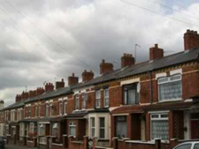
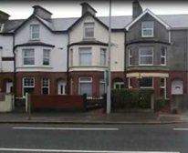
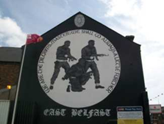
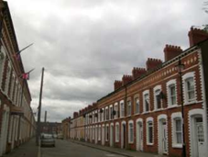
Task 3: After watching
a) The houses are terraced, they’re small and mean. No one here has a garden.
b) I leave behind all the chip shops and charity shops of the Newtownards Road, and the great gable-wall murals for the Loyalist paramilitaries.
c) …… all the houses terraced and cramped, but somehow neater than ours
d) There’s a side gate that takes you into Stranmillis, all big houses and gardens.
https://www.teachingenglish.org.uk/

Slide 8
Task 4: Stephen
What do you think Stephen means when he says 'Aye, grand' to lads he once went to school with?
What does Stephen have in common with the dogs he finds in the park?
Why did Stephen used to be worried that people would ask him what he was doing in the Botanic Gardens?
https://www.teachingenglish.org.uk/

Slide 9
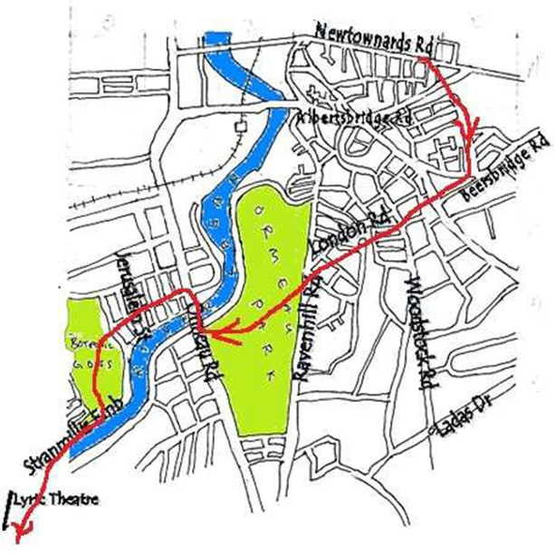
Task 5 – Stephen’s route
https://www.teachingenglish.org.uk/

