Slide 1
Escape 3
TeachingEnglish lesson

Slide 2
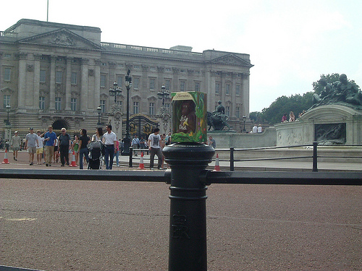
Escape 3
Look at the photo. Why is there a chocolate monkey on the post?
Image supplied courtesy of ELTPics
http://www.flickr.com/photos/54942754@N02/5748469836/in/photolist-9KYpNU-9KYpyy-9Bisgx-9KVAcc-cKfTLw

Slide 3
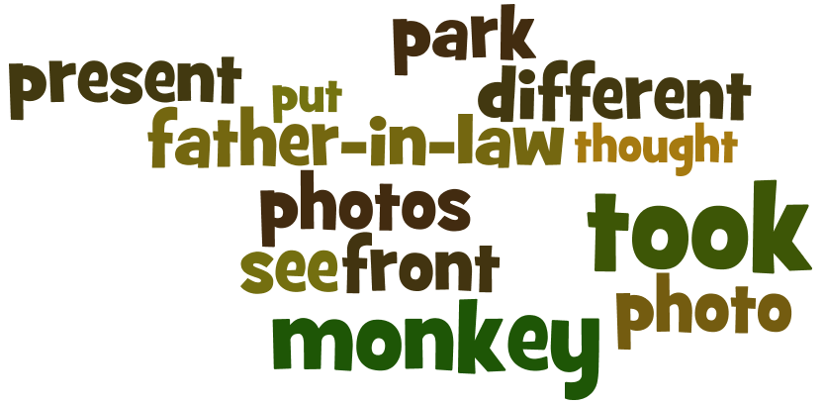
Escape 3
Look at the word cloud. These are some of the words used by the photographer to talk about the photo. Compare them with your ideas about the photo. Using these words to help you, change or develop your ideas.

Slide 4
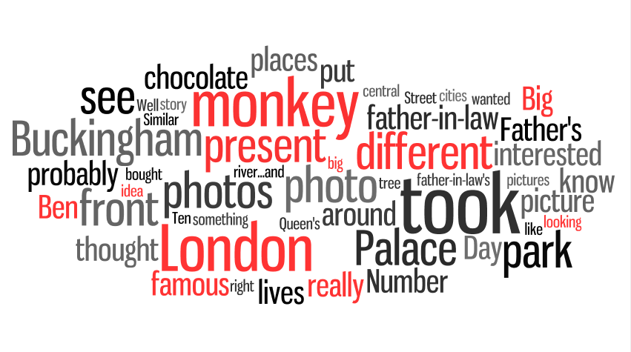
Escape 3
Look at this word cloud. These are more words used by the photographer to talk about the photo. Using these words to help you, try to develop your ideas even more.

Slide 5
Escape 3
Write five ‘True / False / Doesn’t say’ sentences about your ideas and the words in the word cloud. For example:
They took a different photo in front of Big Ben. True / False / Doesn’t say
The photographer’s father-in-law lives in London. True / False / Doesn’t say
The monkey was a present for the father-in-law. True / False / Doesn’t say
d. …………………………………………………..………………… True / False / Doesn’t say e. …………………………………………………..………………… True / False / Doesn’t say f. …………………………………………………..………………… True / False / Doesn’t say g. …………………………………………………..………………… True / False / Doesn’t say h. …………………………………………………..………………… True / False / Doesn’t say

Slide 6
Escape 3
Transcript
Phil
I took this picture in 2007. As you can probably see, I was standing right in front of Buckingham Palace, the Queen's residence in London. It's a very famous building.
There is a story behind the photo, as you can probably imagine. My wife and I were in central London and we were looking for a present for Father's Day for my father-in-law. We wanted to find something different and original, but not very big because we had to send the present by post. Um, my father-in-law lives in Argentina, and he's really interested in things to do with London so.... anyway.

Slide 7
Escape 3
Transcript
Phil
So we found the chocolate monkey that you can see in the photo and we bought it for him – it says Number One Dad in the World on it - and then we were walking around, shopping and having a sandwich in the park and enjoying the day and, I dunno, I decided it would be fun if we put the monkey in a tree in the park and took a photo. And then I thought it'd be a good idea to put it in front of Buckingham Palace and Big Ben and other famous places, and took photos. Similar to the film ‘Amelie’ with the garden gnome that sends postcards from different cities around the world. Do you know it?

Slide 8
Escape 3
Transcript
Interviewer
Yes, yes, it’s a fun idea. I can't remember exactly how she did it in the film though.
Phil
Well, I don't know, that's what we did, we walked to different places – Number Ten Downing Street where the British Prime Minister lives, Trafalgar Square, Big Ben, the river...and took photos with the monkey. And we took a picture of it in front of Buckingham Palace, near the park.
He's very, my father-in-law's very interested in London, he's never been here but he loves to see pictures of it, so we thought he'd really like this. We printed out the photos and we sent them with the chocolate monkey as a Father's Day present. And that's it!

Slide 9
Escape 3
TeachingEnglish lessons
Thanks for attending the lesson

