Slide 1
Describing a city
TeachingEnglish lesson

Slide 2
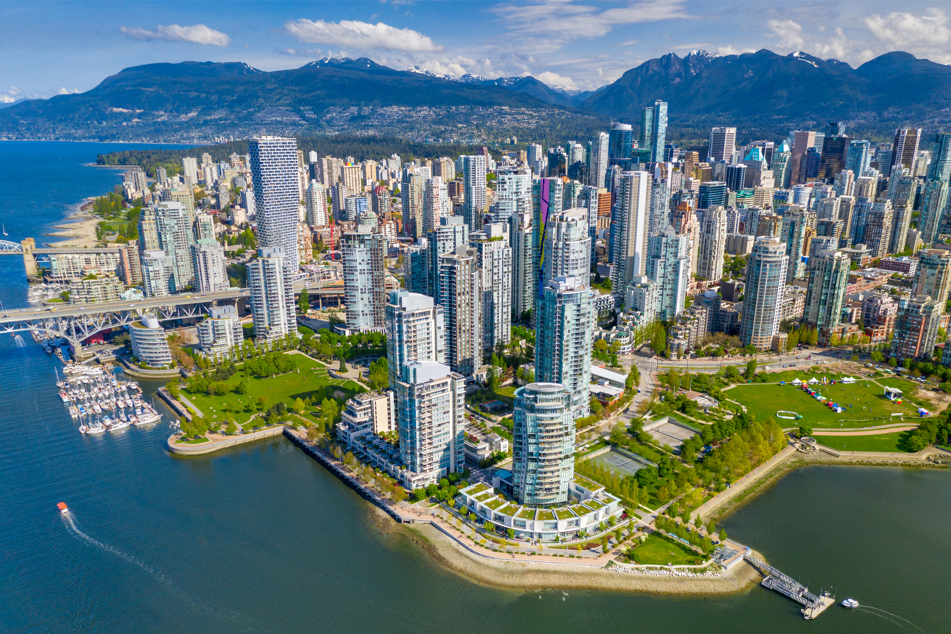
Describing a city
Lead-in: Look at the photo. Can you guess what the city is?
What do you know about the city?
What does the photo tell you about the city?

Slide 3
Describing a city
Task 1: Predict what you will hear in the text about Vancouver, using the different categories to make notes.

Slide 4
Describing a city
Task 2: Read the texts about Vancouver.
Location and climate
Vancouver is located in the southwest corner of Canada in the province of British Columbia, at about 49° latitude and 123° longitude, next to the Pacific Ocean. Vancouver is surrounded by water on three sides and overlooked by the Coast Range mountains that rise abruptly to more than 1,500m. Its climate is one of the mildest in Canada. Temperatures average 3°C in January and 18°C in July. Vancouver's average annual precipitation is 1,219 mm. Most rainfall occurs in winter.
Population
With a population of about 662,248 (according to the 2021 census), Vancouver lies in an urban area of more than 2 million people. Vancouver is the largest city in the province of British Columbia and the third largest metropolitan area in Canada. The metropolitan area covers more than 900 square kilometres.

Slide 5
Describing a city
Task 4: Check the meanings of these words.
primary
expanded
range
domestic
network
output
located
diversified
generate
partners

Slide 6
Describing a city
Task 5: Complete the text about Vancouver’s economy using the words from Task 4.
As the main western terminus of Canada's transcontinental highway and rail __________, Vancouver is the __________ city of western Canada, as well as one of the nation's largest industrial centres. The Port of Vancouver is Canada's largest and most __________ port, trading more than $172 billion in goods with more than 160 trading __________ annually. Port activities _________115,300 jobs in total with $9.7 billion in gross _________ product and $20.3 billion in economic __________. Vancouver's central area has 60% of the region's office space and is home to headquarters of forest products and mining companies as well as branches of national and international banks, accounting and law firms. In recent years, Vancouver has __________ as a centre for software development, biotechnology and the film industry. Two of the Port of Vancouver's container docks are __________ in the city. The Fraser River has barge and log traffic serving forestry and other water related industries. Around 7.3 square kilometres of industrial land provide an important __________ of support services, manufacturing and wholesale premises for businesses throughout the city and region.
primary
expanded
range
domestic
network
output
located
diversified
generate
partners

Slide 7
Describing a city
TeachingEnglish lessons
Thanks for attending the lesson

