Slide 1
Countryside is GREAT
TeachingEnglish lesson
January 2024

Slide 2
Countryside is GREAT
Lead-in: Look at the poster.
What can you see?
Is this landscape different or similar to the landscape where you live?

Slide 3
Countryside is GREAT
Lead-in: Discuss these questions.
1. Would you like to be in this landscape? Why (not)?
2. What is the most beautiful rural area that you have ever visited?
3. What are some factors which threaten rural areas?
4. What can we do to help to protect the countryside?

Slide 4
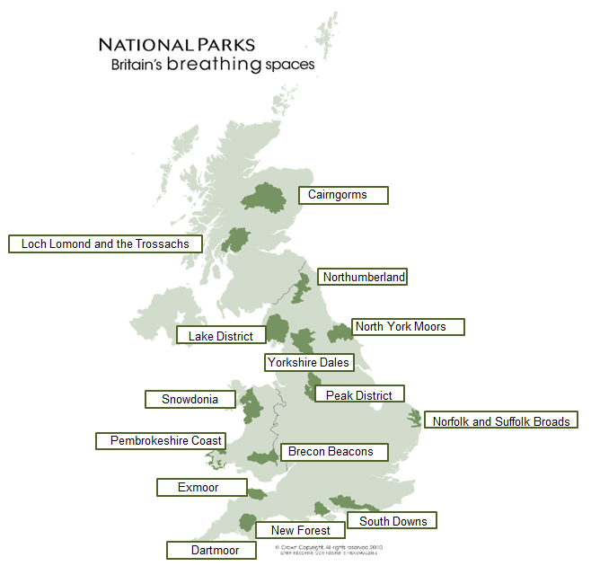
Countryside is GREAT
Task 1: Read these sentences about the UK’s National Parks. There is a mistake in each one. Can you guess what it is?
1. There are 15 National Parks in the UK, 10 in England, 3 in Scotland and 2 in Wales.
2. Some of the parks are designated protected landscapes, but each park is different and administered by its own authority.
3. People live and work in the parks, and anyone can visit during the winter for free.
4. The UK’s National Parks receive more than 10 million visits a year.

Slide 5
Countryside is GREAT
Task 2: Watch a video: ‘UK National Parks in 100 Seconds’. Match . Match the type of land in UK’s National Park with the correct percentage.
crops | 15%
peat bogs | 12%
woods and forests | 24%
grasslands | 22%
heaths and moors | 6%
pastures for sheep and cows | 14%

Slide 6
Countryside is GREAT
Task 3: Apart from national parks, there are many other countryside attractions in the UK. You are going to learn about four of them. Read the questions below and check that you understand them.
How long is Loch Ness?
How many people visit Powis Castle annually?
In which year did Stonehenge get UNESCO World Heritage Site status?
What animals might you see at Powis Castle?
What can visitors do at Giant’s Causeway? Name one thing.
What can visitors do at Loch Ness? Name one thing.
What can visitors do at Powis Castle?
What does ‘Loch’ mean and where is Loch Ness?
What formed the columns of basalt rock at Giant’s Causeway?
What happens at Stonehenge during the summer solstice?
What was the myth of the creation of Giant’s Causeway?
Where is Giant’s Causeway?
Where is Powis Castle? Name one thing.
Where is Stonehenge and how old is it?
Who is ‘Nessie’?
Who owns Stonehenge?

Slide 7
Countryside is GREAT
TeachingEnglish lessons
Thanks for attending the lesson

