Slide 1
The Christmas gift experiment
TeachingEnglish lesson

Slide 2
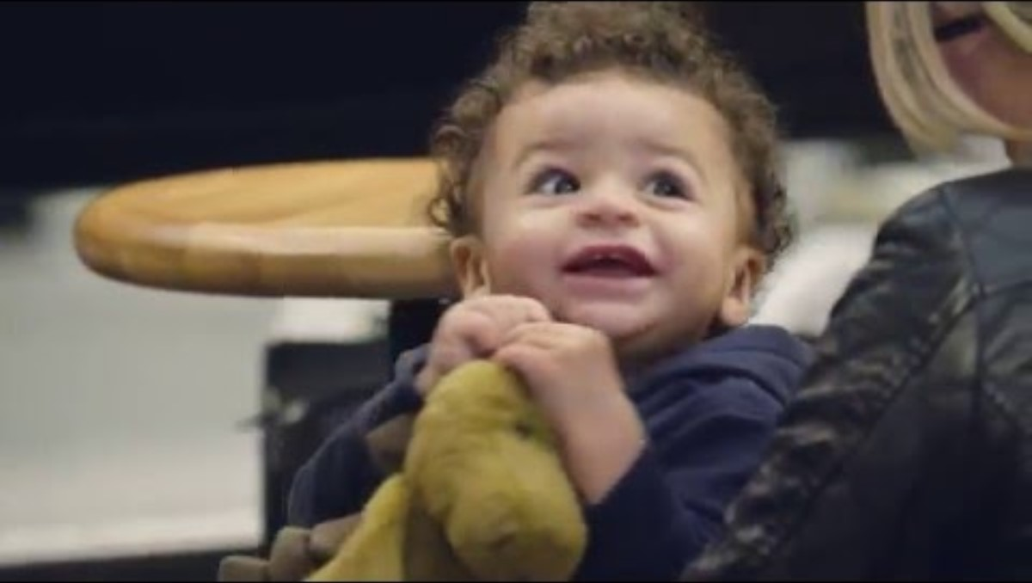
The Christmas gift experiment
Watch part 1 of the video. Is it similar or different to your ideas?
https://www.youtube.com/watch?v=4f4Ve-fuuZQ

Slide 3
The Christmas gift experiment
Read some expressions to make predictions. Decide if people use them when they are sure something will happen, unsure or somewhere in between.
 | Certain | Not certain | In between
Example: The man will definitely run away with the gift | X
1. I’m fairly sure that she’ll / she‘s going to…
2. I have no idea but maybe she’ll / she’s going to…
3. I’m guessing that she’ll / she’s going to…
4. I’d say that she’ll probably / she’s probably going to…
5. I’m totally convinced that she’ll / she’s going to…
6. Who knows? She might or she might not…
7. It’s a pretty strong possibility that she’ll / she’s going to…
8. There’s a good chance that she’ll / she’s going to…
9. 100% she’ll / she’s going to…
10. Hmmm… tricky. I reckon she’ll / she’s going to…

Slide 4
The Christmas gift experiment
Watch part 2 of the video. Are any of your predictions correct?
https://www.youtube.com/watch?v=4f4Ve-fuuZQ

Slide 5
The Christmas gift experiment
Read the comments about the video. Do you agree?
‘It’s always better to give a gift than to receive one.’
‘This is so fake! I don’t think that people would do this.’
‘I’d never take a present from a stranger.’
‘I’d open the present myself!’
Respond to one of these comments or write your own.

Slide 6
The Christmas gift experiment
TeachingEnglish lessons
Thanks for attending the lesson

