Slide 1
Changing lives
TeachingEnglish lesson

Slide 2
Changing lives
Task 1A: Check you understand the meaning of these adjectives then follow the instructions below.
Circle the adjectives which describe your life now. Add more if you need to.
Underline the adjectives which describe the life you would like to have in the future. Add more if you need to.
sporty | peaceful | glamorous | calm
exciting | active | hectic | fast-paced
rural | boring | adventurous | action-packed
urban | slow-paced | fun-filled

Slide 3
Changing lives
Task 1B: Compare the adjectives you circled and underlined. What are the differences? Write some sentences.
I’d like my life in the future to be ...

Slide 4
Changing lives
Task 2: Compare urban and rural life. Think about:
pace of life
expenses
job opportunities
schools
entertainment for young people
types of housing
transport networks
climate
environment
Transport in urban areas is more frequent. In rural areas it’s more difficult to travel by public transport.
Transport in urban areas is more frequent. In rural areas it’s more difficult to travel by public transport.

Slide 5
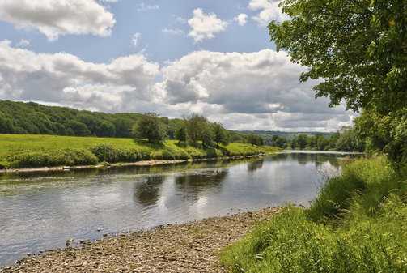
Changing lives
Task 3: The Peak District is a National Park in Central England. Why do you think people might want to live here?

Slide 6
Changing lives
Task 4: Discuss the questions about Jake’s and Jo’s stories.
What might be the biggest change for Jake and for Jo's kids?
What types of things did Jake and his family find hard to leave in the village?
What things might be hard to leave behind in Boston for Jo and her husband?
Do people make lifestyle changes like this in your country?
Have you ever moved house? Describe what happened and how you felt about the move.

Slide 7
Changing lives
Task 5: You and your friend have won a scholarship to study and live in a different school, college or university. Read the role for Student A or Student B and follow the instructions.
Student A: You’d like to study and live at an institution in the city. Make some notes about why you’d like to study and live there.
Student B: You’d like to study and live at an institution in the countryside. Make some notes about why you’d like to study and live there.

Slide 8
Changing lives
TeachingEnglish lessons
Thanks for attending the lesson

