Slide 1
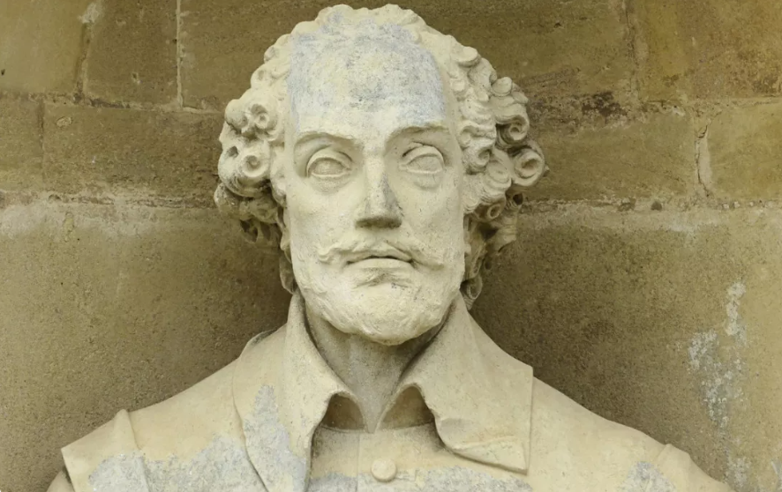
https://www.teachingenglish.org.uk/

Slide 2
A famous writer
MALILIW RAKESHAPEES
https://www.teachingenglish.org.uk/

Slide 3
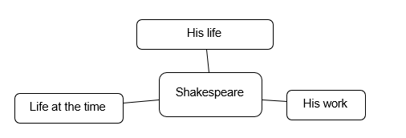
Mind map
https://www.teachingenglish.org.uk/

Slide 4
Task 3: Shakespeare quotes
1.Match the halves to make some famous Shakespeare quotes.
1. All the world’s a stage 2. Love is blind 3. Neither a borrower 4. To be, or not to be: 5. Things without remedy should be without regard 6. The course of true love | a. nor a lender be. b. that is the question. c. what’s done is done. d. and all the men and women are merely players. e. never did run smooth. f. and lovers cannot see.
https://www.teachingenglish.org.uk/

Slide 5
Shakespeare quotes - answers
1d All the world’s a stage and all the men and women are merely players.
2f Love is blind and lovers cannot see.
3a Neither a borrower nor a lender be.
4bTo be, or not to be that is the question.
5c Things without remedy should be without regard, what’s done is done.
6e The course of true love never did run smooth.
• What do you think each quote means?
• Do you agree or disagree with the quotes?
https://www.teachingenglish.org.uk/

