Slide 1
The Windrush generation
teachingenglish.org.uk

Slide 2
1. Your country
Think of two things that you really like about your country.
Think of two things that you would miss very much if you went to live abroad
What sorts of things attract visitors or new immigrants to your country?
teachingenglish.org.uk

Slide 3
2. Going away
Imagine that you or your parents have decided to try life in a new country.
a) Name two things you would definitely take with you.
b) Think of two possible difficulties on arrival.
c) What are the main reasons for people changing countries?
d) Do you know anyone who has moved abroad?
Why did they go?
Was it a positive experience?
Were they homesick?
Did they stay?
teachingenglish.org.uk

Slide 4
3. A poem
Listen to this poem about a ship and its passengers. The ship is called the Empire Windrush.
a) Where is it going to?
b) What do we learn about their country?
c) What is their nationality?
d) Which period in history does the poem refer to?
teachingenglish.org.uk

Slide 5
4. Interpretation Pt1
Which words best describe the feelings of the person writing the poem?
Joyful | confused | bitter | sad
angry | happy | nostalgic | other
teachingenglish.org.uk

Slide 6
4. Interpretation Pt2
How old is the narrator at the start of the poem?
How old is the narrator now?
Who invited the passengers to the Mother Country?
What do you think they were looking forward to?
How do we know that some things disappointed the new arrivals?
Why do you think the new arrivals were not accepted as British?
teachingenglish.org.uk

Slide 7
5. Finish the poem
Now you know more about Black people in Britain today. Finish the poem with another verse in your own words.
But now we live…
Our children…
Our lives had…
teachingenglish.org.uk

Slide 8
6. Black Britons
You’ll read about the life of someone who lives in Britain today and answer the following questions:
• How old is this person?
• What do they do?
• Where did their family come from?
• What is their contribution to life in Britain today?
teachingenglish.org.uk

Slide 9
7. The letter home
Imagine you are a new immigrant and have just arrived in your country.
• Write a letter home to your cousin and tell them about
- The journey
- Your new life
- People you have met
- Your first impressions
- Other…
teachingenglish.org.uk

Slide 10
Informal writing format
Start with a greeting: Dear Mam/ Dad/ Eva Hello everyone Hi | 2. Introduce the topic: I want to tell you about life in England. So, I’ve been in England 5 months now. Let me tell you how everything is going here.
3. Talk about your experiences: I was hoping to find… I was surprised to see… I’m really missing… | End with a closing before your signature: Write soon With love Best
teachingenglish.org.uk

Slide 11
8. Cultural identity
Apart from a passport, what other things help you define your culture?
• What makes someone British, French, Korean or Moroccan ?
• What is your cultural identity?
• Think of three things which help describe your identity?
- is it the language you speak?
- Is it where your parents were born?
- Is it the region where you live?
- Is it the religion your practise?
- Is it the type of food you eat?
- Is it your taste in music?
teachingenglish.org.uk

Slide 12
9. The English-speaking world
The spread of English around the world is part of the history of the Windrush Generation. Jamaicans and other people who came from the West Indies were British passport holders. These countries were once British colonies and their inhabitants were encouraged to think of Britain as the 'Mother Country'. The colonies are now independent nations, but many continue to use English as their main language or second language.
List all the countries where you think English is spoken.
Do you know anything about them?
Have you ever visited one of these counties?
Which one would you like to visit?
teachingenglish.org.uk

Slide 13
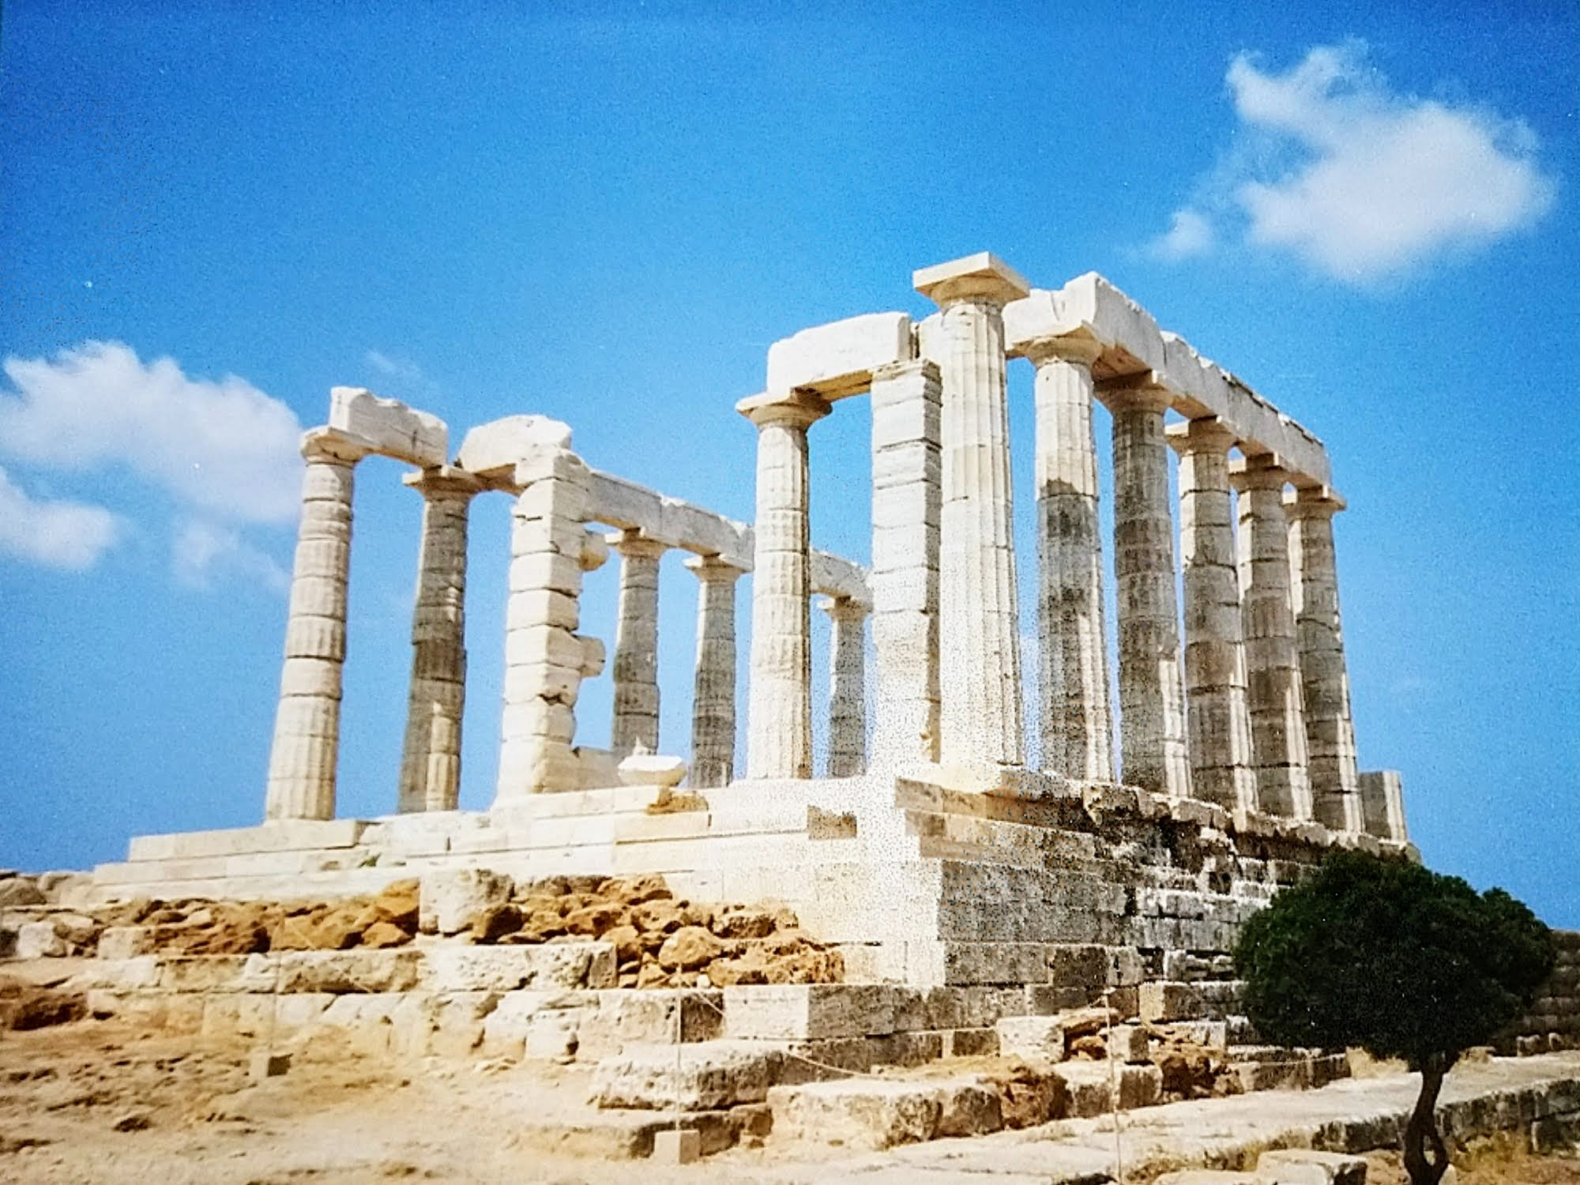
10. Project
Choose a country or place you are interested in. Find out about the country
Make a list of the things you associate with the culture of that country.
- Do you think the description refers to all people who live there?
- What are the stereotypes of this country or its people?
Present a short description to your group.
teachingenglish.org.uk

Slide 14
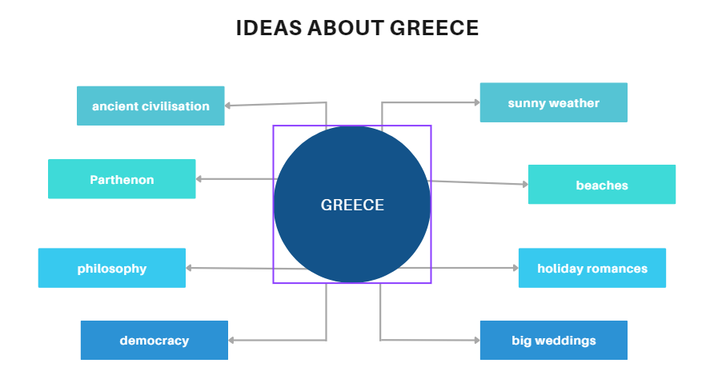
Project - example

