Slide 1
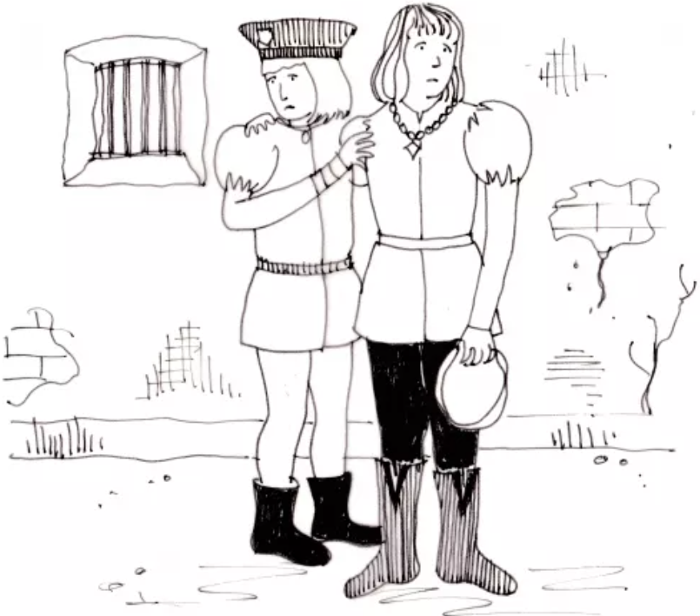
Propaganda in Shakespeare’s time; Richard III
https://www.teachingenglish.org.uk/

Slide 2
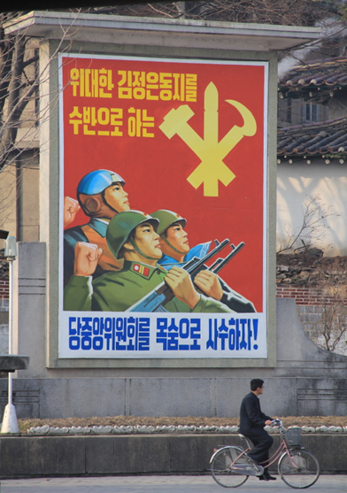
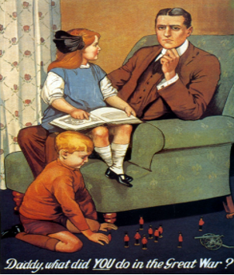
Talking about propaganda
When and where do you think these posters were produced?
Who is portrayed in each poster? What are the people doing, and where are they looking?
What are the artists trying to say in each poster?
Do you think these posters are successful? Why?/Why not?
https://www.teachingenglish.org.uk/

Slide 3
Quiz
1. Who was monarch when Shakespeare was a boy?
a. King James I b. Queen Victoria c. Queen Elizabeth I
2. What religion was this monarch?
a. Protestant b. Catholic c. Buddhist
3. What kind of person is King Richard in Shakespeare’s play Richard III?
a. romantic b. shy and sweet c. evil
4. What was the purpose of plays in Shakespeare’s times?
a. to instruct b. to entertain c. both a and b
5. Where was King Richard III’s body discovered in 2013?
a. under a church b. under a nightclub c. under a car park
https://www.teachingenglish.org.uk/

Slide 4
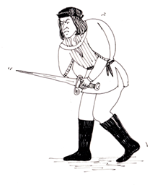
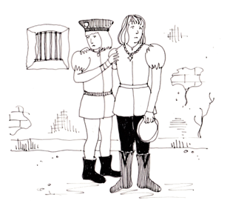
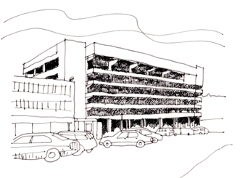
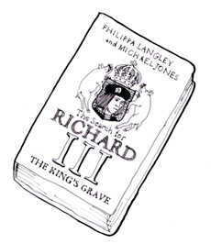
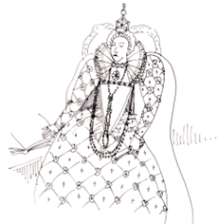
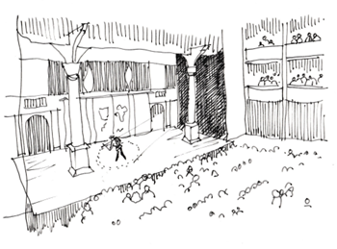
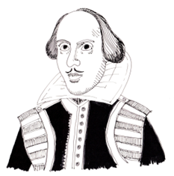
Predict the story
https://www.teachingenglish.org.uk/

Slide 5
https://www.teachingenglish.org.uk/

