Slide 1
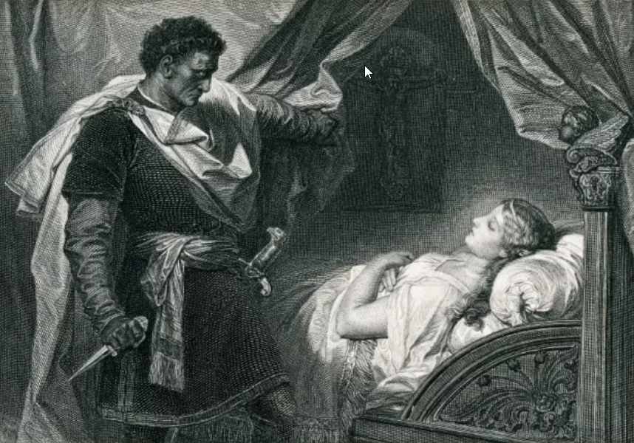
Ready, Steady – Tragedy!
https://www.teachingenglish.org.uk/

Slide 2
It’s a tragedy…
JORDAN’S TRAGIC LOVE SPLIT LEAVES STAR HEARTBROKEN
SCHOOL CLOSURE ‘TRAGEDY’ FOR LOCAL KIDS SAYS HEAD
GWYN’S RED CARPET LOOK ‘FASHION TRAGEDY’
https://www.teachingenglish.org.uk/

Slide 3
Task 1 - Features of a tragedy…
Which of the following would you expect to find in a tragedy?
Death
Lots of jokes
Madness
An uncomplicated hero
e. Violence
f. Strong emotions
g. People living happily ever after
https://www.teachingenglish.org.uk/

Slide 4
Task 3 – Check your understanding
Are these sentences true or false?
a. Elizabethan tragic heroes are often from poor families.
b. The best tragic heroes are totally wicked.
c. Many tragic heroes get into trouble because of their pride.
d. Tragic heroes need to experience a change in luck.
e. For a hero to be truly tragic he needs to see what he has done wrong.
f. The audience should feel totally depressed at the end of a tragedy.
https://www.teachingenglish.org.uk/

Slide 5
Task 4 – Defining words
a. pride
b. terrible pain and suffering
c. coming from the top level of society (e.g. prince, duchess, etc.)
d. knowledge about yourself and who you are on the inside
e. a change in luck
f. something bad about your personality which will result in your downfall
https://www.teachingenglish.org.uk/

Slide 6
Task 5 – Ready, steady – tragedy!
a prison | a castle | a lake | a church
a young prince | a king | a queen | a princess
pride | ambition | love | indecisiveness
a handkerchief | a letter | a knife | a sword
a ghost | a battle | a bed | a pillow
a graveyard | a chemist | a boat | a soldier
https://www.teachingenglish.org.uk/

Slide 7
Task 6 – Talking about tragedies
Copy and fill in the table about the characters in your reading:
a. Is there a tragic hero?
b. Does anyone die?
c. Which ‘ingredients of a tragedy’ can you identify?
d. Does anything positive happen at the end of the tragedy?
https://www.teachingenglish.org.uk/

Slide 8
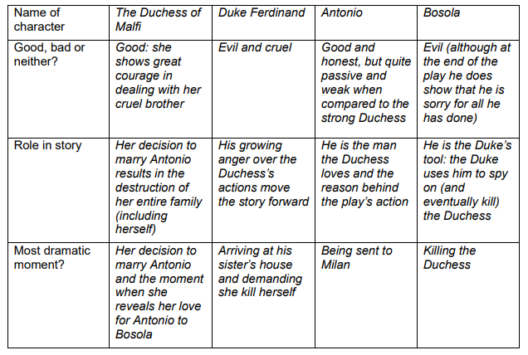
The Duchess of Malfi - answers
https://www.teachingenglish.org.uk/

Slide 9
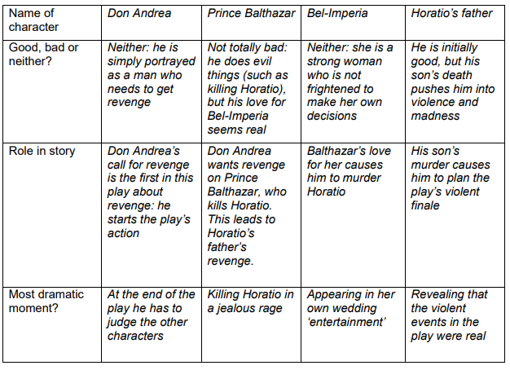
Spanish Tragedy - answers
https://www.teachingenglish.org.uk/

