Slide 1
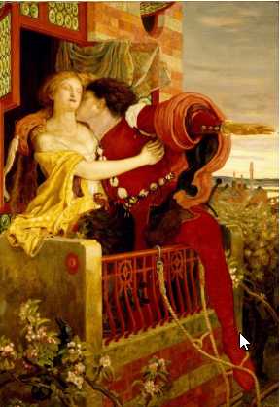
Romeo and Juliet - the world's favourite love story
https://www.teachingenglish.org.uk/

Slide 2
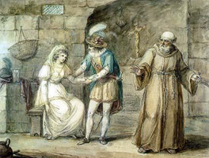
Imagine that you have just met the most fabulous and wonderful person and, incredibly, fallen in love. You are absolutely sure that they are the person you want to spend the rest of your life with. The only problem is that their family is at war with your family and your parents would never allow you to see each other.
What would you do and why?
• stop seeing this person so you don’t upset your family
• tell your family about the situation and hope they understand
• see the person in secret
• marry the person in secret
• move away to another place with the person
Is there anything else you could do?
https://www.teachingenglish.org.uk/

Slide 3
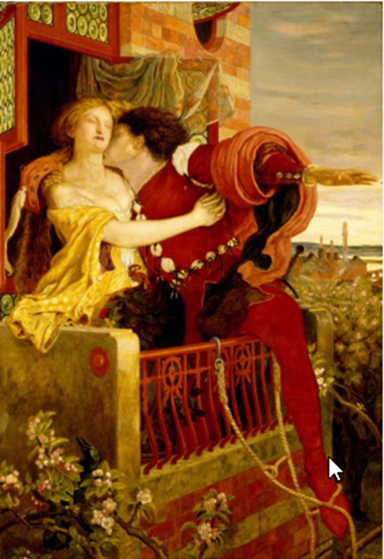
The plot
Romeo and Juliet is probably the most famous romantic story in the world. There have been thousands of productions of the play and many different versions of the film.
In the story, the two families of Capulet and Montague are at war with each other in the city of Verona in Italy. A Montague boy called Romeo and a Capulet girl called Juliet meet and fall in love – even though their families hate each other. The story is a tragedy and although Romeo and Juliet get married, they do not live happily, after a bloody and complex story, they each take their own lives.
https://www.teachingenglish.org.uk/

Slide 4
The main characters in Romeo and Juliet
1. who is / a young / Montague man / distracted by love. / Romeo is
2. who falls / Capulet girl / Juliet is a / in love / wrong person. / with the
3. is / Mercutio / Romeo’s / he is / the Capulets. / friend and / killed by
4. Friar Lawrence / in secret. / marries / Romeo and Juliet / is a priest who
5. marry / Juliet / Count Paris / wants to / love him. / but she / doesn’t
6. The Montagues / at war / with / the Capulets. / are
7. don’t want / Juliet / a Montague boy. / The Capulets / to marry
https://www.teachingenglish.org.uk/

Slide 5
The main characters- answers
1. Romeo is a young Montague man who is distracted by love.
2. Juliet is a Capulet girl who falls in love with the wrong person.
3. Mercutio is Romeo’s friend. He is killed by the Capulets.
4. Friar Lawrence is a priest who marries Romeo and Juliet in secret.
5. Count Paris wants to marry Juliet but she doesn’t love him.
6. The Montagues are at war with the Capulets.
7. The Capulets don’t want Juliet to marry a Montague boy.
https://www.teachingenglish.org.uk/

Slide 6
Task 2 – Props and themes
1.A balcony | a. you could use this to stop someone recognising you
2. A dagger | b. you could write a message on this
3. A letter | c. you could use this to stab someone
4. A rope | d. you could look out over the city from this
5. Some poison | e. you could use this to climb up a wall
6. A disguise | f. you could use this to get married
7. A ring | g. you want this if someone does something bad to you
8. revenge | h. you could use this liquid to kill someone.
9. passion | i. you feel this when you love someone or something very much
https://www.teachingenglish.org.uk/

Slide 7
Task 3: Prediction
a. Romeo falls in love with Juliet as soon as he sees her.
b. Juliet refuses to marry Count Paris.
c. Juliet kills herself.
d. Romeo kills himself.
e. The Capulets and Montagues make peace.
f. Juliet takes a drug that makes her look dead.
g. Romeo goes to a Capulet party in disguise.
h. The Prince of Verona rules that anyone caught fighting will be executed. (1)
i. Romeo and Juliet get married.

Slide 8
Task 5:Motivations
1. Why does the Prince of Verona order all the fighting between the Montagues and
Capulets to stop?
2. Why does Romeo sneak into the ball?
3. Why don’t the Capulets kill Romeo when they discover him at their party?
4. Why does Friar Lawrence agree marry Romeo and Juliet?
5. Why does Juliet want to leave Verona?
6. Why does Juliet take a drug to make it look as if she is dead?
7. Why does Romeo kill himself?
8. Why does Juliet kill herself?

Slide 9
Task 6: Discussion
‘Romeo and Juliet were stupid kids; they shouldn’t have fallen in love with each other because they knew it was wrong.’ Do you agree with this?
Would you have acted differently if you were Romeo or Juliet?
Do you think modern audiences would like watching Romeo and Juliet? Does the play have anything to say in the modern world?
Do you think love is more important than anything else?

