Slide 1
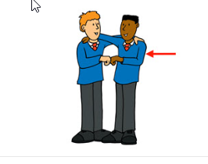
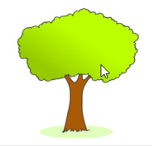
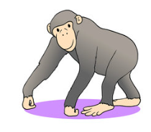
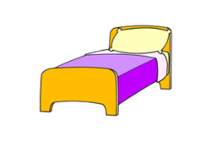
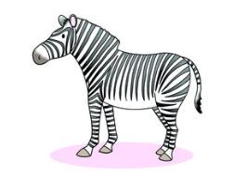
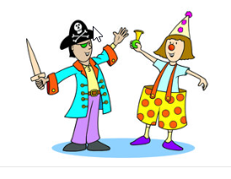
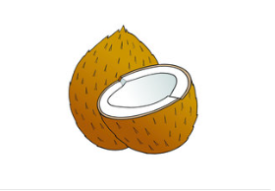
The alphabet song
3. F
1. T
2. J
5. B
4. Ch
6. Z
8. P
7. C
http://www.teachingenglish.org.uk

Slide 2
I’m in the jungle in a coconut tree.
Do you want to come and play?
I will bring a friend or two.
A zebra and a chimpanzee.
We’ll play until it’s time for bed

