Slide 1
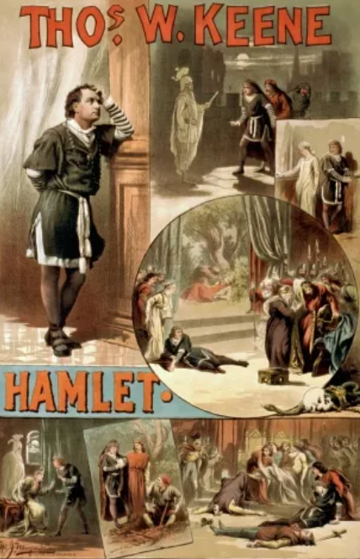
To be or not to be…
www.teachingenglish.org.uk

Slide 2
A happy life
Which THREE of these are most important to make you happy? Discuss them with your partner and see if you agree.
a. having good friends
b. being in a loving relationship
c. doing a satisfying, well-paid job
d. having a loving family around you
e. being able to travel wherever you want
f. studying and learning about things that interest you
www.teachingenglish.org.uk

Slide 3
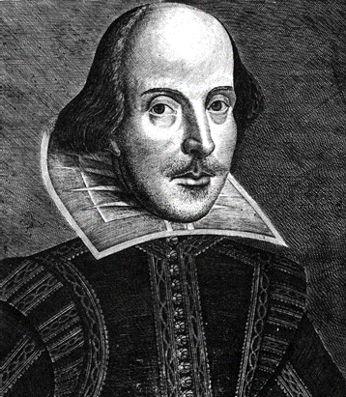
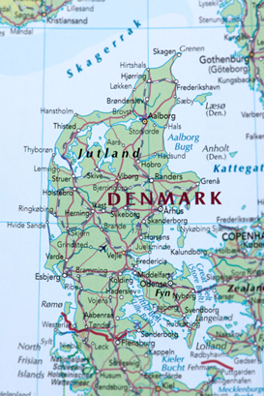
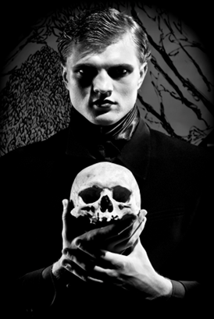
Introducing Hamlet
What do you think is the connection between these pictures?
www.teachingenglish.org.uk

Slide 4
Describing Hamlet
How would you describe Hamnet?
prosperous elderly unimportant youthful
morbid depressed deprived cheerful
www.teachingenglish.org.uk

Slide 5
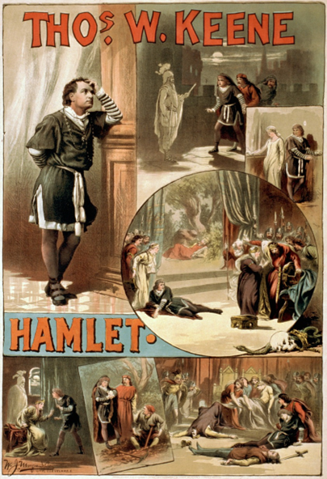
Features of Hamlet
Looking at this advert for a performance of Hamlet, which of the following do you think might feature in the play?
• the appearance of a ghost
• many jokes
• a mysterious death
• depression
• a happy ending
• suicide
• unhappy love
• execution
• murder
www.teachingenglish.org.uk

Slide 6
Information gap
Read your information and use it to complete three of the sentences below.
1. Hamlet is the ____________ of Denmark.
2. Hamlet’s best friend is ________________.
3. ____________ has been killed.
4. _______________ has just married Hamlet’s uncle.
5. Hamlet thinks ___________ is a murderer.
6. Hamlet was in love with _______________.
7. ________________ and _____________ are at university with Hamlet.
8. _____________ may invade Denmark soon.
9. Hamlet lives in a ________________.
www.teachingenglish.org.uk

Slide 7
Information gap answers
Hamlet is the Prince of Denmark.
2. Hamlet’s best friend is Horatio
3. His father has been killed.
4. His mother has just married Hamlet’s uncle.
5. Hamlet thinks his uncle is a murderer.
6. Hamlet was in love with Ophelia.
7. Rosencrantz and Guildenstern are at university with Hamlet.
8. Norway may invade Denmark soon.
9. Hamlet lives in a castle.
www.teachingenglish.org.uk

Slide 8
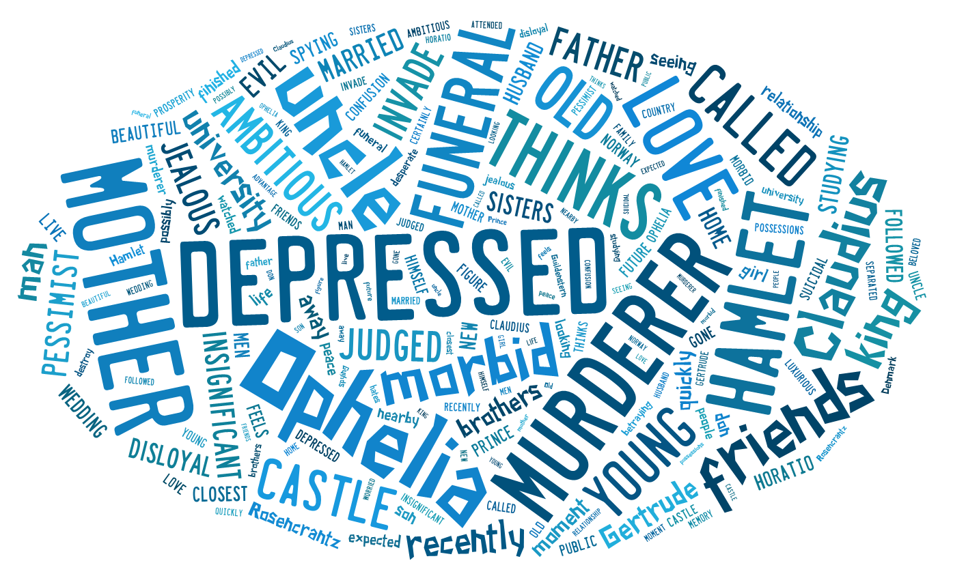
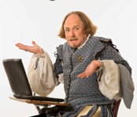
Hamlet’s diary
Hamlet writes a secret diary . Imagine you are Hamlet and write his thoughts for this day. Include his thoughts about his family, his friends, his social situation, and life in general.
Below are some words that could appear in the text.
.
www.teachingenglish.org.uk

