Slide 1
A Midsummer Night’s Dream in Pictures
TeachingEnglish lesson

Slide 2
A Midsummer Night’s Dream in Pictures
Lead-in: Ask and answer questions about ‘A Midsummer’s Night Dream’ using the words in the box.
woods marry donkey potion Titania mistake Puck fall in love a play quarrel

Slide 3
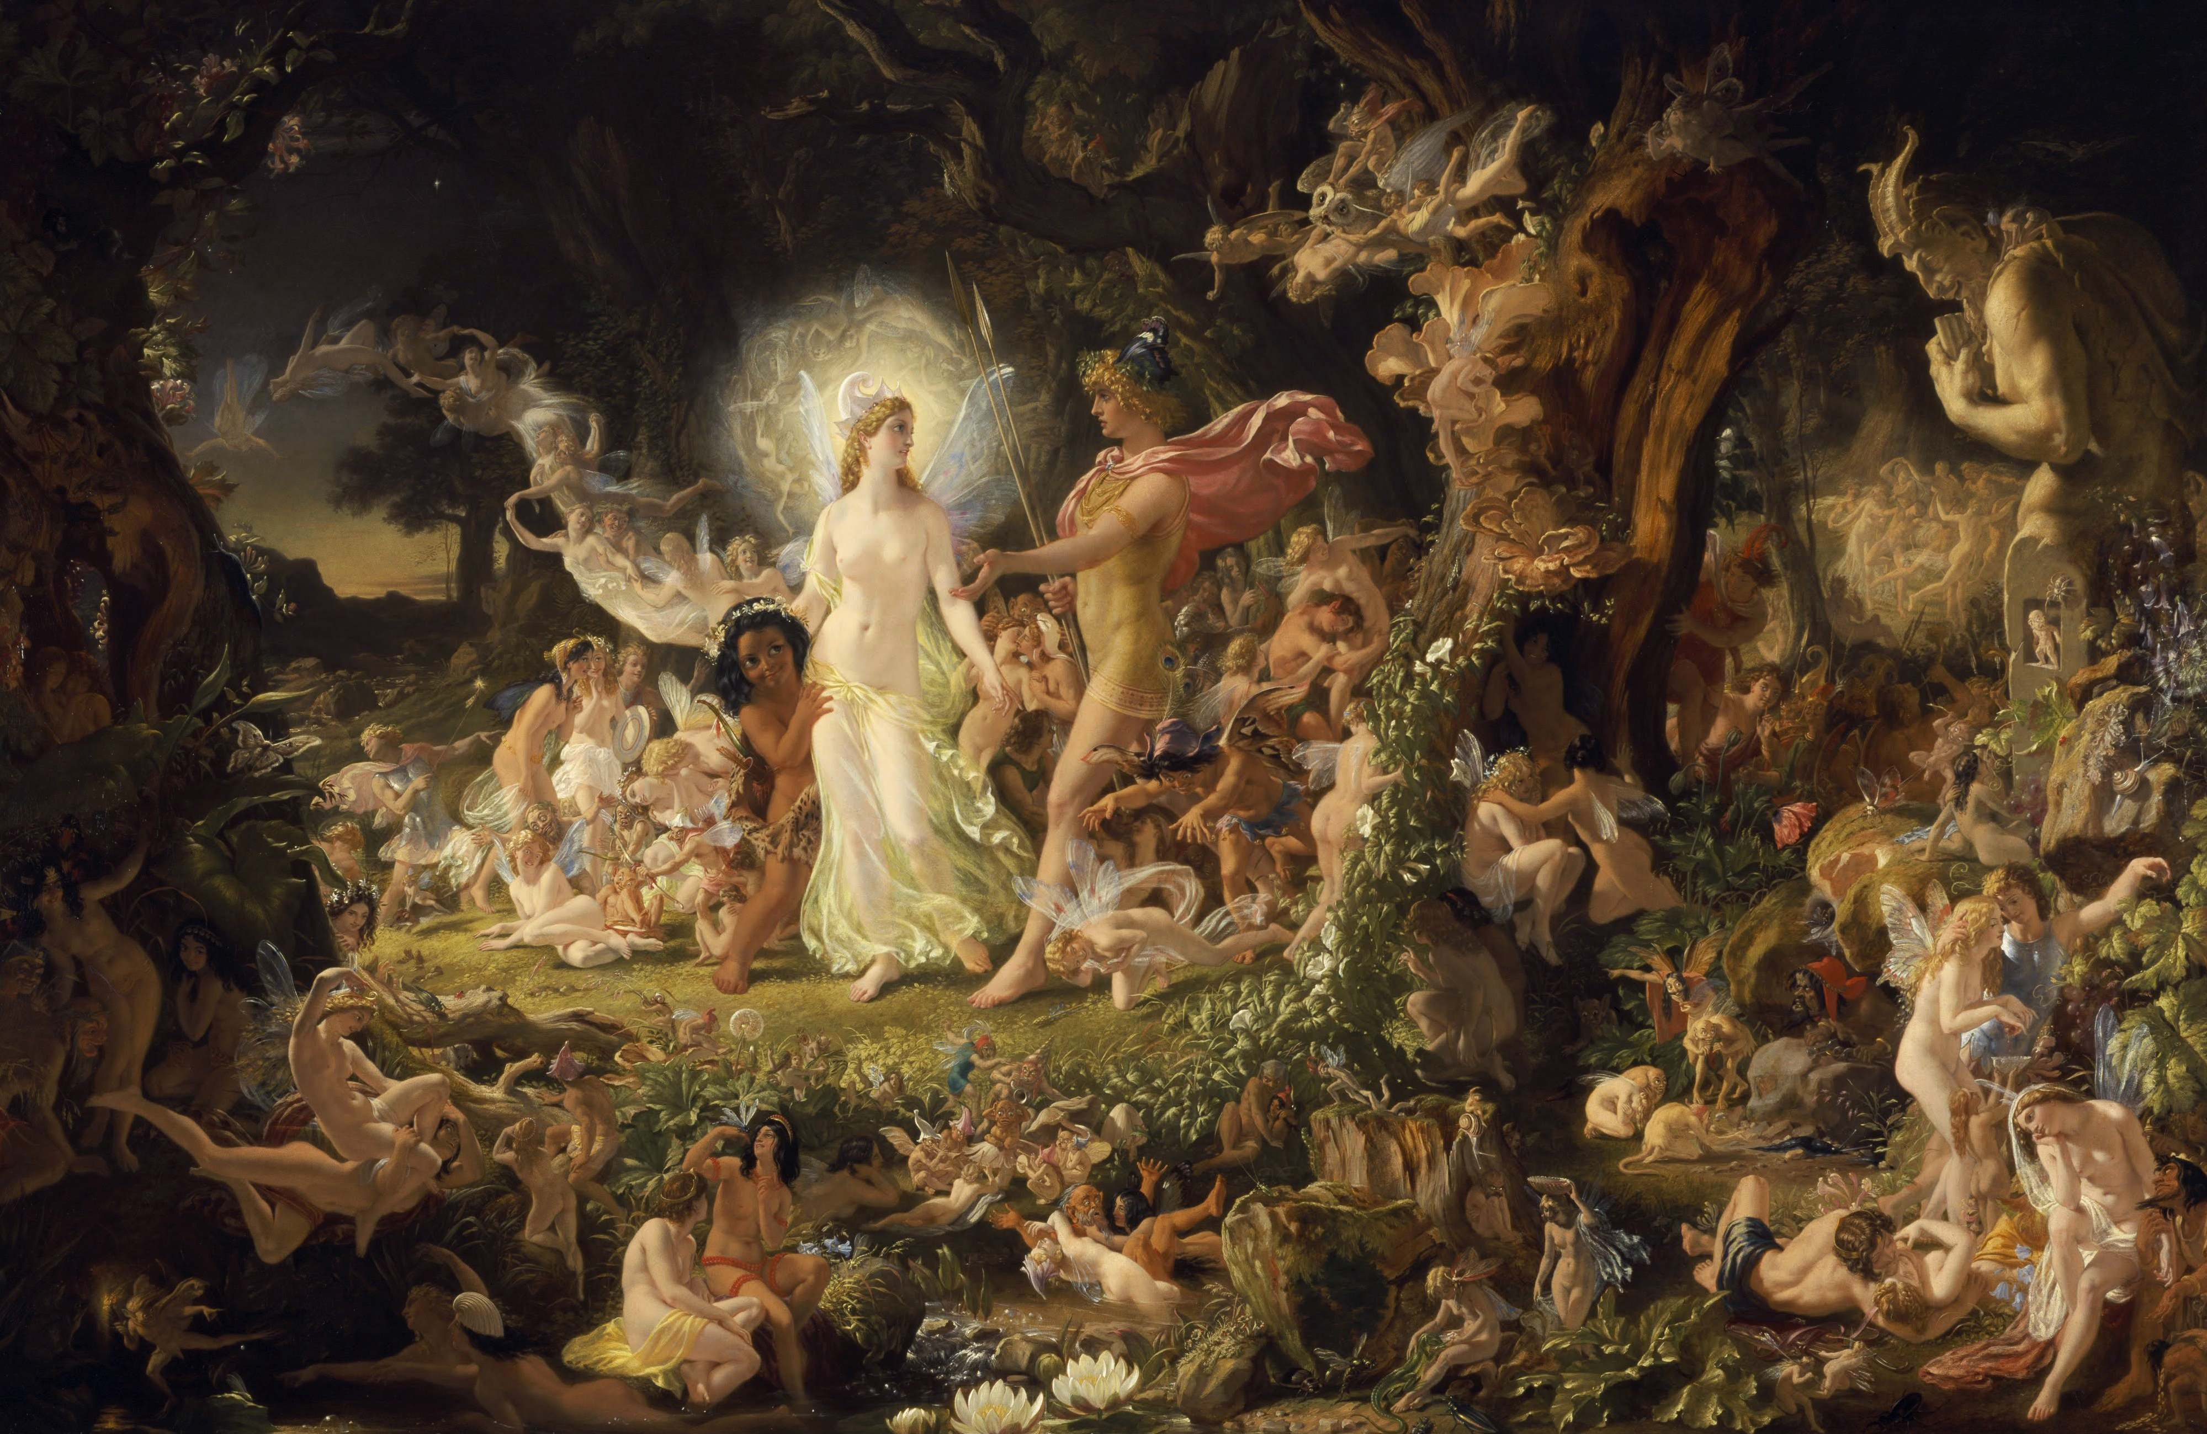
A Midsummer Night’s Dream in Pictures
Task 1: Look at the painting.
Which moment of the play does it represent?

Slide 4
A Midsummer Night’s Dream in Pictures
Task 1: Look at the painting.
It is ‘The Quarrel of Oberon and Titania’ (1850) by Joseph Noel Paton.
What do you think about the painting?

Slide 5
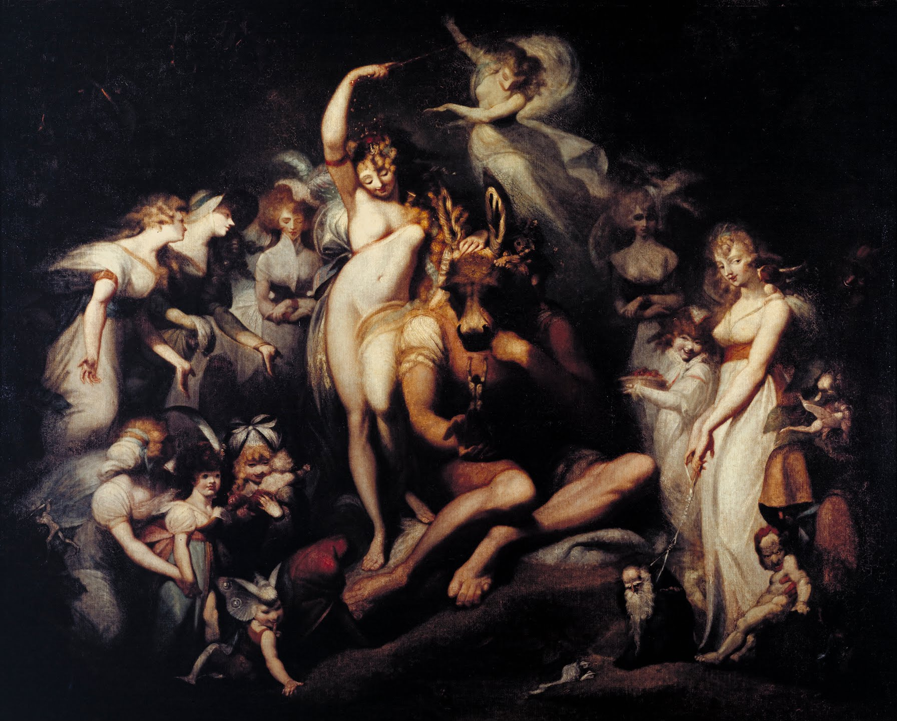
A Midsummer Night’s Dream in Pictures
Task 1: Look at the painting.
Which moment of the play does it represent?

Slide 6
A Midsummer Night’s Dream in Pictures
Task 1: Look at the painting.
It is ‘Titania and Bottom’ (1790) by Henry Fuseli.
What do you think about the painting?

Slide 7
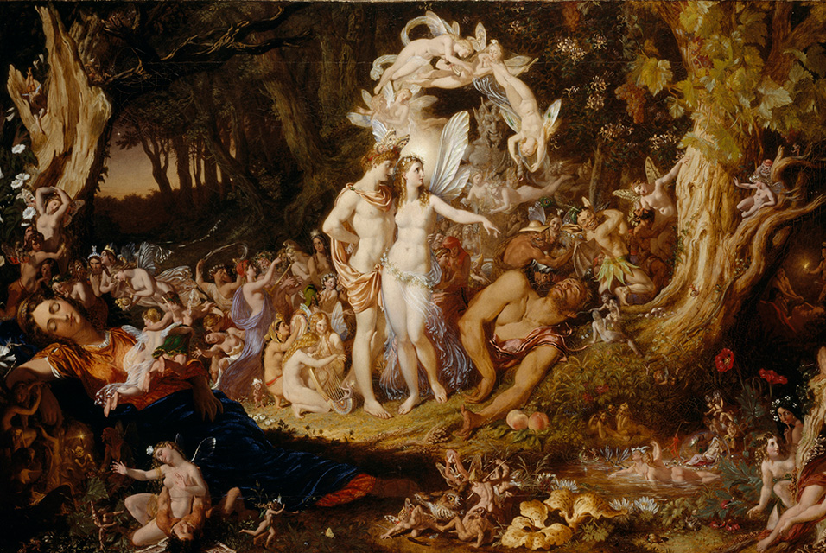
A Midsummer Night’s Dream in Pictures
Task 1: Look at the painting.
Which moment of the play does it represent?

Slide 8
A Midsummer Night’s Dream in Pictures
Task 1: Look at the painting.
It is ‘The Reconciliation of Oberon and Titania’ (1847) by Joseph Noel Paton.
What do you think about the painting?

Slide 9
A Midsummer Night’s Dream in Pictures
Task 2A: Read the first four lines of the dialogue from Act IV Scene I.
TITANIA
Come, sit thee down upon this flowery bed, While I thy amiable cheeks do coy, And stick musk-roses in thy sleek smooth head, And kiss thy fair large ears, my gentle joy.
Match it to one of the paintings.

Slide 10
A Midsummer Night’s Dream in Pictures
Task 2B: Read the rest of the dialogue.
Who are Peaseblossom, Cobweb and Mustardseed?
What does Bottom ask them to do?
BOTTOM | Where's Peaseblossom? Scratch my head Peaseblossom. Where's Mounsieur Cobweb?
COBWEB | Ready.
BOTTOM | Mounsieur Cobweb, good mounsieur, get you your weapons in your hand, and kill me a red-hipped humble-bee on the top of a thistle; and, good mounsieur, bring me the honey-bag. Where's Mounsieur Mustardseed?
MUSTARDSEED | Ready. What's your Will?
BOTTOM | Nothing, good mounsieur, but to help Cavalery Cobweb to scratch. I must to the barber's, monsieur; for methinks I am marvellous hairy about the face; and I am such a tender ass, if my hair do but tickle me, I must scratch.
TITANIA | What, wilt thou hear some music, my sweet love? Sleep thou, and I will wind thee in my arms. Fairies, begone, and be all ways away.

Slide 11
A Midsummer Night’s Dream in Pictures
Task 2C: Look at the painting.
Find some of the characters from the dialogue in the painting.
Describe some of the characters in the painting.
Find something in the painting which symbolizes the triumph of youth over old age.

Slide 12
A Midsummer Night’s Dream in Pictures
Task 3: Complete the description of the painting with words and phrases from the box.
beside In the foreground In the centre To his right a symbol of
(1) __________________________ of the painting, Bottom is sitting on the ground. We can see he has the body of a man and the head of a donkey. Titania is (2) ________________________ him. She is calling upon her fairies to look after Bottom and get him everything he needs. One fairy scratches Bottom’s head; Mustardseed perches on his hand and Cobweb has killed a bee and is bringing him the honey-bag. (3) __________________________, a young woman offers him a basket of dried peas. (4) __________________________, a young woman is leading a small doll-like creature by a string. She is (5) __________________________ the triumph of youth over old age.

Slide 13
A Midsummer Night’s Dream in Pictures
Task 4: Look at ‘The Quarrel of Oberon and Titania’ (1850) by Joseph Noel Paton.
Describe some characters in the painting. Can others guess?

Slide 14
A Midsummer Night’s Dream in Pictures
Task 4: Look at ‘The Reconciliation of Oberon and Titania’ (1847) by Joseph Noel Paton.
Describe some characters in the painting. Can others guess?

Slide 15
A Midsummer Night’s Dream in Pictures
TeachingEnglish lessons
Thanks for attending the lesson

