Slide 1
Upcycling
Classroom presentation

Slide 2
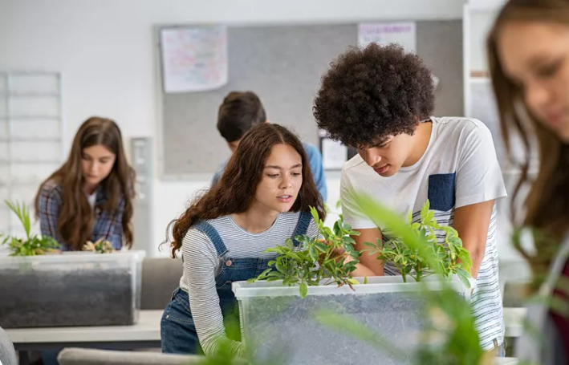
Is it a word?
Which 3 words are real?
Upcycle
Down cycle
Pro cycle
Com cycle
recycle
www.teachingenglish.org.uk
© British Council 2021 The United Kingdom’s international organisation for educational opportunities and cultural relations. We are registered in England as a charity.

Slide 3
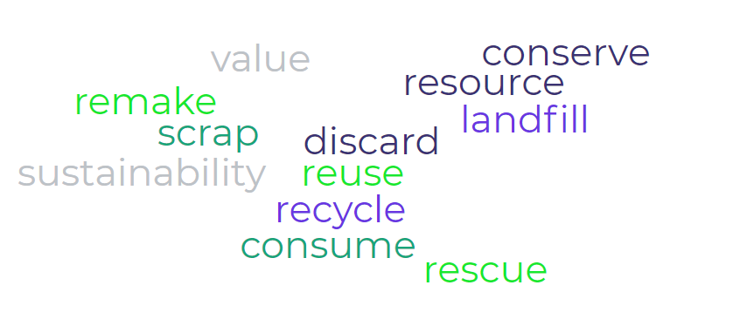
Vocabulary

Slide 4
Reading 1
The rise and rise of upcycling
Do you know the difference between recycling, upcycling and downcycling?
We handle 1. __________ materials and waste in different ways depending on how they can be used. When we transform a product into something which has less 2. __________ than the original, we are downcycling. This happens with paper, which is 3. __________ into a lower-grade recycled paper. Downcycling is still recycling – and a good thing to do. But upcycling is even better.
www.teachingenglish.org.uk
© British Council 2021 The United Kingdom’s international organisation for educational opportunities and cultural relations. We are registered in England as a charity.

Slide 5
Reading 2
This happens when we transform a product into something which has a greater value than the original. For example, when clothes are made in a factory, there are 4.__________ of material left over that are thrown away because they have no immediate value. These scraps are usually destined to be burnt or sent to a 5. __________ site. If, instead, these scraps are 6. __________ and sewn together to make a bag or a wallet, the finished product has increased in value and become useful to someone.
Upcycling extends the life of materials. It also 7. __________ valuable 8. __________. If we make a bag out of throwaway scraps, we don’t need to use brand-new material, which often requires huge quantities of water and energy.
www.teachingenglish.org.uk
© British Council 2021 The United Kingdom’s international organisation for educational opportunities and cultural relations. We are registered in England as a charity.

Slide 6
Reading 3
According to the Macmillan dictionary, ‘there is some evidence for use of the word upcycle as far back as 1994, but the term was first brought into the spotlight by US architect William McDonough and German chemist Michael Braungart in a 2002 book entitled Cradle to Cradle: 9. __________ the Way We Make Things’. As people have become more interested in 10. __________ and finding ways to 11. __________ less and 12. __________ more, upcycling has become increasingly more popular with businesses and individuals.
www.teachingenglish.org.uk
© British Council 2021 The United Kingdom’s international organisation for educational opportunities and cultural relations. We are registered in England as a charity.

Slide 7
Reading 4
In 2019, Cambridge Dictionary named upcycling as its Word of the Year. It had been in the online dictionary since December 2011 but by 2018 the number of searches rose by 181%.
According to Wendalyn Nichols, Publishing Manager of the Cambridge Dictionary, ‘We think it’s the positive idea behind upcycling that appeals more than the word itself. Stopping the progression of climate change, let alone reversing it, can seem impossible at times. Upcycling is a concrete action a single human being can take to make a difference.’
www.teachingenglish.org.uk
© British Council 2021 The United Kingdom’s international organisation for educational opportunities and cultural relations. We are registered in England as a charity.

Slide 8
Discussion
Reading
The writer says, ‘Upcycling is a concrete action a single human being can take to make a difference.’ What do they mean by this?
What kinds of things can you upcycle?
Describe something you upcycled or an upcycling idea.
www.teachingenglish.org.uk
© British Council 2021 The United Kingdom’s international organisation for educational opportunities and cultural relations. We are registered in England as a charity.

Slide 9
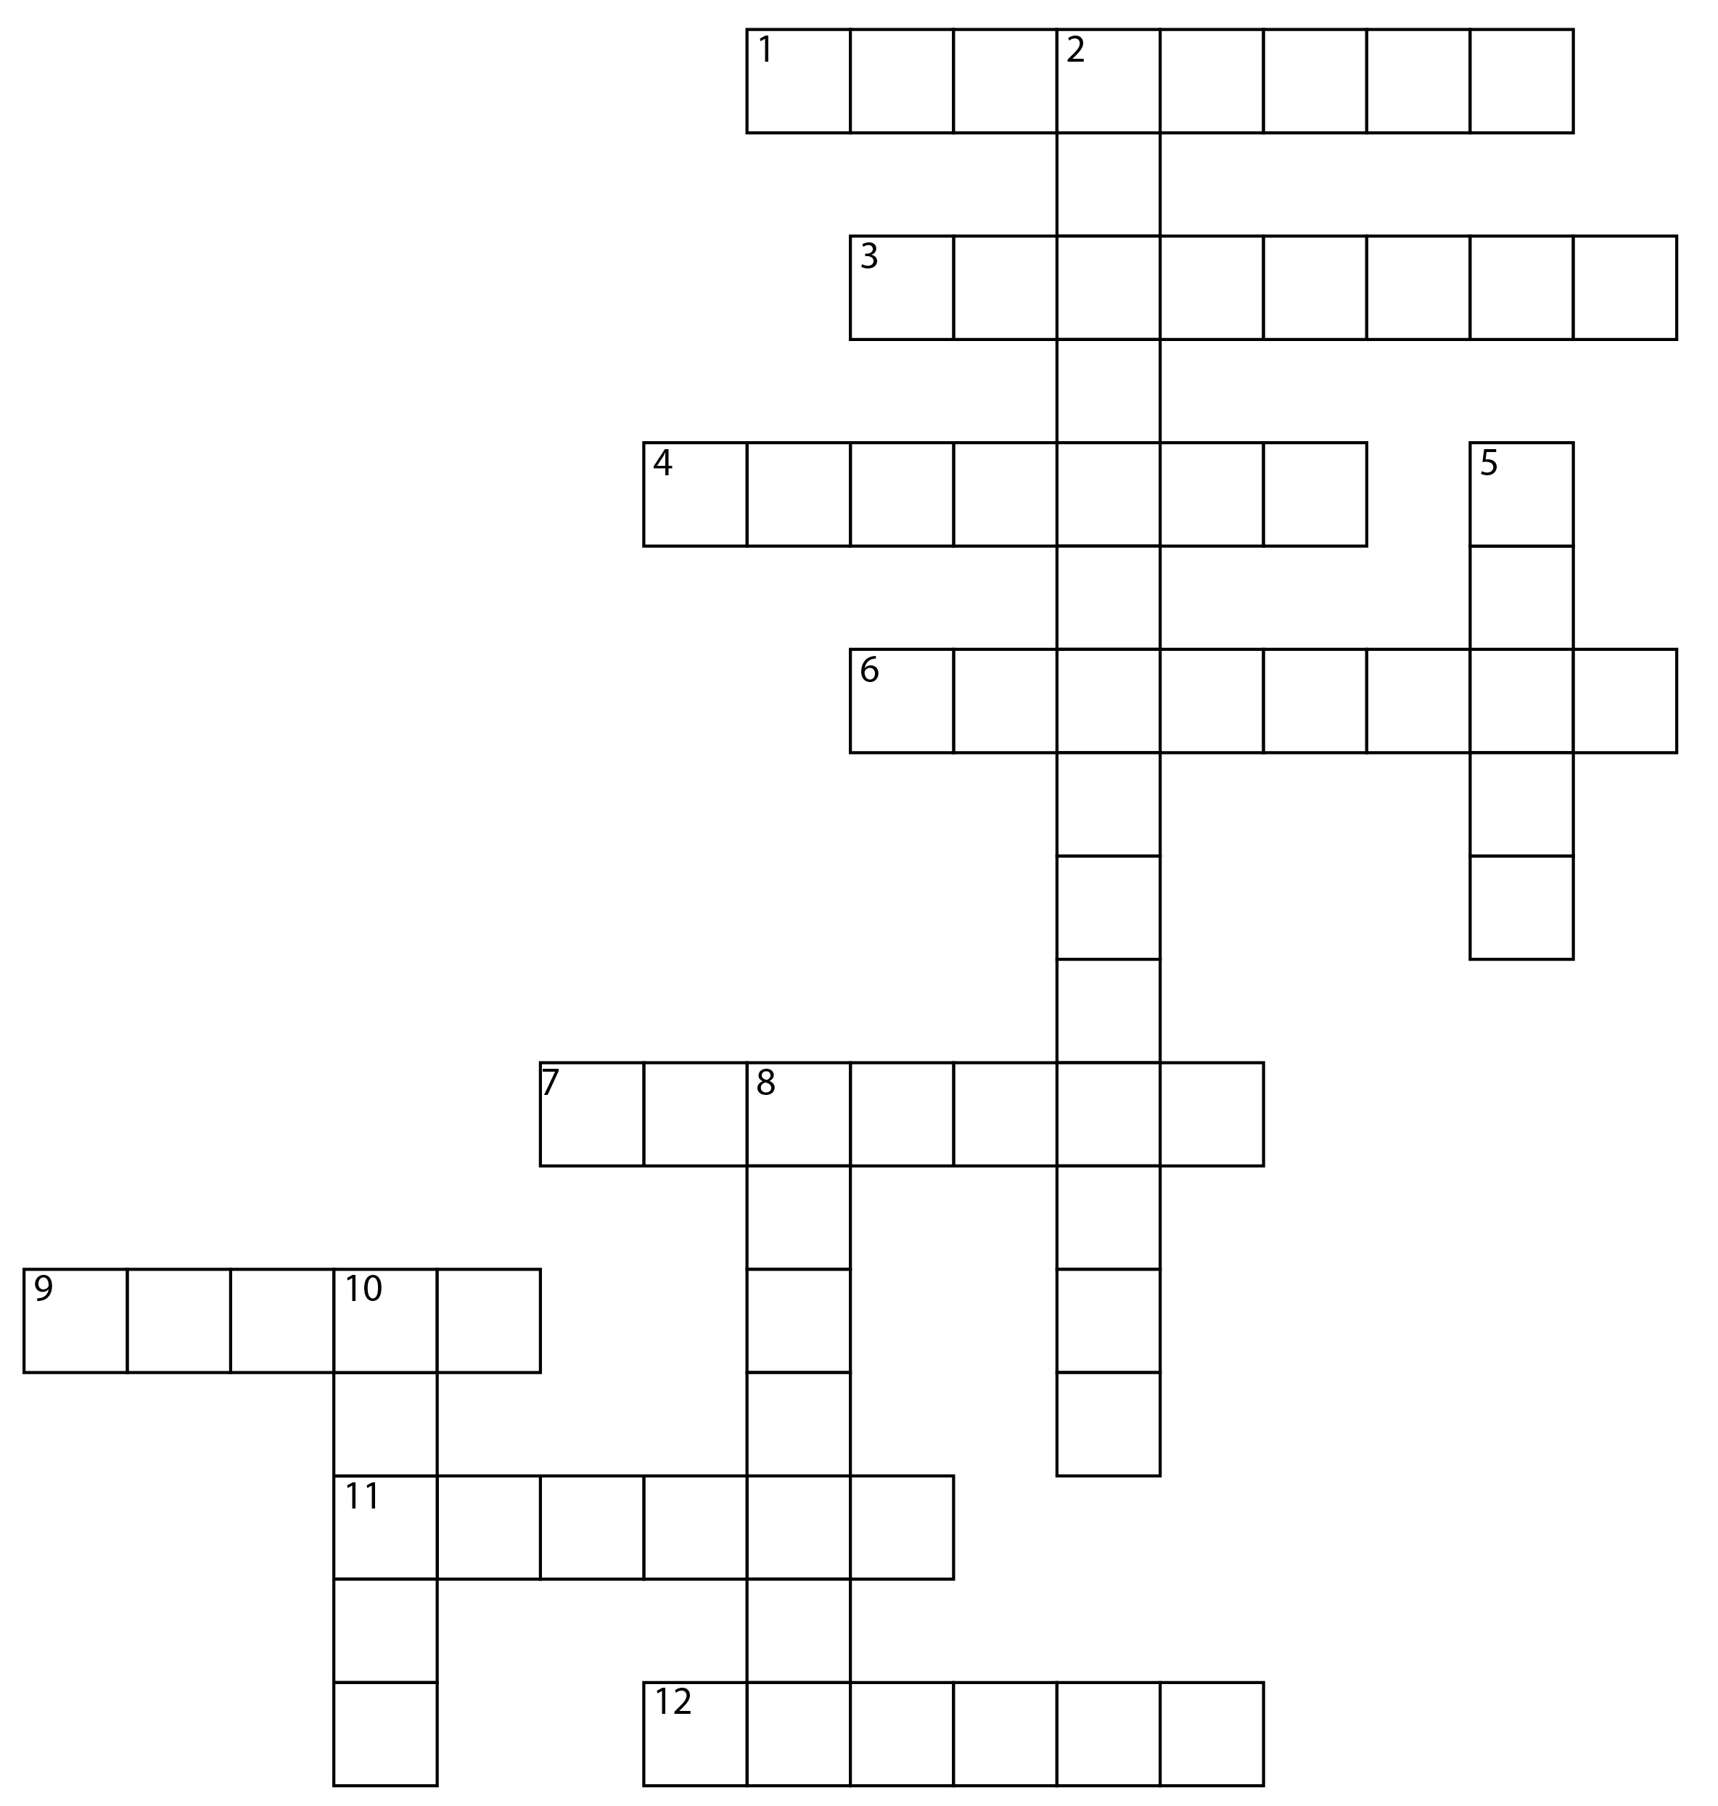
Crossword
Across
Protect something from harm (v)
Supply of materials (n)
Get rid of something (v)
Area filled with waste material (n)
Change waste into reusable stuff (v)
Use something again (v)
Keep something from being lost or thrown away (v)
Make something again (v)
Down
Avoidance of depletion of a natural resource to keep an ecological balance
What something is worth
Eat or buy
Small amount of something left over
www.teachingenglish.org.uk
© British Council 2021 The United Kingdom’s international organisation for educational opportunities and cultural relations. We are registered in England as a charity.

Slide 10
Crossword
c o n s e r v e
u
Answers:
r e s o u r c e
t
Across
conserve
resource
discard
landfill
recycle
reuse
rescue
remake
Down
sustainability
value
consume
scrap
d i s c a r d
v
i
a
l a n d f i l l
a
u
b
e
i
r e c y c l e
o
i
r e u s e
n
t
c
s
y
r e s c u e
a
m
p
r e m a k e
www.teachingenglish.org.uk
© British Council 2021 The United Kingdom’s international organisation for educational opportunities and cultural relations. We are registered in England as a charity.

Slide 11
Upcycling project
Read the information below about an upcycling project.
New product | A denim tote bag
Old product | A pair of jeans
Description | A spacious tote bag with strong handles, pockets and an optional zip
Materials | A pair of jeans, strong cotton, a needle, sewing pins, scissors
Optional | A sewing machine
www.teachingenglish.org.uk
© British Council 2021 The United Kingdom’s international organisation for educational opportunities and cultural relations. We are registered in England as a charity.

Slide 12
Upcycling project
Step 1 | Cut bottoms off the two legs (about 45cm). Cut along the inside seam of each section and open to a square
Step 2 | Measure and draw a square (about 8cm x 8cm) on the two bottom corners of each piece. Cut out the squares, leaving a large, fat T-shape.
Step 3 | Place one of the pieces on top of the other. with the outsides facing inwards, and sew the pieces together along the two (long) sides and across the bottom (the base of the T).
Step 4 | Turn the bag the right way round so that the outside is visible.
Step 5 | Cut the waistband from the old jeans and remove the button and any loose cotton. Then cut the strip into two equal halves for the handles. Sew each handle in place.
Optional | Add the jeans’ pockets to the tote bag and decorate as you wish.

Slide 13
Upcycling
New product | A denim tote bag
Old product | A pair of jeans
Description | A spacious tote bag with strong handles, pockets and an optional zip
Materials | A pair of jeans, strong cotton, a needle, sewing pins, scissors
Optional | A sewing machine
Step 1 | Cut bottoms off the two legs (about 45cm). Cut along the inside seam of each section and open to a square
Step 2 | Measure and draw a square (about 8cm x 8cm) on the two bottom corners of each piece. Cut out the squares, leaving a large, fat T-shape.
Step 3 | Place one of the pieces on top of the other, with the outsides facing inwards, and sew the pieces together along the two (long) sides and across the bottom (the base of the T).
Step 4 | Turn the bag the right way round so that the outside is visible.
Step 5 | Cut the waistband from the old jeans and remove the button and any loose cotton. Then cut the strip into two equal halves for the handles. Sew each handle in place.
Optional | Add the jeans’ pockets to the tote bag and decorate as you wish.
How is the information organised?
Is the information clear?
Which verb form is used to give instructions?
Is there anything that would make the information clearer?
www.teachingenglish.org.uk
© British Council 2021 The United Kingdom’s international organisation for educational opportunities and cultural relations. We are registered in England as a charity.

Slide 14
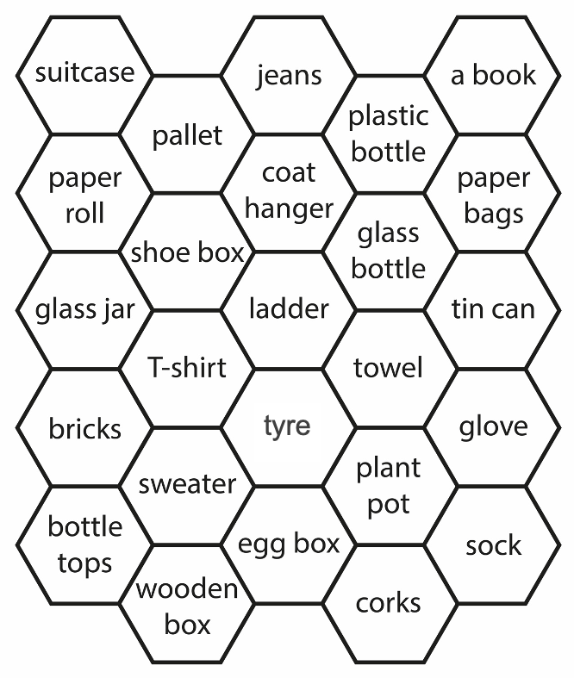
Upcycling game
www.teachingenglish.org.uk
© British Council 2021 The United Kingdom’s international organisation for educational opportunities and cultural relations. We are registered in England as a charity.

Slide 15
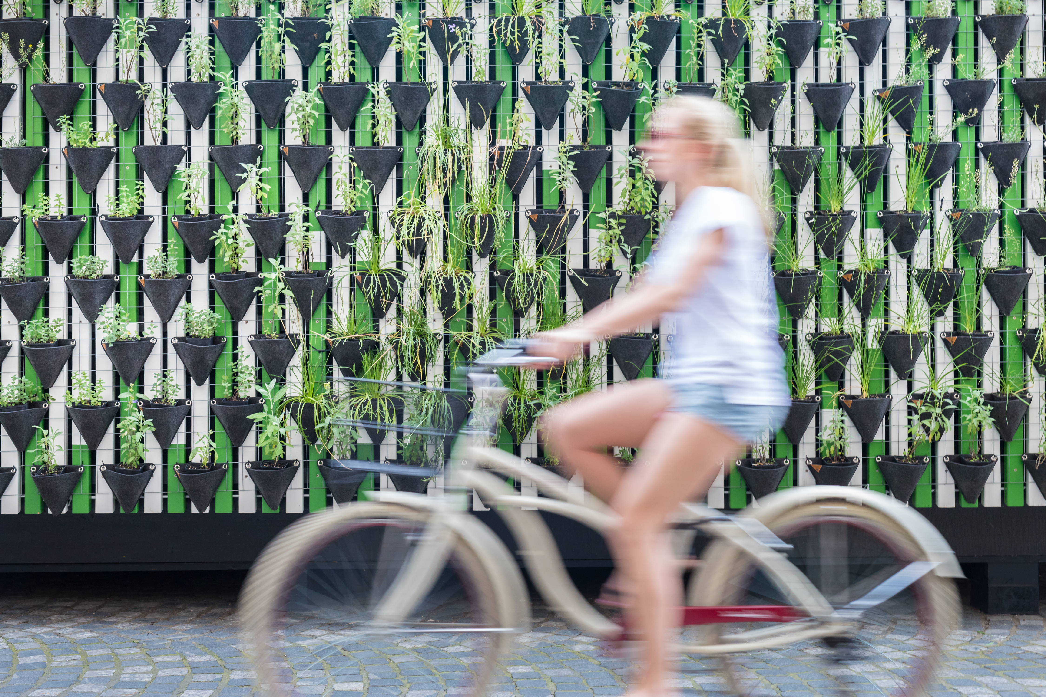
Mini project
1. research 2. plan 3. prepare 4. present
www.teachingenglish.org.uk
© British Council 2021 The United Kingdom’s international organisation for educational opportunities and cultural relations. We are registered in England as a charity.

Slide 16
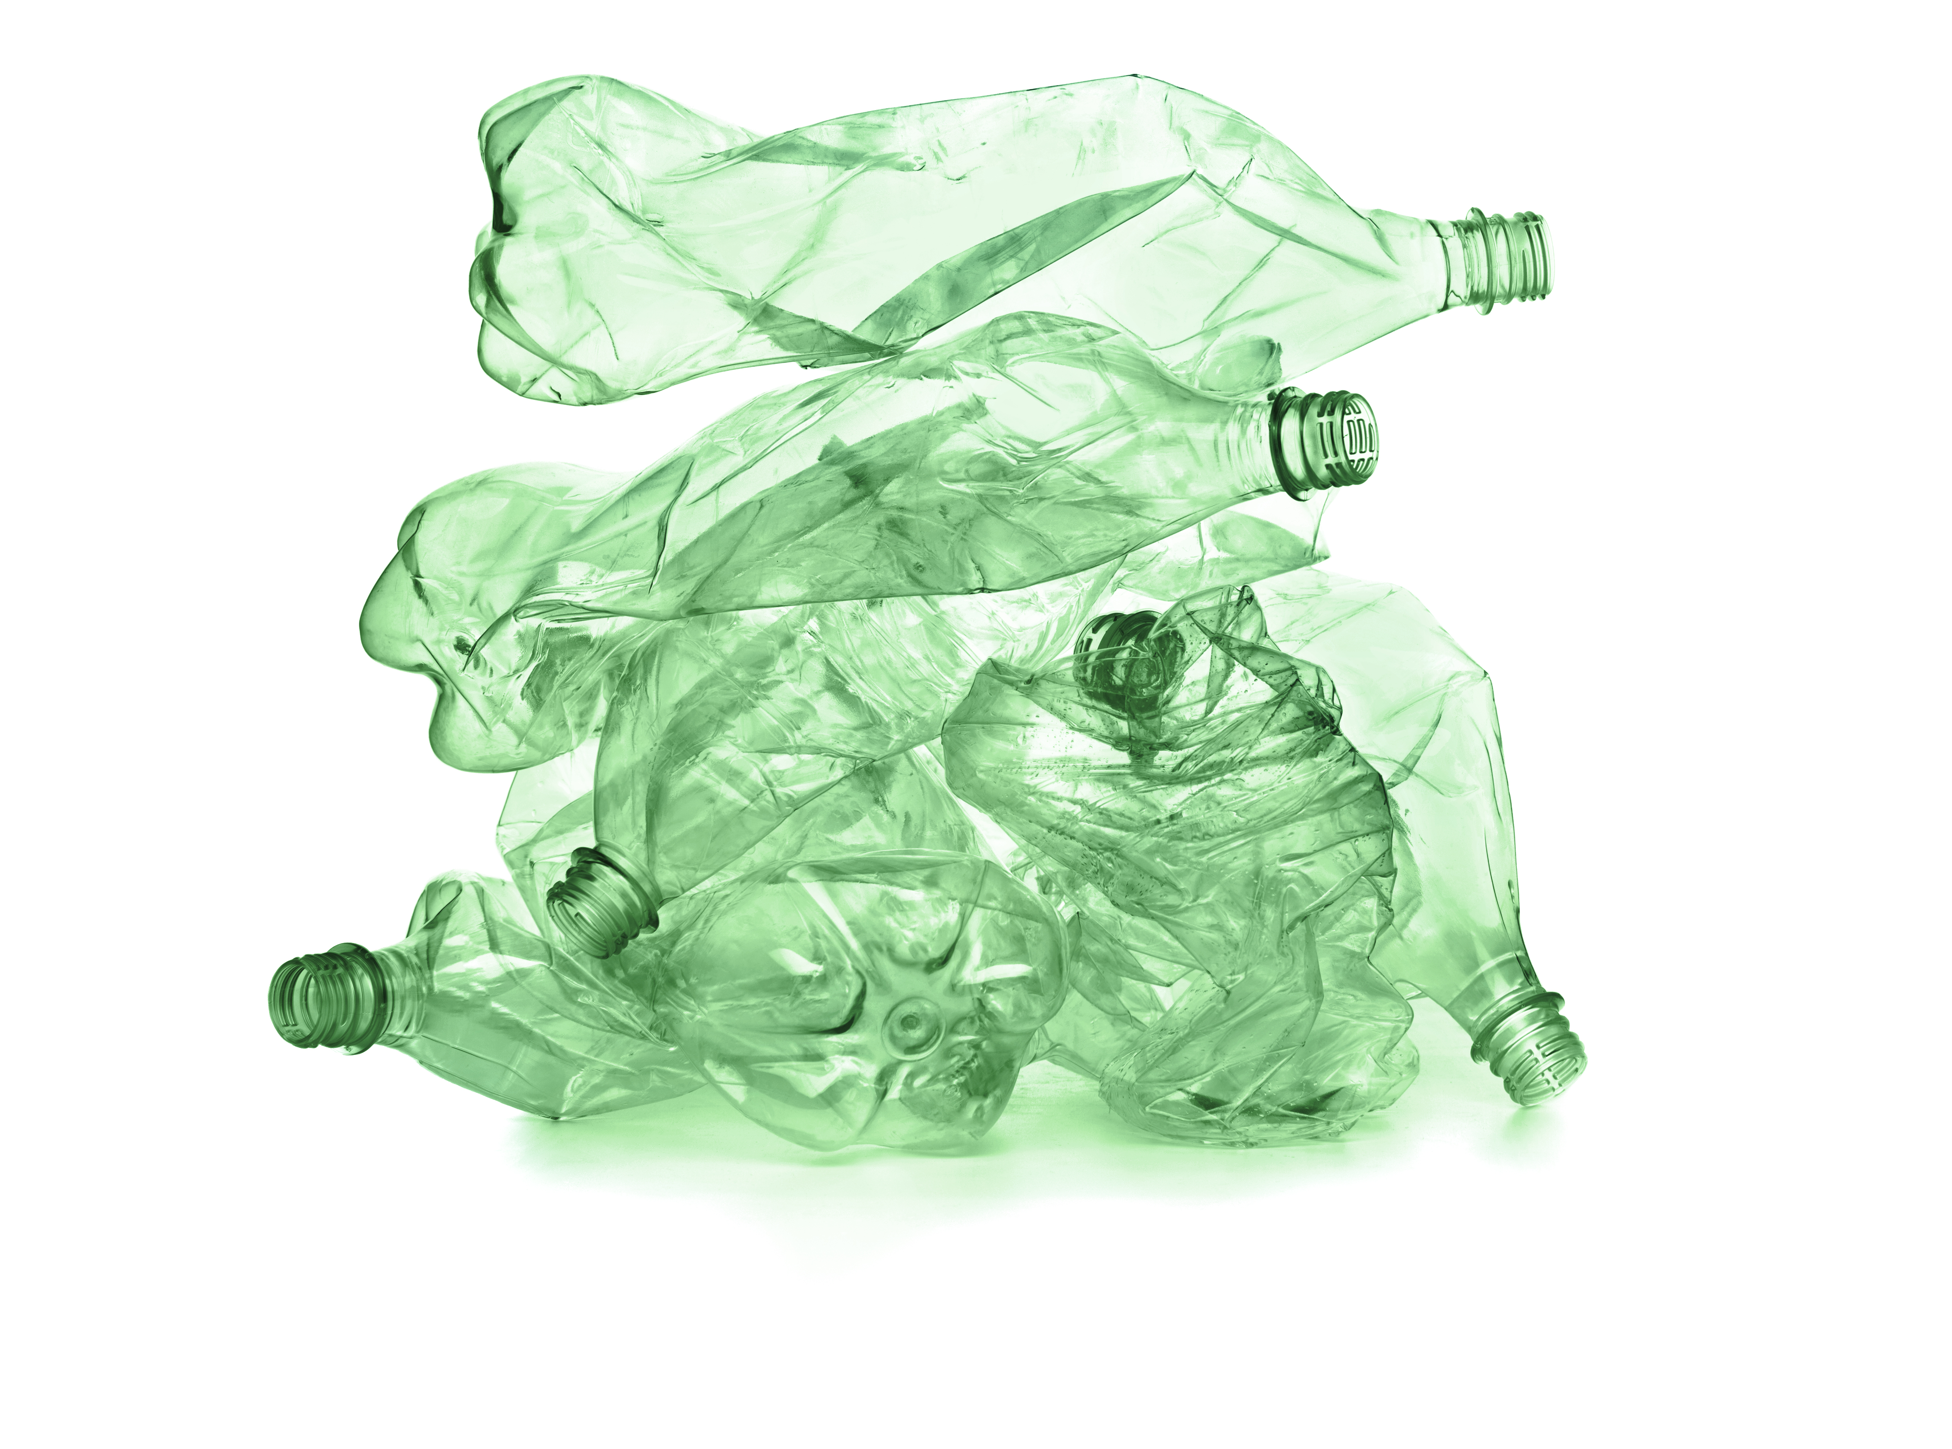
Upcycling
www.teachingenglish.org.uk
© British Council 2021 The United Kingdom’s international organisation for educational opportunities and cultural relations. We are registered in England as a charity.

