Slide 1
Water for all
The global water crisis – causes and solutions
Classroom presentation

Slide 2
Learning outcomes
During and after the lesson, learners will be able to demonstrate they can:
employ critical-thinking skills
• read texts to find specific types of information
• collaborate and share written information
• create simple written messages that lead to action an awareness.

Slide 3
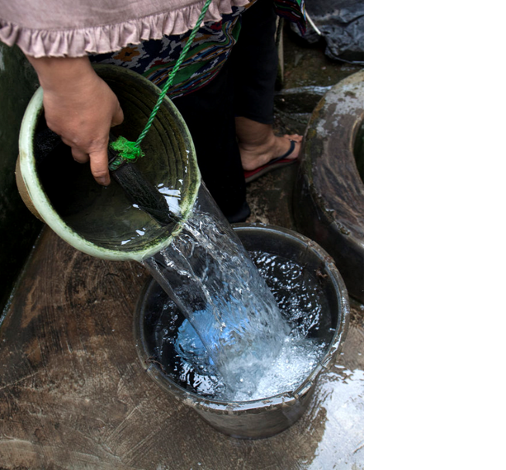
Water crisis
What is the water crisis?
Many rural communities globally
have no clean water for drinking, washing or cooking.

Slide 4
A poster
You are going to design a poster explaining what the water crisis is and its causes.
Your poster will be designed to encourage people to take action about the water crisis.
www.teachingenglish.org.uk
© The British Council, 2021 The United Kingdom’s international organisation for educational opportunities and cultural relations. We are registered in England as a charity.

Slide 5
GrGroup activity o activity (breakout rooms)
Reading task
Before you read, look at the title of the article and briefly discuss what you think the text will be about.
While you read the text, underline any information that might help you with your poster. Remember, the poster is designed to encourage people to act. Each text has one example of this kind already underlined.
After you have read the text, discuss and agree a list of key pieces of information to use in your poster.
Check any new vocabulary in the text with your group.
Check the vocabulary sheet for a list of unknown words that appear in your text.
www.teachingenglish.org.uk
© The British Council, 2021 The United Kingdom’s international organisation for educational opportunities and cultural relations. We are registered in England as a charity.

Slide 6
Vocabulary
sanitation intention hygiene infrastructure infectious diseases transmitted | fossil fuel starvation catastrophic sustainable development adequate
www.teachingenglish.org.uk
© The British Council, 2021 The United Kingdom’s international organisation for educational opportunities and cultural relations. We are registered in England as a charity.

Slide 7
Vocabulary: Text 1
The water crisis – what are the big issues?
sanitation – cleaning and washing of, for example, kitchens and bathrooms Example: There is good sanitation at the hospital.
intention – a plan or schedule Example: The intention is to finish on Wednesday.
www.teachingenglish.org.uk
© The British Council, 2021 The United Kingdom’s international organisation for educational opportunities and cultural relations. We are registered in England as a charity.

Slide 8
Vocabulary: Text 2
hygiene – keeping things clean to stop disease and illness Example: Good hygiene is essential when cooking.
infrastructure – basic systems to make a town or country operate correctly Example: Our hospital infrastructure needs to improve.
infectious diseases – sickness that moves from one person to another, such as cholera or Covid-19 Example: We have infectious diseases in rural areas.
transmitted – moved from one person or place to another Example: Poor hygiene transmitted the cholera.
www.teachingenglish.org.uk
© The British Council, 2021 The United Kingdom’s international organisation for educational opportunities and cultural relations. We are registered in England as a charity.

Slide 9
Vocabulary: Text 3
Climate change and water
fossil fuel – any fuel made from carbon, such as oil, gas or petrol Example: Burning oil and fossil fuels causes climate change.
starvation – the result of people not eating enough Example: There was starvation after the floods.
catastrophic – a very serious situation Example: The result of the fire was a catastrophic loss of life.
www.teachingenglish.org.uk
© The British Council, 2021 The United Kingdom’s international organisation for educational opportunities and cultural relations. We are registered in England as a charity.

Slide 10
Vocabulary: Text 4
=
The water crisis – facts and figures from the United Nations
sustainable development – development that is enough for the needs of today and does not damage the future Example: Sustainable development will help us save the planet for our grandchildren.
adequate – something is adequate when it is good enough to meet a goal Example: The sanitation at the school is adequate now.
www.teachingenglish.org.uk
© The British Council, 2021 The United Kingdom’s international organisation for educational opportunities and cultural relations. We are registered in England as a charity.

Slide 11
Designing a poster
Work together to combine the key points from each of the reading
texts (1–4) and agree two action points you can put on the poster.

Slide 12
Sample poster
You can use the structure below to make the two action points:
Cause – Problem – Result – Your actions
Climate change makes the air warmer. (Cause)
Warm air from climate change increases rainfall in some places. (Problem)
Flooding destroys crops and communities can’t feed themselves. (Result)
Can you reduce your impact on climate change by recycling paper and glass? This reduces carbon dioxide production from burning waste. (Your actions)

Slide 13
Cause, problem, result
Increased rainfall in vulnerable places
Flooding destroys crops
Communities can’t feed themselves
Warmer air
Reduce your impact on climate change. Recycle paper and glass.
Recycling paper and glass reduces carbon dioxide production from burning waste

Slide 14
Remember…
climate change is caused largely by fossil fuels such as coal, gas, petrol, oil, trees and waste being burned and producing carbon dioxide.
‘Your actions’ could include ways of reducing environmental impacts but also giving money to climate-change organisations or working to raise awareness.

Slide 15
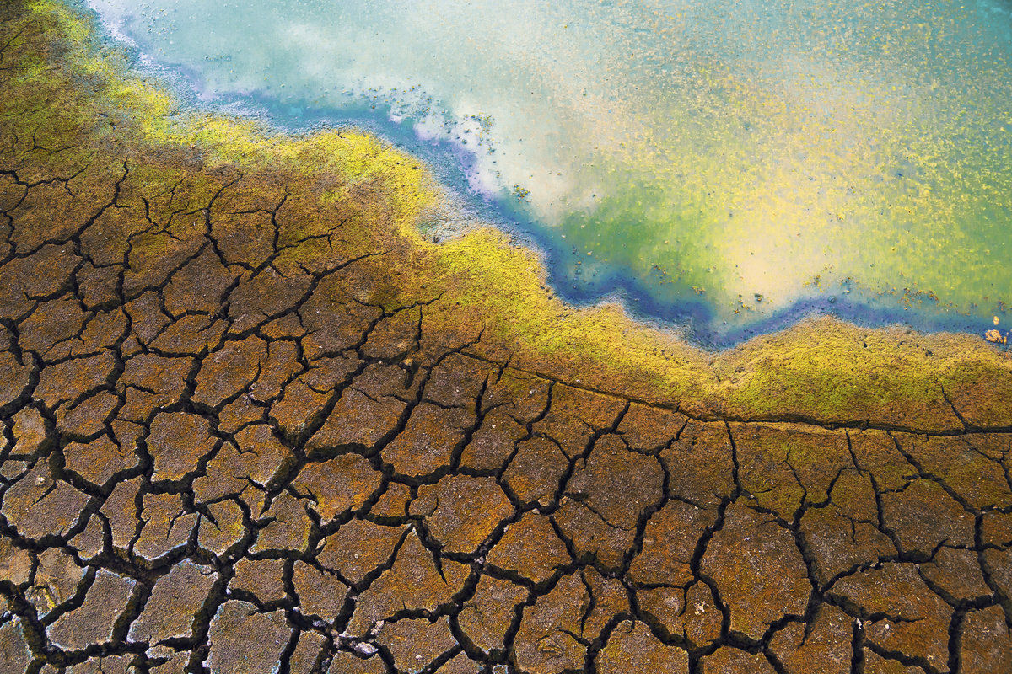
How to design a poster
Important points:
The poster needs an objective – what result do we want from it?
Who is the poster for?
How can we make the poster eye-catching?
Where can we put the poster?

Slide 16
Water for all
www.teachingenglish.org.uk
© The British Council, 2021 The United Kingdom’s international organisation for educational opportunities and cultural relations. We are registered in England as a charity.

