Slide 1
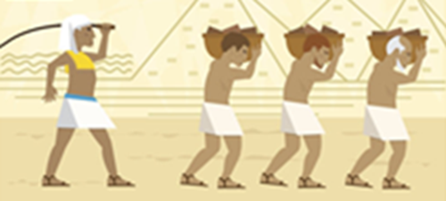
Is slavery a thing of the past?
www.teachingenglish.org.uk © The British Council, 2016 The United Kingdom’s international organisation for educational opportunities and cultural relations. We are registered in England as a charity.

Slide 2
1. What do you know about slavery?
What is slavery? Can you give a definition?
Is slavery still a problem today? Why/why not?
Does slavery have any effect on your life? Why/why not?
www.teachingenglish.org.uk © The British Council, 2016 The United Kingdom’s international organisation for educational opportunities and cultural relations. We are registered in England as a charity.

Slide 3
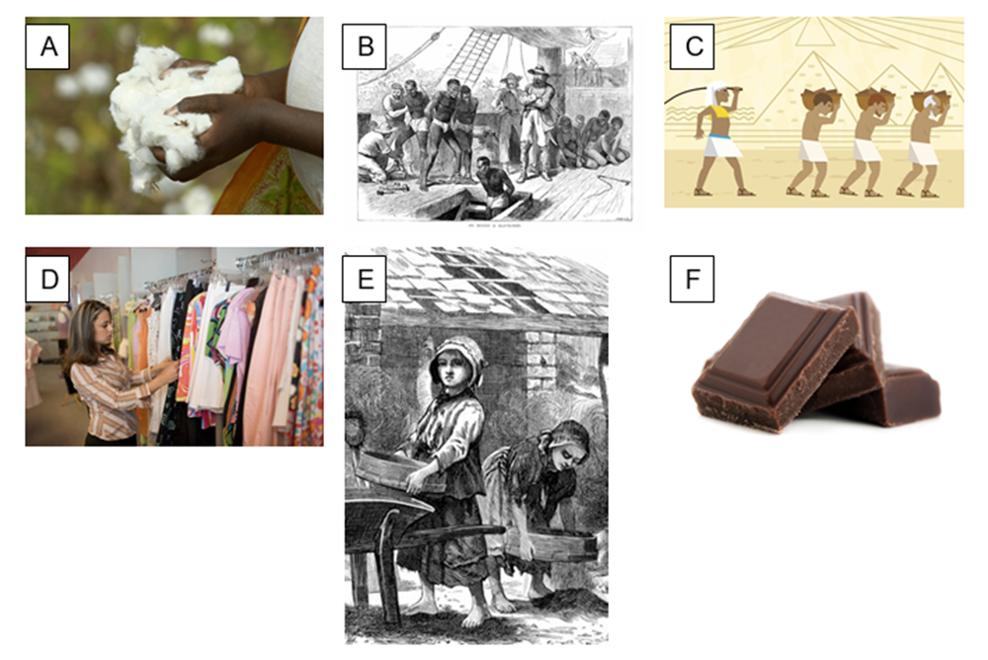
How is each picture related to slavery?
www.teachingenglish.org.uk © The British Council, 2016 The United Kingdom’s international organisation for educational opportunities and cultural relations. We are registered in England as a charity.

Slide 4
2. Vocabulary
Match the words and definitions.
cargo (n) force (v) slave labour (n) trade (n) exchange (v) campaign (n) abolish (v) goods (n) product (n) victory (n) consumer (n) | Work done by slaves. To officially end a law or a system Things that are made to be sold. A thing that is grown or made. The activity of buying and selling. Success or winning A person who buys things. Things to sell carried in a ship or plane. Make somebody do something they do not want to do To give something to someone and receive something from them. A series of activities to change a law or what people think.
www.teachingenglish.org.uk © The British Council, 2016 The United Kingdom’s international organisation for educational opportunities and cultural relations. We are registered in England as a charity.

Slide 5
Vocabulary - Answers
1h. Cargo - Things to sell carried in a ship or plane. 2i. Force - Make somebody do something they do not want to do 3a Slave labour - Work done by slaves. 4e Trade - The activity of buying and selling. 5j Exchange - To give something to someone and receive something from them. 6k Campaign - A series of activities to change a law or what people think. 7B Abolish - To officially end a law or a system 8C Goods - Things that are made to be sold. 9D Product - A thing that is grown or made. 10F Victory – Success or winning 11G Consumer - A person who buys things.
www.teachingenglish.org.uk © The British Council, 2016 The United Kingdom’s international organisation for educational opportunities and cultural relations. We are registered in England as a charity.

Slide 6
3. Grammar - past simple and present simple passives
Read the sentences from each text and use the verbs in the box to make past simple or present simple passives.
abolish build buy exchange sell
Most ancient cultures had slaves, people who ______and sold and forced to work without being paid.
The Great Pyramids in Egypt _________with slave labour.
First, the British traders took goods to Africa, where these goods _________for slaves.
Finally, the products that the slaves had grown ________in England.
After a huge campaign the slave trade __________ in 1807.
www.teachingenglish.org.uk © The British Council, 2016 The United Kingdom’s international organisation for educational opportunities and cultural relations. We are registered in England as a charity.

Slide 7
3. Grammar - past simple and present simple passives
Read the sentences from each text and use the verbs in the box to make past simple or present simple passives.
grow pay produce
6. Many people think that cotton __ no longer _____ using slaves.
7. It is not just the way that cotton __________which can involve slavery.
8. Some workers _______as little as 50 cents an hour.
www.teachingenglish.org.uk © The British Council, 2016 The United Kingdom’s international organisation for educational opportunities and cultural relations. We are registered in England as a charity.

Slide 8
What have you learnt?
Discuss the following questions in small groups.
List at least 3 things that you learned about slavery in the lesson.
Think about your answers to the questions from the start of the lesson would you now change anything you said? The questions:
What is slavery? Can you give a definition?
Is slavery still a problem today? Why/why not?
Does slavery have any effect on your life? Why/why not?

