Slide 1
Music is GREAT
TeachingEnglish lesson
January 2024

Slide 2
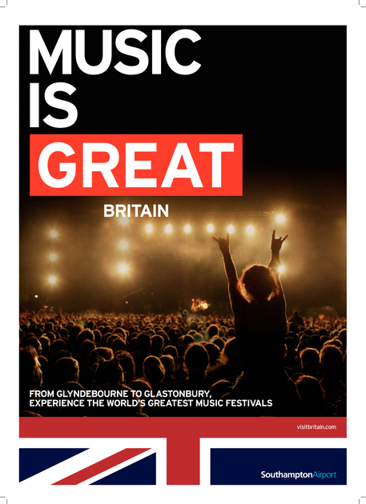
Music is GREAT
Lead-in: Look at the poster and discuss the questions.
1. Which of the adjectives below would you use to describe the picture? Can you add any more?
exciting
overcrowded
exhilarating
awesome
claustrophobic
thrilling
2. What kind of music do you listen to? How do you access music? Where do you listen to it? Who are your favourite bands or musicians?
3. How popular is live music in your culture? Are music festivals an important part of your culture?

Slide 3
Music is GREAT
Task 1: Match the words and definitions.
Word | Definition
1. exponentially (adverb) | a. an abbreviated form of ‘wellington boot’s which are rubber boots worn in wet, muddy conditions
2. countless (adjective) | b. well-known, or famous, usually for a positive reason
3. renowned (adjective) | c. describes the way something is growing or increasing very quickly
4. quagmire (noun) | d. the end or death of something
5. undeterred (adjective) | e. very many
6. wellies (plural noun – informal) | f. not prevented from doing something, even though it may be difficult or problematic
7. demise (noun) | g. large in size, amount, degree or importance
8. substantial (adjective) | h. a soft, wet area of land, which you may sink into if you walk across it

Slide 4
Music is GREAT
Task 2: Read about Glastonbury Festival, a major music festival in England. Are you surprised by anything?
The first Glastonbury Festival took place in 1970 and was organised by Michael Eavis, who still runs the festival with his daughter on his farm in Somerset in the south-west of England. Michael charged people just £1 to enter, and the ticket included free milk from the farm. Only 1,500 people attended on that occasion, but this number has grown exponentially since then. In 2023, there were more than 200,000 people in the crowd and tickets, which cost £335 each, sold out within 1 hour. The festival takes place almost every year in the last weekend of June and lasts for five days.
Although it is best known for contemporary music, Glastonbury (or ‘Glasto’ as it is often called) is host to other performing arts such as dance, comedy and theatre. The festival site is now made up of distinct zones, each one providing something different to cater for the tastes of all those present.
Countless famous British musicians have played at the festival, including Sir Paul McCartney, Coldplay and Adele, however the festival also attracts international interest, and has seen headline acts in recent years such as the likes of Beyonce Knowles, Taylor Swift and Billie Eilish.

Slide 5
Music is GREAT
Task 2: Read about Glastonbury Festival, a major music festival in England. Are you surprised by anything?
The festival is renowned for being extremely muddy, and on many occasions heavy rainfall has turned the whole festival site into a quagmire. Glastonbury-goers remain undeterred, however, and are quite happy to boogie the festival away in their wellies.
Because of the high demand for tickets, the festival has also been famous for ‘fence-jumpers’. In 2000, when only 100,000 tickets were sold, about 250,000 people attended the event – many of whom jumped over the surrounding fence to gain entry. Security increased in 2002 and a ‘superfence’ was created to prevent people from entering without a ticket. In the same year, the new Pyramid Stage, graced by the presence of David Bowie, was welcomed back following its demise in 1994 when it burnt down just a week before the festival was to begin.
The festival supports Fair Trade and has made substantial contributions to charity over the years. In 2023, over 3.7 million pounds was donated, and Greenpeace, Oxfam and WaterAid continue to be main beneficiaries.

Slide 6
Music is GREAT
Discuss these questions.
How has the festival changed since it began in1970?
How has it remained the same?
What challenges has the festival faced?
How did the organisers deal with these problems?
How does the festival benefit others?
What are some disadvantages of music festivals? How could organisers improve them?

Slide 7
Music is GREAT
Task 3: What can you remember? Complete the information about Glastonbury Festival.
Festival name
When it began
Location
When it takes place
How often it happens
How long it lasts for
Price of ticket
The sort of music played
Famous artists
Other attractions

Slide 8
Music is GREAT
Task 4: Design your dream music festival. Be ready to present!
Festival name
When it began
Location
When it takes place
How often it happens
How long it lasts for
Price of ticket
The sort of music played
Famous artists
Other attractions

Slide 9
Music is GREAT
TeachingEnglish lessons
Thanks for attending the lesson

