Slide 1
Lies in Shakespeare’s ‘Othello’
TeachingEnglish lesson
January 2024

Slide 2
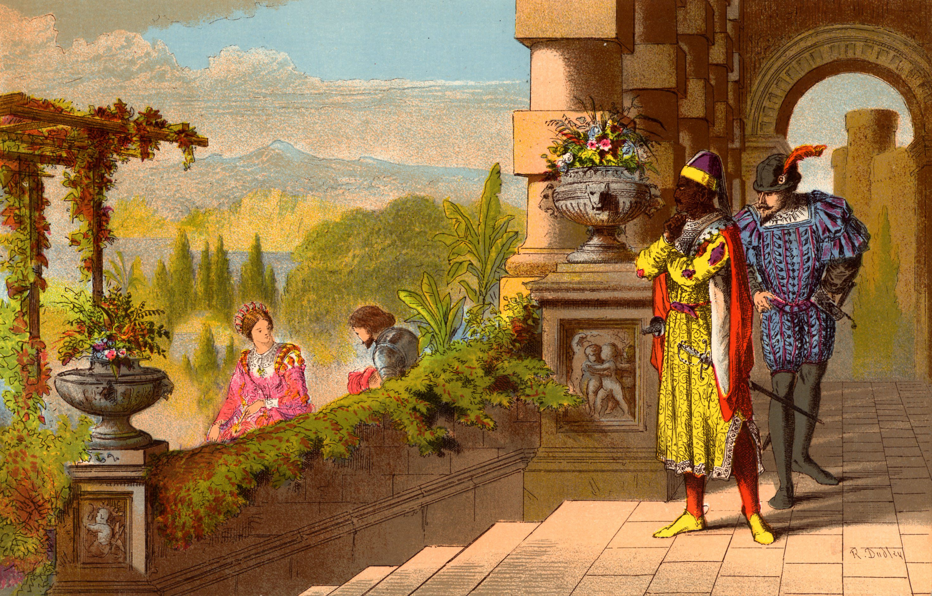
Lies in Shakespeare’s ‘Othello’
Lead-in: This picture shows a scene from Shakespeare’s play ‘Othello’. Discuss the questions about the picture.
What can you see in the picture?
Why do you think the men on the terrace are watching the woman and the man in the garden?
Where and when do you think this scene takes place?
Now write five words you associate with the picture.

Slide 3
Lies in Shakespeare’s ‘Othello’
Othello is the hero of the play. He is a powerful general in the army of Venice and is respected by those around him for being experienced and talented. He is well thought of because of his past actions. Othello has a good nature, but he is passionate and his love for his wife Desdemona is twisted by Iago.
Task 1: Read about the main characters.
Desdemona is the daughter of a powerful senator in Venice, and she is married to Othello. Although she is kind and sweet, Desdemona can also be playful. She is strong enough to stand up to Othello when he accuses her of being unfaithful.
Othello’s lieutenant Cassio is a young and inexperienced soldier. He has a high position in the army which makes Iago angry. Cassio is loyal to Othello and an honourable man. He wants to do the best he can and is faithful to his friends and his position.
Iago is a standard bearer (flag carrier) in the Venetian army. It’s not the best job and he knows it. He is an ambitious, bitter and manipulative man who uses lies to control people. Although he pretends to be Othello’s friend, Iago bitterly hates him and wants to hurt him any way he can. During the play, Iago’s lies turn Othello into a jealous monster.

Slide 4
Lies in Shakespeare’s ‘Othello’
Othello is the hero of the play. He is a powerful general in the army of Venice and is respected by those around him for being experienced and talented. He is well thought of because of his past actions. Othello has a good nature, but he is passionate and his love for his wife Desdemona is twisted by Iago.
Task 2: Find the adjectives in the texts. Are they negative? Positive? Both? Neutral?
Desdemona is the daughter of a powerful senator in Venice, and she is married to Othello. Although she is kind and sweet, Desdemona can also be playful. She is strong enough to stand up to Othello when he accuses her of being unfaithful.
Othello’s lieutenant Cassio is a young and inexperienced soldier. He has a high position in the army which makes Iago angry. Cassio is loyal to Othello and an honourable man. He wants to do the best he can and is faithful to his friends and his position.
Iago is a standard bearer (flag carrier) in the Venetian army. It’s not the best job and he knows it. He is an ambitious, bitter and manipulative man who uses lies to control people. Although he pretends to be Othello’s friend, Iago bitterly hates him and wants to hurt him any way he can. During the play, Iago’s lies turn Othello into a jealous monster.

Slide 5
Lies in Shakespeare’s ‘Othello’
Task 3A: Read a short summary of the first part of the play.
Othello is an army general. He has promoted Cassio to the role of lieutenant. Iago has a lower position in the army, and he is angry that the young and inexperienced Cassio has been promoted instead of himself. He wants revenge! First, Iago gets Cassio drunk, which means that Cassio loses his position. Then, Iago lies to Othello. He tells him that Desdemona, his wife, has another lover – Cassio.
What will happen next?

Slide 6
Lies in Shakespeare’s ‘Othello’
Task 3A: Some students have made predictions about what will happen in the play. Put the phrases in the correct order.
that / will probably be / Desdemona / unfaithful / I think / to Othello
to Othello / is certain to / Iago / lie / again
Desdemona / Iago will / lie to / most probably / as well
kill themselves / the characters / is bound to / one of
friends / Cassio and / probably won’t / be / Iago
is likely to / position / his / in the / Cassio / army / lose
that / kill / I doubt / Othello will / Desdemona
with Iago / get / Othello / might well / angry

Slide 7
Lies in Shakespeare’s ‘Othello’
Task 3A: Read the predictions and note the phrases that the students use. What do they mean?
I think that Desdemona will probably be unfaithful to Othello.
Iago is certain to lie to Othello again.
Iago will most probably lie to Desdemona as well.
One of the characters is bound to kill themselves.
Cassio and Iago probably won’t be friends.
Iago is likely to lose his position in the army.
I doubt that Othello will kill Desdemona.
Othello might well get angry with Iago.

Slide 8
Lies in Shakespeare’s ‘Othello’
Task 3B: Use phrases below to write some predictions about what will happen in the play.
will probably is certain to will most probably is bound to probably won’t
is likely to I doubt that … will might well
A character hides something in someone’s bedroom. | Ex: I think Othello will probably hide some poison in Desdemona’s room.
A character changes so much that they seem to be a different person by the end of the play. | Ex: I doubt that Iago will change.
Someone uses a pillow. | Ex: Desdemona might well kill Iago with a pillow.
One of the characters kills himself / herself. | Ex: Cassio is bound to kill himself.

Slide 9
Lies in Shakespeare’s ‘Othello’
Task 5: How well can you remember the plot? Answer these questions.
Why does Iago hate Othello?
Why does Cassio lose his position in the army?
How does Iago try to prove that Desdemona is being unfaithful?
Why does Othello’s personality appear to change?
How does Othello kill Desdemona?
How does Othello eventually find out that his wife was telling the truth?

Slide 10
Lies in Shakespeare’s ‘Othello’
Task 6: Discuss these questions.
As well as being lied to by Iago, Othello lies to himself. In what way do people lie to themselves?
When was the last time someone told you a lie and you found out about it?
Is there a difference between good and bad lies? Is it OK to lie sometimes?
‘If you tell the truth, you don’t have to remember anything.’ Do you agree with this quotation from Mark Twain? Why? Why not?

Slide 11
Lies in Shakespeare’s ‘Othello’
TeachingEnglish lessons
Thanks for attending the lesson

