Slide 1
Our Family Footprint
The environmental impact of family life
Classroom presentation

Slide 2
Family Footprint
Learning Outcomes
During and after the lesson, you will be able to demonstrate you can:
• describe the environmental impact of family life
• apply critical thinking and collaborative working techniques
• seek agreement and compromises in group discussions
• use specific vocabulary related to the family footprint
• ask sensitive questions about environmentally responsible behaviours.

Slide 3
Family Footprint
Transport and Travel | Waste
car-sharing | landfills
emissions | raw materials
fuel efficiency | recycling – aluminium, plastic, glass, paper, food, tin
home-working
Energy | Food
boiler | diet – meat, beef, vegetarian, vegan
energy efficiency | food miles
solar energy | food waste
thermostat | locally sourced
traditional energy sources – gas, electricity, oil, wood, coal
www.teachingenglish.org.uk
© The British Council, 2021 The United Kingdom’s international organisation for educational opportunities and cultural relations. We are registered in England as a charity.

Slide 4
Family Footprint
Transport and Travel
car-sharing | When several people travel together to save fuel energy
emissions | Poisonous gases produced by cars and other devices
fuel efficiency | Using the least fuel possible for a journey
home-working | Working from home to reduce the environmental impact of travelling
Waste
landfill | Places where waste and rubbish are buried under the earth
raw materials | Basic materials used to make things, for example wood
recycling – aluminium, plastic, glass, paper, food, tin | Where items we no longer need are used to produce something else or be used again, for example bottles
www.teachingenglish.org.uk
© The British Council, 2021 The United Kingdom’s international organisation for educational opportunities and cultural relations. We are registered in England as a charity.

Slide 5
Family Footprint
Energy
boiler | A household device for heating water
energy-efficiency | How different devices use less energy for the same function. Newer cars, for example, are more energy efficient.
solar energy | Power generated from the sun
thermostat | A device to control heating or air conditioning
traditional energy sources (gas, electricity, oil, wood, coal) | Basic things we used and still use to create energy, but with an environmental impact
Food
diet (meat, beef, vegetarian, vegan) | What we eat
food miles | How far food ‘travels’ from where it is produced to where it is eaten
food waste | Food we don’t eat but throw away
locally sourced | Food that is from our local community or nearby, for example a local farm or fishing boat
www.teachingenglish.org.uk
© The British Council, 2021 The United Kingdom’s international organisation for educational opportunities and cultural relations. We are registered in England as a charity.

Slide 6
Family Footprint
Below are comments from conversations between family members about their environmental footprint.
Read the comments and then make a list of ways that families can reduce their carbon footprint.
The vocabulary on the previous slide will help you as well.
‘… we never walk to the supermarket …’
‘… we often leave the heating on at night …’
‘… I sometimes buy locally produced food …’
‘… we never walk anywhere, even though the school is so close to home …’
‘… your grandmother always fixed things instead of throwing them away …’
www.teachingenglish.org.uk
© The British Council, 2021 The United Kingdom’s international organisation for educational opportunities and cultural relations. We are registered in England as a charity.

Slide 7
Family Footprint
On the next slide, there are some questions about families and their environmental impact.
This subject can sometimes be sensitive, so the questions need to be put in a sensitive way too.
Look at the question examples and underline any sensitive questions or advice.
One has been done as an example.
www.teachingenglish.org.uk
© The British Council, 2021 The United Kingdom’s international organisation for educational opportunities and cultural relations. We are registered in England as a charity.

Slide 8
Family Footprint
Questions:
Do you ever walk to school?
Is it all right to discuss why you don’t buy locally produced food?
Do you mind if I ask about your electricity use?
How often do you take the bus to school?
Do you separate glass and paper waste?
How do you feel about trying car-sharing?
Do you ever fix ‘old’ clothes or shoes and not buy new ones?
www.teachingenglish.org.uk
© The British Council, 2021 The United Kingdom’s international organisation for educational opportunities and cultural relations. We are registered in England as a charity.

Slide 9
Family Footprint
Questions:
Is it all right to plus infinitive
Is it all right to discuss why you don’t buy locally produced food?
Do you mind if plus simple present
Do you mind if I ask about your electricity use?
How do you feel about plus -ing
How do you feel about trying car-sharing?
www.teachingenglish.org.uk
© The British Council, 2021 The United Kingdom’s international organisation for educational opportunities and cultural relations. We are registered in England as a charity.

Slide 10
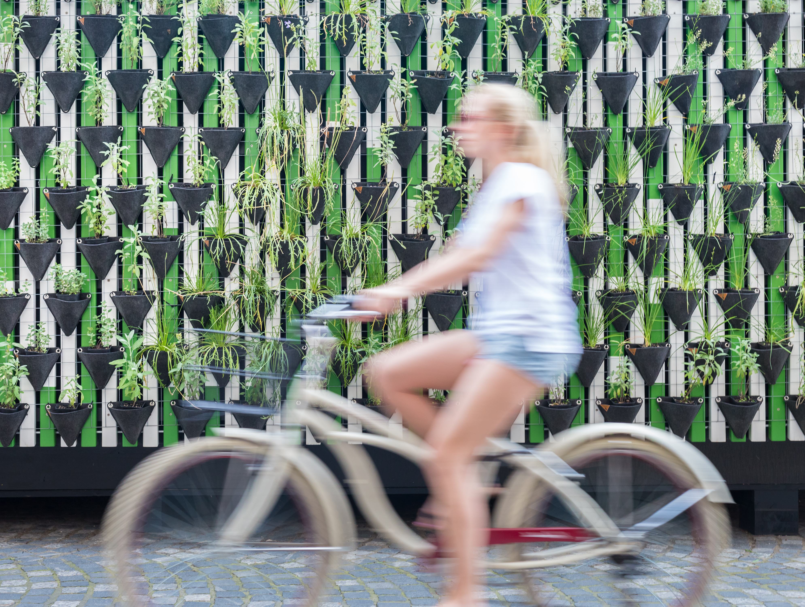
Family Footprint
www.teachingenglish.org.uk
© The British Council, 2021 The United Kingdom’s international organisation for educational opportunities and cultural relations. We are registered in England as a charity.

