Slide 1
Disguise in Shakespeare’s Much Ado About Nothing
TeachingEnglish lesson
January 2024

Slide 2
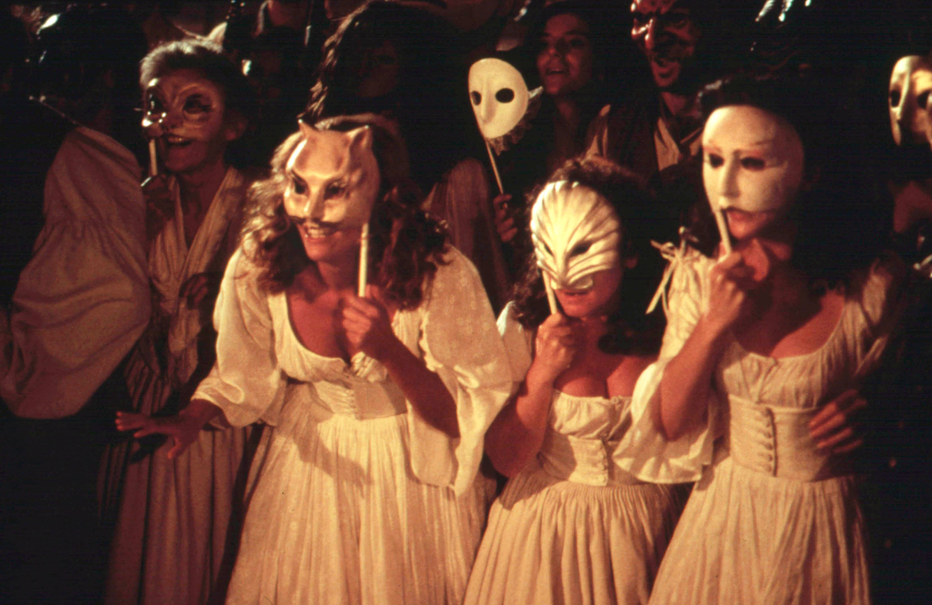
Disguise in Shakespeare’s Much Ado About Nothing
Lead-in: This picture shows a scene from a film of Shakespeare’s play ‘Much Ado About Nothing’. Discuss the questions about the picture.
What can you see in the picture?
Why do you think the people are wearing masks?
Where and when do you think this story takes place?
Now write five words you associate with the picture.

Slide 3
Disguise in Shakespeare’s Much Ado About Nothing
Task 1: Read about disguise in ‘Much Ado About Nothing’. Then discuss the questions below.
Disguise is very important in ‘Much Ado About Nothing’, particularly in the relationship between a woman called Beatrice and a soldier called Benedick. Beatrice and Benedick, who are both playful and clever, have disliked each other for many years. They often argue and insult each other. At a party, the characters use masks to hide their faces, and pretend to be someone else. This is great fun, as they can say whatever they like without being recognised. Beatrice and Benedick begin a conversation. Benedick is disguised, but Beatrice is not, and she doesn’t realise who she is talking to. Benedick tells Beatrice that no one thinks she’s funny. Beatrice tells Benedick that everyone thinks he’s an idiot. This leads their friends to make a plan. They decide to stop Beatrice and Benedick arguing, and make them fall in love instead.
What do you learn about Beatrice and Benedick?
What does Benedick say to Beatrice at the party?
What does Beatrice say to Benedick?

Slide 4
Disguise in Shakespeare’s Much Ado About Nothing
Task 2: Read some of the things that Beatrice says about Benedick. Can you guess what any of them mean?
he is the Prince’s jester, a very dull fool
none but libertines delight in him
strikes him into melancholy
he both pleases men and angers them
only his gift is in devising impossible slanders

Slide 5
Disguise in Shakespeare’s Much Ado About Nothing
Task 2: Read some of the things that Beatrice says about Benedick. Match them with their modern translations.
he is the Prince’s jester, a very dull fool
none but libertines delight in him
strikes him into melancholy
he both pleases men and angers them
only his gift is in devising impossible slanders
he’s only really good at inventing lies about other people
he makes people laugh and at the same time he makes them furious
makes him feel miserable
only immoral people enjoy spending time with him
he’s the Prince’s clown, a stupid idiot

Slide 6
Disguise in Shakespeare’s Much Ado About Nothing
Task 3: Read an extract from ‘Much Ado About Nothing’ Act 2, Scene 1.
BENEDICK: I pray you, what is he?
BEATRICE: Why, he is the Prince’s jester, a very dull fool, only his gift is in devising impossible slanders. None but libertines delight in him, and the commendation is not in his wit but in his villainy, for he both pleases men and angers them, and then they laugh at him and beat him. I am sure he is in the fleet. I would he had boarded me.
BENEDICK: When I know the gentleman, I’ll tell him what you say.
BEATRICE: Do, do. He’ll but break a comparison or two on me, which, peradventure not marked or not laughed at, strikes him into melancholy, and then there’s a partridge wing saved, for the fool will eat no supper that night.

Slide 7
Disguise in Shakespeare’s Much Ado About Nothing
Task 3: Read a modern translation of the extract.
BENEDICK: Who is this man? Tell me!
BEATRICE: He’s the Prince’s clown, a stupid idiot. He’s only really good at inventing lies about other people. Only immoral people enjoy spending time with him, and that’s not because he’s funny – it’s because he’s outrageous. He makes people laugh and at the same time he makes them furious. They laugh at him and then beat him up. I’m sure I saw him out there with the dancers. I’m sure he stepped on my toe!
BENEDICK: When I meet this gentleman, I’ll tell him what you’ve said.
BEATRICE: Yes, please tell him. He’ll probably make a joke or two about me – and if no one laughs, that’ll make him feel miserable. But that will mean there will be more food for us, as he won’t eat anything.

Slide 8
Disguise in Shakespeare’s Much Ado About Nothing
Task 3: Discuss these questions.
How does Beatrice feel about Benedick? How do you know?
What sort of people like him?
What effect does he have on people?
How does he respond when people don’t laugh at his jokes?

Slide 9
Disguise in Shakespeare’s Much Ado About Nothing
Task 4: In ‘Much Ado About Nothing’ Beatrice and Benedick don’t continue to hate each other. Their friends make a plan to help them fall in love, and they do. They both realise they were wrong about each other.
Discuss these questions.
Why do you think that first impressions of a person are important?
Is it possible to change your mind about someone’s personality? Can you give any examples of this, either from your own life, or from a film or book?

Slide 10
Disguise in Shakespeare’s Much Ado About Nothing
TeachingEnglish lessons
Thanks for attending the lesson

