Slide 1
Buy. Use. Toss.
Shopping and services: responsible consumption
Classroom presentation

Slide 2
Talk about the last item you threw away.
1 What is it made of? Where is the material from?
2 Where was it manufactured?
3 How did it travel from there to you?
4 How long did you use it for?
5 What did you do with it when you threw it away?
6 What happened to it after that?

Slide 3
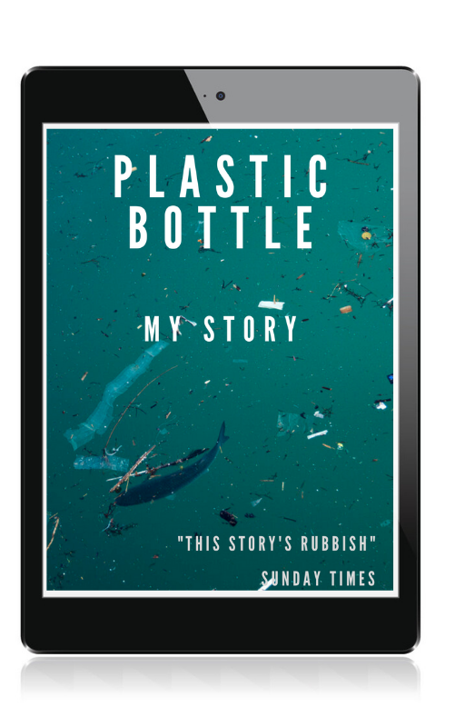

Slide 4
Plastic bottle: my story
The first thing I remember is coming out of a very hot machine. I was in a long line of hundreds of bottles the same as me.

Slide 5
After a few days there, we were taken in another lorry to a supermarket.
Two days later, we were unwrapped and I was put on a shelf in the shop. I wasn’t there long before I was quickly put in a shopping basket and bought.
And that’s where I am now, and where I will still be in hundreds of years’ time. Just floating around.
I didn’t get to the person’s house. It was a hot day, so they drank my water outside the supermarket. I was thrown away, in a bin in the supermarket car park.
I floated in the water all the way to the sea. After many weeks and months slowly drifting, I ended up in the middle of the Pacific Ocean, with lots of other bottles.
I was filled with water and given a label. Then I was wrapped in plastic with many other bottles and we were put in a big lorry and went on a very long journey.
On the journey to the rubbish dump, there was a bump! The bag I was in fell out into the road. Then a car hit us and I was thrown into a river. I quickly lost my label in the water.
The next day, I was picked up in the rubbish bag and thrown into a bin lorry.
We were taken to a big building with thousands of other bottles, cans, packets and boxes.
www.teachingenglish.org.uk
© British Council 2021 The United Kingdom’s international organisation for educational opportunities and cultural relations. We are registered in England as a charity.

Slide 6
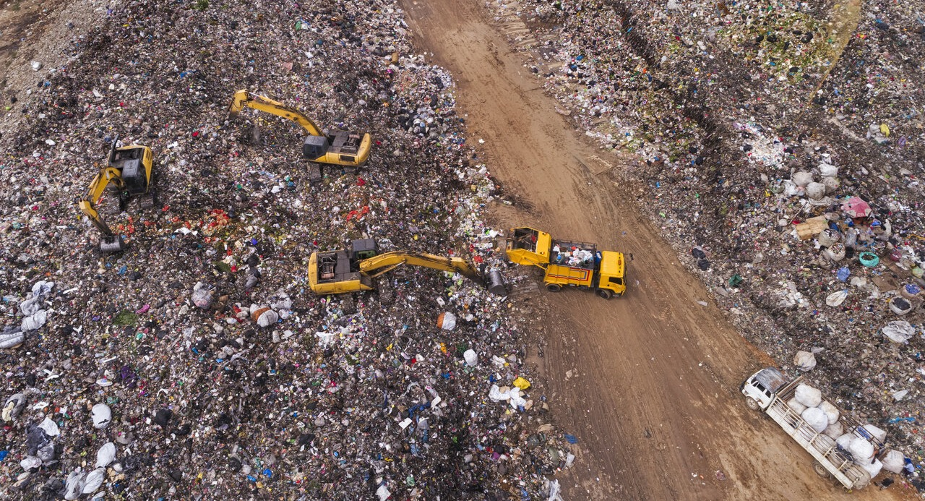
www.teachingenglish.org.uk
© British Council 2021 The United Kingdom’s international organisation for educational opportunities and cultural relations. We are registered in England as a charity.

Slide 7
a bin lorry
a rubbish dump
www.teachingenglish.org.uk
© British Council 2021 The United Kingdom’s international organisation for educational opportunities and cultural relations. We are registered in England as a charity.

Slide 8
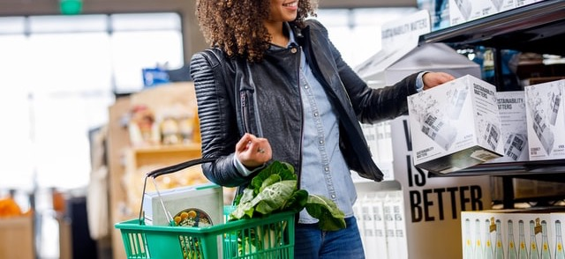
Photo by Boxed Water Is Better on Unsplash
www.teachingenglish.org.uk
© British Council 2021 The United Kingdom’s international organisation for educational opportunities and cultural relations. We are registered in England as a charity.

Slide 9
Photo by Boxed Water Is Better | Unsplash
a shopping basket
www.teachingenglish.org.uk
© British Council 2021 The United Kingdom’s international organisation for educational opportunities and cultural relations. We are registered in England as a charity.

Slide 10
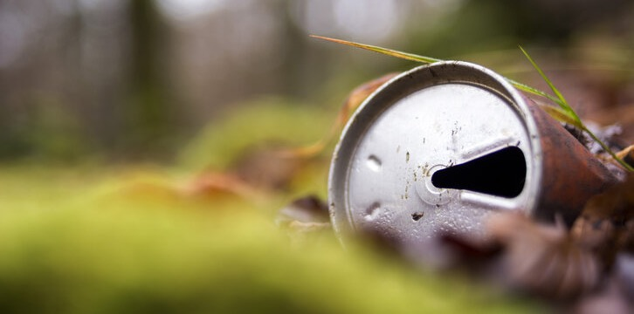
www.teachingenglish.org.uk
© British Council 2021 The United Kingdom’s international organisation for educational opportunities and cultural relations. We are registered in England as a charity.

Slide 11
a drinks can
www.teachingenglish.org.uk
© British Council 2021 The United Kingdom’s international organisation for educational opportunities and cultural relations. We are registered in England as a charity.

Slide 12
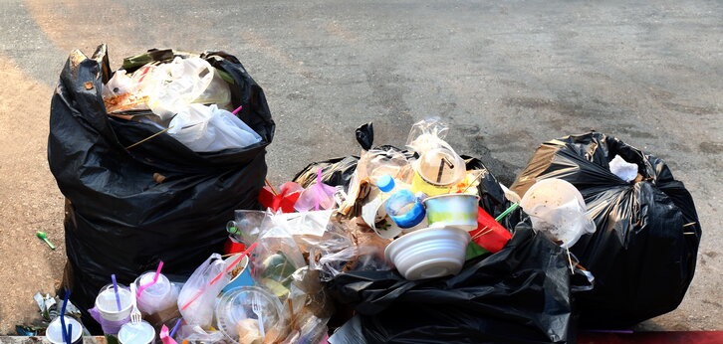
www.teachingenglish.org.uk
© British Council 2021 The United Kingdom’s international organisation for educational opportunities and cultural relations. We are registered in England as a charity.

Slide 13
rubbish bags
www.teachingenglish.org.uk
© British Council 2021 The United Kingdom’s international organisation for educational opportunities and cultural relations. We are registered in England as a charity.

Slide 14
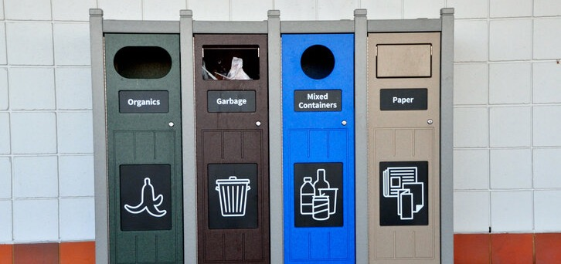
www.teachingenglish.org.uk
© British Council 2021 The United Kingdom’s international organisation for educational opportunities and cultural relations. We are registered in England as a charity.

Slide 15
bins
www.teachingenglish.org.uk
© British Council 2021 The United Kingdom’s international organisation for educational opportunities and cultural relations. We are registered in England as a charity.

Slide 16
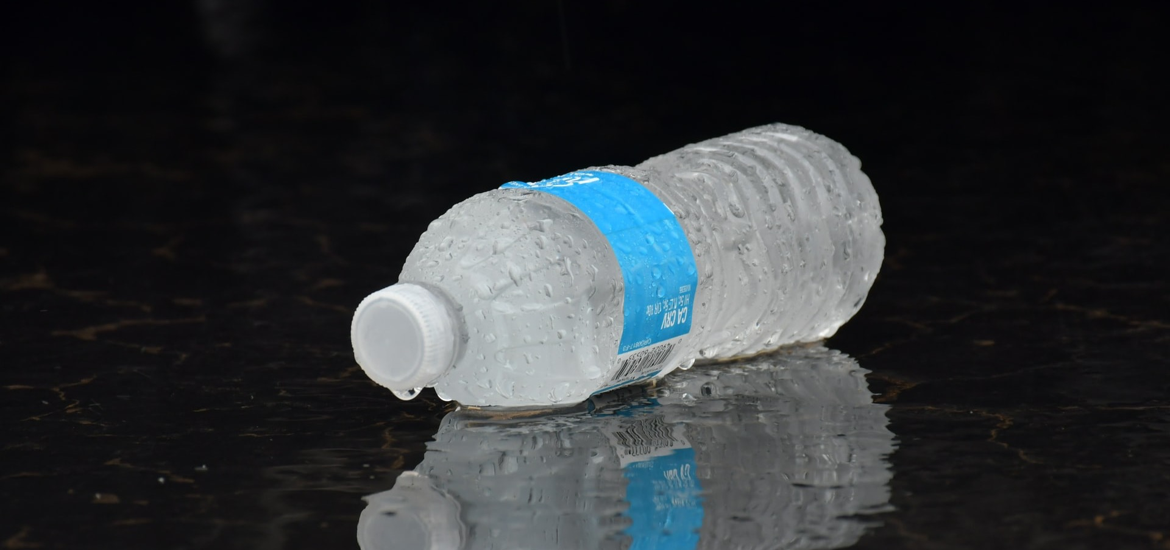
Photo by Serenity Mitchell on Unsplash
www.teachingenglish.org.uk
© British Council 2021 The United Kingdom’s international organisation for educational opportunities and cultural relations. We are registered in England as a charity.

Slide 17
label
Photo by Serenity Mitchell on Unsplash
www.teachingenglish.org.uk
© British Council 2021 The United Kingdom’s international organisation for educational opportunities and cultural relations. We are registered in England as a charity.

Slide 18
3
After a few days there, we were taken in another lorry to a supermarket.
Two days later, we were unwrapped and I was put on a shelf in the shop. I wasn’t there long before I was quickly put in a shopping basket and bought.
And that’s where I am now, and where I will still be in hundreds of years’ time. Just floating around.
I didn’t get to the person’s house. It was a hot day, so they drank my water outside the supermarket. I was thrown away, in a bin in the supermarket car park.
I floated in the water all the way to the sea. After many weeks and months slowly drifting, I ended up in the middle of the Pacific Ocean, with lots of other bottles.
I was filled with water and given a label. Then I was wrapped in plastic with many other bottles and we were put in a big lorry and went on a very long journey.
On the journey to the rubbish dump, there was a bump! The bag I was in fell out into the road. Then a car hit us and I was thrown into a river. I quickly lost my label in the water.
The next day, I was picked up in the rubbish bag and thrown into a bin lorry.
We were taken to a big building with thousands of other bottles, cans, packets and boxes.
4
9
5
8
1
7
6
2
www.teachingenglish.org.uk
© British Council 2021 The United Kingdom’s international organisation for educational opportunities and cultural relations. We are registered in England as a charity.

Slide 19
I was filled with water and given a label.
www.teachingenglish.org.uk
© British Council 2021 The United Kingdom’s international organisation for educational opportunities and cultural relations. We are registered in England as a charity.

Slide 20
I was filled with water and given a label.
was/were + past participle
www.teachingenglish.org.uk
© British Council 2021 The United Kingdom’s international organisation for educational opportunities and cultural relations. We are registered in England as a charity.

Slide 21
3
After a few days there, we were taken in another lorry to a supermarket.
Two days later, we were unwrapped and I was put on a shelf in the shop. I wasn’t there long before I was quickly put in a shopping basket and bought.
And that’s where I am now, and where I will still be in hundreds of years’ time. Just floating around.
I didn’t get to the person’s house. It was a hot day, so they drank my water outside the supermarket. I was thrown away, in a bin in the supermarket car park.
I floated in the water all the way to the sea. After many weeks and months slowly drifting, I ended up in the middle of the Pacific Ocean, with lots of other bottles.
I was filled with water and given a label. Then I was wrapped in plastic with many other bottles and we were put in a big lorry and went on a very long journey.
On the journey to the rubbish dump, there was a bump! The bag I was in fell out into the road. Then a car hit us and I was thrown into a river. I quickly lost my label in the water.
The next day, I was picked up in the rubbish bag and thrown into a bin lorry.
We were taken to a big building with thousands of other bottles, cans, packets and boxes.
4
9
5
8
1
7
6
2
www.teachingenglish.org.uk
© British Council 2021 The United Kingdom’s international organisation for educational opportunities and cultural relations. We are registered in England as a charity.

Slide 22
Discuss the questions in groups
How much is a bottle of water? Does that include the cost of cleaning it up in 400 years’ time?
What problems are caused by having lots of plastic in the oceans and in the countryside?
Whose responsibility is it to clean it up?
The people who buy the products?
The companies who insist on selling their products in plastic?
The governments for allowing companies to use plastic in this way?
What can we do to reduce the amount of plastic on the planet?
www.teachingenglish.org.uk
© British Council 2021 The United Kingdom’s international organisation for educational opportunities and cultural relations. We are registered in England as a charity.

Slide 23
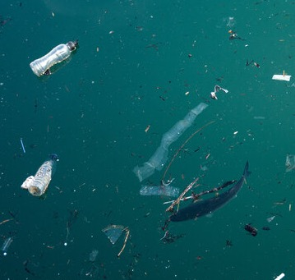
My action plan
To reduce the amount of plastic in the world, I’m going to …
____________________________.
This is at a personal/local/national level.
www.teachingenglish.org.uk
© British Council 2021 The United Kingdom’s international organisation for educational opportunities and cultural relations. We are registered in England as a charity.

Slide 24
Thank you
www.teachingenglish.org.uk
© British Council 2021 The United Kingdom’s international organisation for educational opportunities and cultural relations. We are registered in England as a charity.

